Slide 1
Notation

Slide 2
What is the Atomic notation for tritium? (tritium is an isotope of Hydrogen with 2 neutrons)
Hydrogen has a Z = 1, A = 1 p + 2 n = 3
3/1 H

Slide 3
10 protons, 12 neutrons. What is its atomic notation?
Z = 10, A = 10 + 12 = 22, element 10 is Ne
22/10 Ne

Slide 4
How many neutrons in U 235? (235 = A) (1)
U is element 92
235 - 92 = 143 neutrons
143

Slide 5
How many neutrons in Pb 208? (208 = A) (1)
Pb is element 82
208 - 82 = 126 neutrons
126

Slide 6
Binding Energy

Slide 7
What is the binding energy for Fe 56?
What is the Binding Energy per nucleon? (Divide by the mass#)
Look up the neutral atom mass, look up hydrogen
Neutron = 1.008665 u
1 u = 931.5 MeV
492.3 MeV, 8.790 MeV per nucleon

Slide 8
What is the binding energy for U 235?
What is the binding energy per nucleon?
Look up the mass in your packet
Neutron = 1.008665 u
1 u = 931.5 MeV
1784 MeV, 7.591 MeV per nucleon

Slide 9
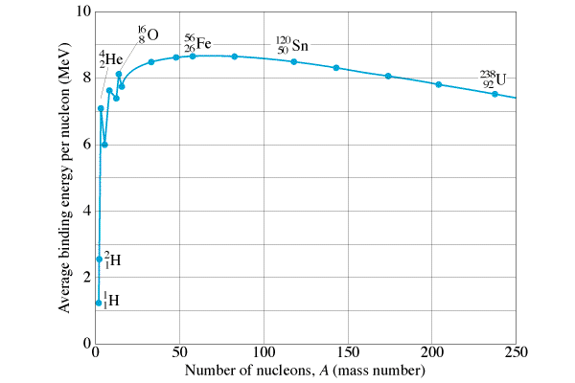
What does binding energy mean??

Slide 10
Balancing Equations
Memorize
p
d
t
n (I will give you the mass)
α
γ

Slide 11
¹³⁷₅₆Ba(n, γ)???
¹³⁸₅₆Ba

Slide 12
¹³⁷₅₆Ba(n, ?)¹³⁷₅₅Cs
p

Slide 13
²₁H(d, ?)⁴₂He
γ

Slide 14
¹⁹⁷₇₉Au(α, d)???
¹⁹⁹₈₀Hg

Slide 15
⁹₄Be(?, t)⁸₄Be
²₁d

Slide 16
Q Value

Slide 17
Try this reaction - is it endo or exo, and how much?
⁴⁰₁₉K(p, n) ⁴⁰₂₀Ca
Q = +0.529 MeV (Exo)

Slide 18
Try this reaction - is it endo or exo, and how much?
¹³⁷₅₆Ba(n, γ) ¹³⁸₅₆Ba
Q = +8.611MeV (Exo)

Slide 19
Fission Reactions

