Slide 1
IB Review
Following the Data Packet
The front matter
Section by section formulas/problems
Linear kinematics
Dynamics (F = ma)
Circular Motion
Energy
Momentum
Waves
Thermal
Field Theory
Currents and Induction
The rest of the formulas

Slide 2
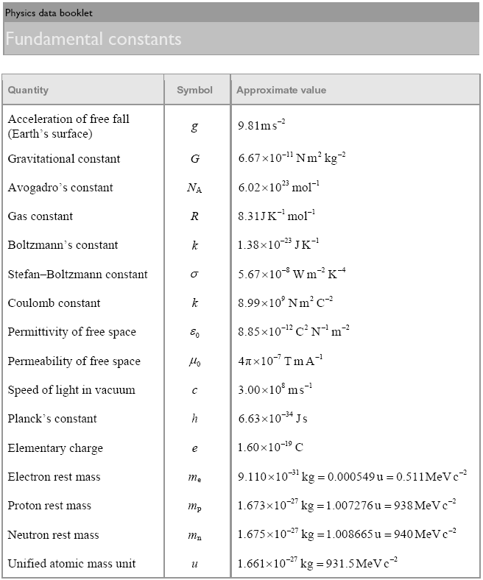

Slide 3
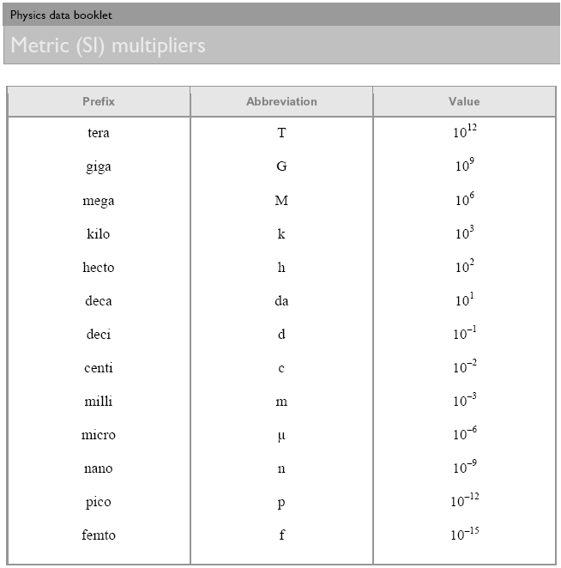

Slide 4
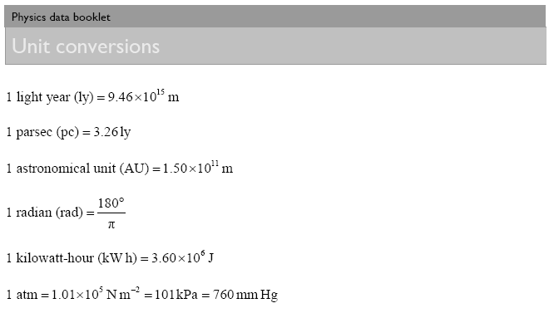

Slide 5
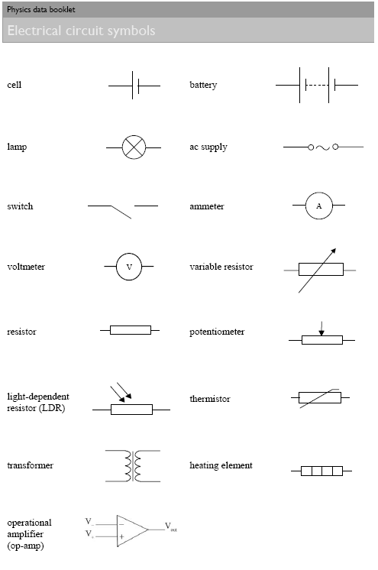

Slide 6
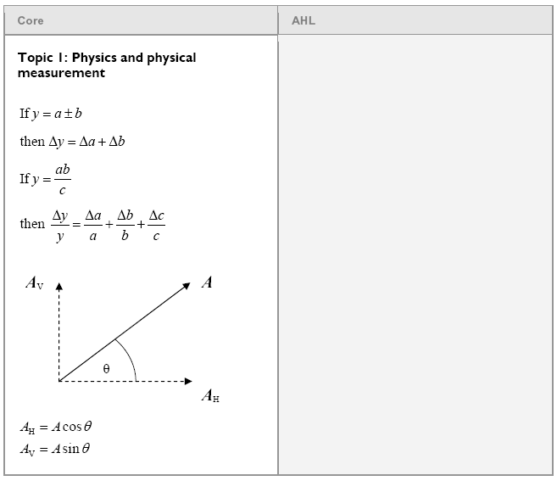
Uncertainty and vector components

Slide 7
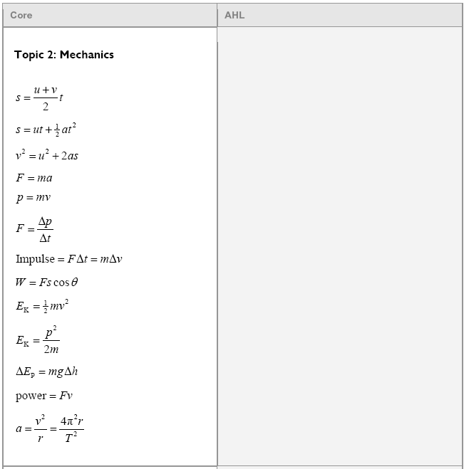
Linear Kinematics
v = u + at ?????

Slide 8
An air rocket leaves the ground straight up, and strikes the ground 4.80 seconds later.
A) What time does it take to get to the top?
uh - Half the time - 2.4 s
…

Slide 9
An air rocket leaves the ground straight up, and strikes the ground 4.80 seconds later.
B) How high does it go?
28.2 m - use s = ut +¹/₂at²
…

Slide 10
An air rocket leaves the ground straight up, and strikes the ground 4.80 seconds later.
C) What was its initial velocity?
23.5 m/s - use v = u + at
…

Slide 11
An air rocket leaves the ground straight up, and strikes the ground 4.80 seconds later.
D) What is the velocity at elevation 21.0 m?
11.9 m/s - use v² = u² + 2as
…

Slide 12
2-Dimensional Motion
H
V
s
u
v
a
t
s
u
v
a
t
A_{v} = A sinθ
θ
A_{H} = A cosθ
Pythagorean x² + y² = hyp²

Slide 13
V = 9.21 m/s
t = 2.17 s
Fill in your H/V table of suvat
How far out does she land?
20.0 m
…

Slide 14
V = 9.21 m/s
t = 2.17 s
Fill in your H/V table of suvat
How high is the cliff?
23.1 m
…

Slide 15
V = 9.21 m/s
t = 2.17 s
Fill in your H/V table of suvat
What is the velocity of impact in VC Notation?
9.21 m/s x + -21.3 m/s y
…

Slide 16
V = 9.21 m/s
t = 2.17 s
Fill in your H/V table of suvat
What is the velocity of impact? (in AM Notation)
23.2 m/s 66.6º below horiz
…

Slide 17
Find vector components
Fill in your H/V table of suvat
Find the hang time
Find the horizontal distance traveled
v = 126 m/s
angle = 43º
s = (92.15)(18.39) = 1690 m (6) s = -78.5 (0)
u_{H} = 126cos(43) = 92.15 m/s (1) u_{V} = 126sin(43) = 85.93 m/s (1)
v = 92.15 m/s (2) v = √(85.93² + 2*(-78.5)(-9.81)) = -96.47 (3)
a = 0 (0) a = -9.81 (0)
t = 18.39 s(5) t = (-96.47-85.93)/(-9.81) = 18.39 s (4)
The cliff is 78.5 m tall

Slide 18
Dynamics

Slide 19
F_{N} = mgcosθ
(Causes friction)
And the plane pushes back
(It doesn’t break)
F_{perp} = mgcosθ
❑
mg
Since we know the angle,
we can calculate the components
F|| = mgsinθ
(Acts down the plane)

Slide 20
Find the force:
F = ma,
wt = 1176 N downward
<F – 1176 N> = (120. kg)(-4.50 m/s/s)
F – 1176 N = -540 N
F = 636 N
…
F
120. kg
a = -4.50 m/s/s
(DOWNWARD)
636 N
W

Slide 21
+
-
4.50 kg
❑ = 23.5º
The plane is frictionless, so the component of gravity parallel to the plane is unopposed. What is the acceleration of the block down the plane?
F_{perp} = 40.48 N, F|| = 17.60 N, F = ma, <-17.60 N> = (4.50 kg)a
a = F/m = F||/m = (-17.58 N)/(4.50 kg) = -3.91 m/s/s
W
-3.91 m/s/s

Slide 22
+
-
4.50 kg
❑ = 23.5º
What force would make the block accelerate up the plane at 2.10 m/s/s?
F_{perp} = 40.48 N, F|| = 17.60 N, F = ma, <-17.60 N + F> = (4.50 kg)(+2.10 m/s/s)
F = 27.053 = 27.1 N
W
27.1 N

Slide 23
+
-
4.50 kg
❑ = 23.5º
Suppose it accelerates down the plane at 2.71 m/s/s. What other force is acting on the block? What is the direction?
F_{perp} = 40.48 N, F|| = 17.60 N, F = ma, <-17.60 N + F> = (4.50 kg)(-2.71 m/s/s)
F = 5.41 N (up the plane)
W
5.41 N up the plane

Slide 24
In the y direction:
T₁ = (12.5 kg)(9.81 N/kg) = 122.625 N
(down)
Find the tensions T₁, T₂, and T₃
T₂ has an upward component:
T₂ sin(180-40º) = T₂ sin(140º)
T₂
T₃
T₃ also has an upward component:
T₃ sin(20º)
40º
20º
T₁
So our expression becomes:
T₂ sin(140º) + T₃ sin(20º) - 122.625 N = 0
(Making up positive)
12.5 kg
T2 = 133.06
T3 = 108.47

Slide 25
Step By Step:
Take all the given forces and break them into components
Express the unknown forces as components
Set up a <sum of all forces> = 0 equation for x and another for the y direction
Do math.
In the x direction:
T₂ has an leftward (-) component:
T₂ cos(140º)
Find the tensions T₁, T₂, and T₃
T₃ has an rightward (+) component:
T₃ cos(20º)
T₂
T₃
40º
20º
So our expression becomes:
T₂ cos(140º) + T₃ cos(20º) = 0
(One is +, the other -)
T₁
12.5 kg

Slide 26
Now it’s MATH time!!!!!
Two equations, two unknowns:
T₂ cos(140º) + T₃ cos(20º) = 0
T₂ sin(140º) + T₃ sin(20º) - 122.625 N = 0
Re-Write them like this:
cos(140º) T₂ + cos(20º) T₃ = 0
sin(140º) T₂ + sin(20º) T₃ = 122.625 N
Matrices:
A B
[ cos(140º) , cos(20º)] [T₂] = [0 ]
[ sin(140º) , sin(20º)] [T₃] = [122.625 N]
The answer is [A]⁻¹[B]
T₂ = 133.06
T₃ = 108.47
(Demo with calculator)

Slide 27
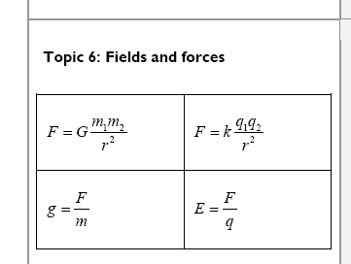
Also on page 8:
Gravity and Circular Motion

Slide 28
What should be the period of motion if you want 3.5 “g”s of centripetal acceleration 5.25 m from the center of rotation?
a = 4π²r/T²
a = (3.5)(9.8 m/s/s) = 34.3 m/s/s
34.3 m/s/s = 4π²(5.25 m)/T²
T = 2.5 s
…
2.5 s
W

Slide 29
It takes 35 N of force to make a glob of Jello go in a 2.0 m radius circle with a period of 1.85 seconds What’s the mass? What’s its flavor?
a = 4π²r/T²
F = ma
a = 4π²(2.0 m)/(.85 s)²
a = 23.07 m/s/s
F = ma, m = F/a = (35 N)/(23.07 m/s/s) = 1.5 kg
Flavor= Red
…
1.5 kg
W

Slide 30
The moon has a mass of 7.36 x 10²² kg, and a radius of 1.74 x 10⁶ m. What does a 34.2 kg mass weight on the surface?
r = Center to center distance
m₁ = One of the masses
m₂ = The other mass
G = 6.67 x 10⁻¹¹ Nm²/kg²
F = Gm₁m₂
r²
F = 55.5 N
…
55.5 N
W

Slide 31
At what distance from the moon’s center is the orbital velocity 52.5 m/s?
M_{m} = 7.36 x 10²² kg
m_{s}v²
r
= Gm_{s}m_{c}
r²
r = Gm_{c}
v²
1781086621 m
W
1.78 x 10⁹ m

Slide 32
Also
Power = work/time
E_{elas} = ¹/₂kx²
Energy

Slide 33
Toby Continued lifts a 75.0 kg box doing 1573 J of work. What is the change in height of the box?
PE = mgh
h = PE/(mg) = (1573 J)/(75 kg)/(9.80 N/kg)
= 2.14 m
…
2.14 m
W

Slide 34
A European swallow has 2.35 J of kinetic energy when it is flying at 14.23 m/s. What is its mass?
KE = ¹/₂mv²
m = 2 KE/v² = 2(23.5 J)/(14.23 m/s)² = .0232 kg
…
.0232 kg
W

Slide 35
15 kg
v_{i} = 5.8 m/s
What speed at the bottom?
h = 2.15 m
Fd + mgh + ¹/₂mv² = Fd + mgh + ¹/₂mv²
0 + mgh + ¹/₂mv² = 0 + 0 + ¹/₂mv²
(15 kg)(9.8 N/kg)(2.15 m) + ¹/₂(15 kg)(5.8 m/s)²= ¹/₂(15 kg)v²
v = 8.7 m/s
…
8.7 m/s
W

Slide 36
Momentum

Slide 37
Jolene exerts a 50. N force for 3.00 seconds on a stage set. It speeds up from rest to .25 m/s. What is the mass of the set?
(m)(Δv) = (F )(Δ t)
(m)(.25 m/s) = (50. N )(3.0 s)
m = (50. N )(3.0 s)/(.25 m/s) =
600 kg = 6.0 x10² kg
…
6.0 x10² kg

Slide 38
Before
+
After
6.20m/s
1.20 m/s
v = ?
13.0 kg
17.0 kg
13.0 kg
17.0 kg
(13kg+17kg)(6.2m/s) = (13kg)(-1.2m/s)+(17kg)v
186kgm/s = -15.6kgm/s+(17kg)v
201.6kgm/s = (17kg)v
(201.6kgm/s)/(17kg) = 11.9 m/s = v
…
11.9 m/s

Slide 39
A 153 gram bullet going 452 m/s goes through two stationary 3.50 kg blocks of wood. After this, the first block is traveling at 6.50 m/s and the second is going 8.30 m/s in the same direction. What is the bullet’s velocity after this?
(.153kg)(452m/s)= (3.5kg)(6.5m/s)+(3.5kg)(8.3m/s)+(.153kg)v
69.156kgm/s = 22.75kgm/s+29.05kgm/s+(.153kg)v
17.356kgm/s = (.153kg)v
(17.356kgm/s)/(.153kg) = 113.44 = 113 m/s
…
113 m/s

Slide 40
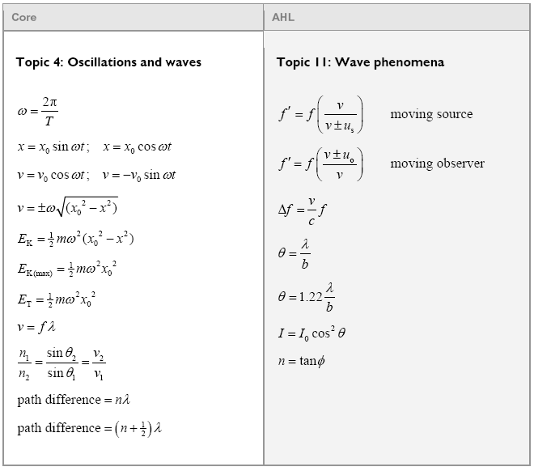
Oscillations and waves

Slide 41
What is the frequency of a sound wave that has a wavelength of 45 cm, where the speed of sound is 335 m/s
v = f λ
f = v/λ = (335 m/s)/(.45 m) = 744.444 = 740 Hz
…
W
740 Hz

Slide 42
The waveform is 62 cm long. What is the λ?
If it is a sound wave (v = 343 m/s), what is its frequency (v = fλ)
L = ²/₄ λ
λ = ⁴/₂(.62 m) = 1.24 m
v = fλ, f = v/λ = (343 m/s)/(1.24 m) = 277 Hz
…
W
277 Hz

Slide 43
The waveform is 2.42 m long. What is the λ?
If it is a sound wave (v = 343 m/s), what is its frequency (v = fλ)
L = ¹/₄ λ
λ = ⁴/₁(2.42 m) = 9.68 m
v = fλ, f = v/λ = (343 m/s)/(9.68 m) = 35.4 Hz
...
W
35.4 Hz

Slide 44
A person who is late for a concert runs at 18.0 m/s towards an A 440.0 Hz. What frequency do they hear? (use v sound = 343 m/s)
Moving observer
higher frequency
f’ = f{1 + v_{o}/v}
f = 440.0 Hz, vo = 18.0 m/s, v = 343 m/s, and +
F = 463 Hz
…
W
463 Hz

Slide 45
Two speakers 3.0 m apart are making sound with a wavelength of 48.0 cm.
If I am 2.12 m from one speaker, and 3.80 m from the other, is it loud, or quiet, and how many wavelengths difference in distance is there?
3.80 m - 2.12 m = 1.68 m
(1.68 m)/(.48 m) = 3.5 λ = destructive interference
…
W
3.5 λ = destructive interference

Slide 46
What is the speed of light in diamond? n = 2.42
n = ^{c}/_{v}
n = 2.42, c = 3.00 x 10⁸ m/s
V = 1.24 x 10⁸ m/s
…
W
1.24 x 10⁸ m/s

Slide 47
A ray of light has an incident angle of 12º with the underside of an air-water interface, what is the refracted angle in the air? (n = 1.33 for water, 1.00 for air)
n₁ sin θ₁ = n₂ sin θ₂
n₁ = 1.33, θ₁ = 12º, n₂ = 1.00
Angle = 16º
…
??
n = 1.00
n = 1.33
12º
W
16º

Slide 48
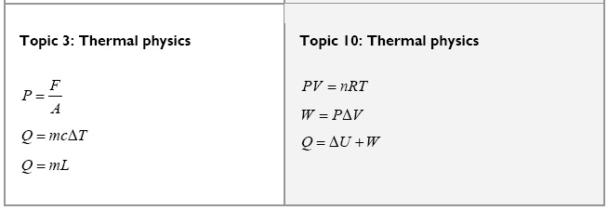
Thermal

Slide 49
What is the volume of 1.3 mol of N₂ at 34 ºC, and 1.0 atm? (1 atm = 1.013 x 10⁵ Pa)
pV = nRT
p = 1.013 x 10⁵ Pa, n = 1.3, T = 273 K + 34 K,
V = .033 m³
…
W
.033 m³

Slide 50
What is specific heat of the gaseous phase?
ΔQ = 10,000, ΔT = 15 ºC, m = .45 kg, c = 1480 J ºC⁻¹ kg⁻¹
…
W
1480 J oC-1 kg-1

Slide 51
What is the latent heat of fusion?
ΔQ = 10,000, m = .45 kg, L = ?? Lf = 22,000 J kg⁻¹
W
22,000 J kg-1

Slide 52
Which process is adiabatic, which is isothermal?
(Explain why)
Adiabatic = no heat flow, Isothermal = const T
Pressure
A
B
Volume
In which process would the temperature drop?
B is adiabatic
…
TOC

Slide 53
How much net work done by this cycle?
500 Pa
P
V
.5 m³
ΔW = Area = LxW = (.3 m³)(100 Pa) = +30 J (CW)
…
W
+30 J

Slide 54
127 grams of copper at 99.5 ºC is dropped into 325 g of water at 23.6 ºC in a 562 g glass beaker. What will be the final equilibrium temperature if no heat is lost to the surroundings?
(c_{water} = 4180 JºC⁻¹kg⁻¹, c_{glass} = 840 JºC⁻¹kg⁻¹, c_{Cu} = 390 JºC⁻¹kg⁻¹)
Heat lost = Heat gained
m₁c₁ΔT₁ = m₂c₂ΔT₂ + m₃c₃ΔT₃
(.127)(390)(99.5-T) = (.325)(4180)(T-23.6) + (.562)(840)(T-23.6)
T = 25.6 ºC
...
W
25.6 oC

Slide 55
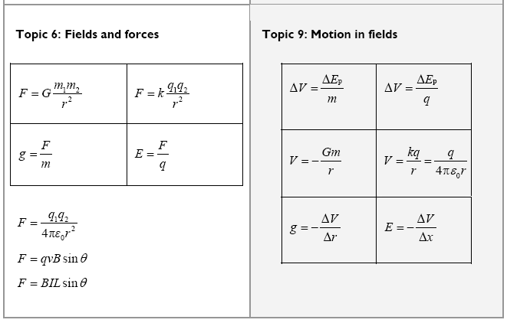
Field Theory

Slide 56
Ido Wanamaker places an electron 1.32x10⁻¹⁰ m from a proton. What is the force of attraction?
F = kq₁q₂
r²
k = 8.99x10⁹ Nm²C⁻², q₁ = -1.602x10⁻¹⁹ C,
q₂ = +1.602x10⁻¹⁹ C, r = 1.32x10⁻¹⁰ m
F = -1.32x10⁻⁸ N
W
-1.32x10⁻⁸ N

Slide 57
Ishunta Dunnit notices that a charge of -125 μC experiences a force of .15 N to the right. What is the electric field and its direction?
E = F/q = (.15 N)/(-125x10⁻⁶ N) = -1200 N/C right or 1200 N/C left
W
1200 N/C left

Slide 58
Amelia Rate measures a gravitational field of 3.4 N/kg. What distance is she from the center of the earth? (Me = 5.98 x 10²⁴ kg. )
g for a point mass:
g = Gm
r²
G = 6.67x10⁻¹¹ Nm²kg⁻², g = 3.4 N/kg, m = 5.98x10²⁴ kg
r = 10831137.03 m = 10.8 x 10⁶ m (r_{e} = 6.38 x 10⁶ m)
W
1.1 x 10⁷ m

Slide 59
Lila Karug moves a 120. μC charge through a voltage of 5000. V. How much work does she do?
ΔV = ΔE_{p}/q, q = 120x10⁻⁶ C, ΔV = 5000. V
ΔE_{p} = 0.600 J
W
.600 J

Slide 60
Art Zenkraftz measures a 125 V/m electric field between some || plates separated by 3.1 mm. What must be the voltage across them?
E = -ΔV/Δx, Δx = 3.1x10⁻³ m, E = 125 V/m
ΔV = 0.3875 V = 0.39 V
W
.39 V

Slide 61
Brennan Dondahaus accelerates an electron (m = 9.11x10⁻³¹ kg) through a voltage of 1.50 V. What is its final speed assuming it started from rest?
ΔV = ΔE_{p}/q, ΔE_{p} = ΔVq = ¹/₂mv²
ΔV = 1.50 V, m = 9.11x10⁻³¹ kg, q = 1.602x10⁻¹⁹ C
v = 726327.8464 = 726,000 m/s
W
726,000 m/s

Slide 62
Ashley Knott reads a voltage of 10,000. volts at what distance from a 1.00 μC charge?
V = kq/r, V = 10,000 V, q = 1.00x10⁻⁶ C
r = .899 m
W
.899 m

Slide 63
Try this one
What work to bring a 13.0 μC charge from halfway between the other two charges to 6.0 cm from the positive and 18 cm from the negative?
+3.20 μC
+13.0 μC
-4.10 μC
12.0 cm
12.0 cm
q
q
q
Initial V -67425 V
Final V 274700. V
Change in V 342100. V
Work 4.448 V
TOC
+4.4 J

Slide 64
C
Find the force on C, and the angle it makes with the horizontal.
+180 μC
.92 m
+150 μC
+520 μC
1.9 m
A
B
F_{AC}= 286.8 N, F_{BC} = 188.8 N
θ_{ABC} = Tan⁻¹(.92/1.9) = 25.84º
F_{AC} = 0 N x + 286.8 N y
F_{BC} = -188.8cos(25.84º) x + 188.8sin(25.84º)y
F_{total} = -170. x + 369 y
W
410 N, 65º above x axis (to the left of y)

Slide 65
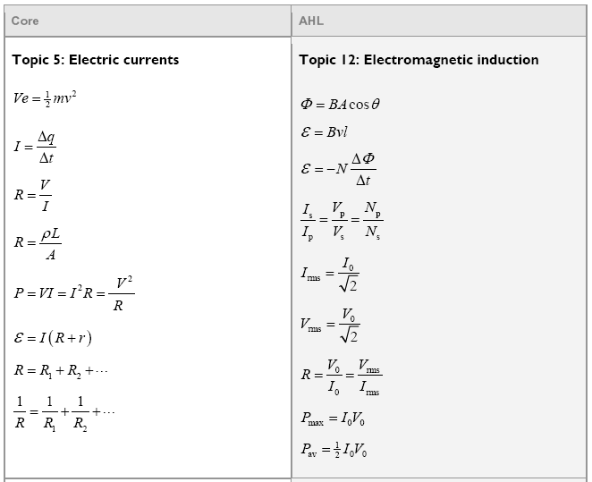
Current and Induction

Slide 66
What current flows through a 15 ohm light bulb attached to a 120 V source of current? What charge passes through in a minute? What is the power of the light bulb?
I = 120/15 = 8.0 Ampz
q = It = (8 C/s)(60 s) = 480 Coulombs
P = V²/R = 1800 W
W
8.0 A, 480 C, 1800 W

Slide 67
A copper wire is 1610 m long (1 mile) and has a cross sectional area of 4.5 x 10⁻⁶ m². What is its resistance? (This wire is about 2.4 mm in dia)
R = ρL
A
and
A = πr²
R = ??
ρ = 1.68E-8 Ωm
L = 1610 m
A = 4.5E-6 m²
R = 6.010666667 = 6.0 Ω
Silver 1.59E-8
Copper 1.68E-8
Gold 2.44E-8
Aluminium 2.65E-8
Tungsten 5.6 E-8
Iron 9.71E-8
Platinum 10.6E-8
Nichrome 100E-8
W
6.0 Ω

Slide 68
What’s the rms voltage here?
I_{rms} = I_{o} V_{rms} = V_{o}
√2 √2
Given:
V_{rms} = V_{o}
√2
V_{o} = 16 V
V_{rms} = ??
V_{rms} = 11.3 = 11 V
+16 V
-16 V
W
11 V

Slide 69
What do the voltmeters read? (3 SF)
V₁
V₂
5 Ω
7 Ω
11 Ω
20.0 V
V = IR
V₁ = (5 Ω)(.8696 A) = 4.35 V
V₂ = (18 Ω)(.8696 A) = 15.7 V
4.35 V, 15.7 V

Slide 70
What are the readings on the meters? (2 SF)
A₁
A₂
I₁ = 4.0A
I₂ = 3.0 A
I₃ = 2.0 A
I₁
A₃
I₃
18 Ω
24 Ω
36 Ω
72 V
I₂
A₄
A₁ = 4 + 3 + 2 = 9 A
A₂ = 3 + 2 = 5 A
A₃ = 3 A
A₄ = 2 A
9.0, 5.0, 3.0, 2.0 A

Slide 71
What is the current through and the power dissipated by each resistor?
12 Ω
5 Ω
7 Ω
24 Ω
17 V
Step 1 - reduce until solvable

Slide 72
Which way is the force?
I
B
outa the page

Slide 73
Which way is the force?
. . . . . . . . . . . .
. . . . . . . . . . . .
. . . . . . . . . . . .
. . . . . . . . . . . .
. . . . . . . . . . . .
. . . . . . . . . . . .
. . . . . . . . . . . .
. . . . . . . . . . . .
. . . . . . . . . . . .
. . . . . . . . . . . .
. . . . . . . . . . . .
I
B
left

Slide 74
A 0.15 T magnetic field is 17º east of North What’s the force on a 3.2 m long wire if the current is 5.0 A to the West?
θ = 90º + 17º = 117º
F = IlBsinθ
F = (5.0 A)(3.2 m)(0.15 T)sin(117º) = 2.1 N
E x U = S
N
W E
S
2.1 N South

Slide 75
What is the force acting on a proton moving at 2.5 x 10⁸ m/s perpendicular to a .35 T magnetic field?
q = 1.602 x 10⁻¹⁹ C
F = qvBsinθ
F = qvBsinθ
F = (1.602 x 10⁻¹⁹ C)(2.5 x 10⁸ m/s)(.35 T)sin(90º) = 1.4 x 10⁻¹¹ N
1.4 x 10⁻¹¹ N

Slide 76
What is the path of the electron in the B field?
. . . . . . . . . .
. . . . . . . . . .
. . . . . . . . . .
. . . . . . . . . .
. . . . . . . . . .
. . . . . . . . . .
. . . . . . . . . .
. . . . . . . . . .
. . . . . . . . . .
. . . . . . . . . .
. . . . . . . . . .
. . . . . . . . . .
. . . . . . . . . .
. . . . . . . . . .
. . . . . . . . . .
e-
ACW

Slide 77
What is the path of the proton in the B field?
p+
x x x x x x x x x x x x
x x x x x x x x x x x x
x x x x x x x x x x x x
x x x x x x x x x x x x
x x x x x x x x x x x x
x x x x x x x x x x x x
x x x x x x x x x x x x
x x x x x x x x x x x x
x x x x x x x x x x x x
x x x x x x x x x x x x
ACW

Slide 78
If the electron is going 1.75 x 10⁶m/s, and the magnetic field is .00013 T, what is the radius of the path of the electron?
m = 9.11 x 10⁻³¹ kg
q = 1.602 x 10⁻¹⁹ C
F = qvBsinθ
F = ma, a = v²/r
x x x x x x x x x x
x x x x x x x x x x
x x x x x x x x x x
x x x x x x x x x x
x x x x x x x x x x
x x x x x x x x x x
x x x x x x x x x x
x x x x x x x x x x
x x x x x x x x x x
x x x x x x x x x x
x x x x x x x x x x
x x x x x x x x x x
x x x x x x x x x x
x x x x x x x x x x
x x x x x x x x x x
x x x x x x x x x x
x x x x x x x x x x
F = qvBsinθ
F = ma, a = v²/r
qvB = mv²/r
r = mv/qB
r = 0.07655 m = 7.7 cm
e-
7.7 cm

Slide 79
The loop is removed in .012 s. What is the EMF generated? Which way does the current flow? (N = 1)
. . . . . . . . . . . .
. . . . . . . . . . . .
. . . . . . . . . . . .
. . . . . . . . . . . .
. . . . . . . . . . . .
. . . . . . . . . . . .
. . . . . . . . . . . .
. . . . . . . . . . . .
. . . . . . . . . . . .
. . . . . . . . . . . .
. . . . . . . . . . . .
75 cm
50. cm
B = 1.7 T
Three ways for direction, resist change, magnet, qvb
53 V, acw

Slide 80
The bar moves to the right at 2.0 m/s, and the loop is 1.5 m wide. What EMF is generated, and which direction is the current?
x x x x x x x x x x x x
x x x x x x x x x x x x
x x x x x x x x x x x x
x x x x x x x x x x x x
x x x x x x x x x x x x
x x x x x x x x x x x x
x x x x x x x x x x x x
x x x x x x x x x x x x
x x x x x x x x x x x x
x x x x x x x x x x x x
1.5 m
2.0 m/s
B = 3.2 T
9.6 V, acw

Slide 81
Where da North Pole?
into da page

Slide 82
Where da North Pole?
Current goes up in the front of the coil
left side

Slide 83
Which way is the current? (When does it stop flowing?)
. . . . . . . . . . . .
. . . . . . . . . . . .
. . . . . . . . . . . .
. . . . . . . . . . . .
. . . . . . . . . . . .
. . . . . . . . . . . .
. . . . . . . . . . . .
. . . . . . . . . . . .
. . . . . . . . . . . .
. . . . . . . . . . . .
. . . . . . . . . . . .
CW

Slide 84
Which way is the current?
x x x x x x x x x x x x
x x x x x x x x x x x x
x x x x x x x x x x x x
x x x x x x x x x x x x
x x x x x x x x x x x x
x x x x x x x x x x x x
x x x x x x x x x x x x
x x x x x x x x x x x x
x x x x x x x x x x x x
x x x x x x x x x x x x
B increases
into page
ACW

Slide 85
Which way is the current?
x x x x x x x x x x x x
x x x x x x x x x x x x
x x x x x x x x x x x x
x x x x x x x x x x x x
x x x x x x x x x x x x
x x x x x x x x x x x x
x x x x x x x x x x x x
x x x x x x x x x x x x
x x x x x x x x x x x x
x x x x x x x x x x x x
ACW

Slide 86
Which way is the current on the front of the coil? (up or down)
N
S
Up the front

Slide 87
The wire moves to the right at 12.5 m/s. What is the EMF generated? Which end of the wire is the + end?
. . . . . . . . . . . .
. . . . . . . . . . . .
. . . . . . . . . . . .
. . . . . . . . . . . .
. . . . . . . . . . . .
. . . . . . . . . . . .
. . . . . . . . . . . .
. . . . . . . . . . . .
. . . . . . . . . . . .
. . . . . . . . . . . .
. . . . . . . . . . . .
B = 1.7 T
50. cm
12.5 m/s
ε = Bvl
ε = (1.7 T)(12.5 m/s)(.50 m)
= 10.625 V = 11 V
11 V , Bottom

Slide 88
The wire has a potential of .215 V, and the right end is positive. What is the magnetic field, and which direction is it?
B = ??
175. cm
2.45 m/s
ε = Bvl
.215 V = B(2.45 m/s)(1.75 m)
B = 0.050145773 = .0501 T
.0501 T ,into page

Slide 89
A transformer has 120 primary windings, and 2400 secondary windings. If there is an AC voltage of 90. V , and a current of 125 mA in the primary, what is the voltage across and current through the secondary?
This one steps up
V = 90*(2400/120) = 1800 V
Current gets less: Power in = power out
IV = IV
(0.125 A)(90. V) = (I)(1800) = .00625 A = 6.25 mA
1800 V, 6.25 mA

Slide 90
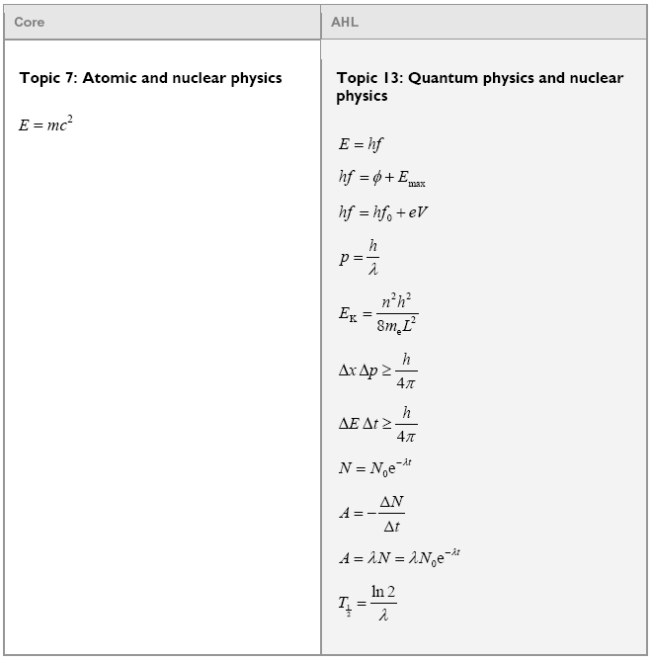
Atomic and Nuclear

Slide 91
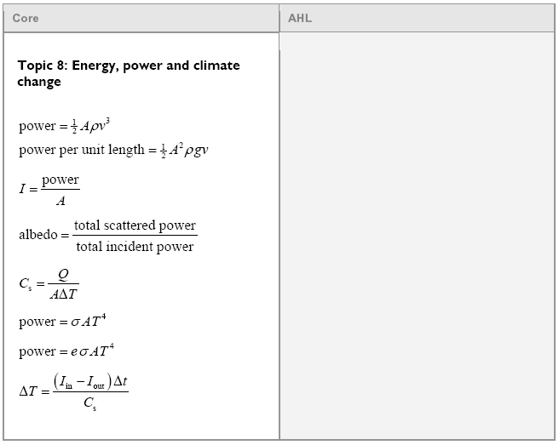
Energy, Power and Climate

Slide 92
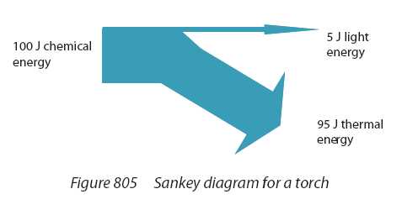
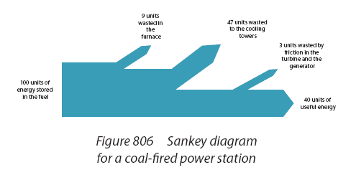
Sankey diagrams

Slide 93
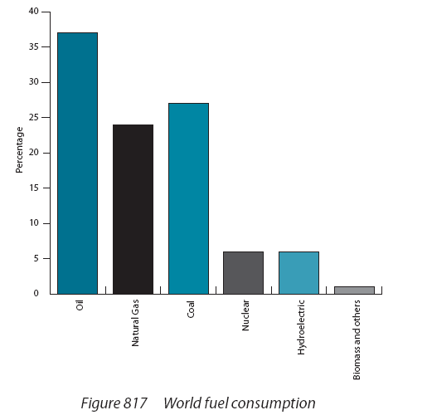

Slide 94
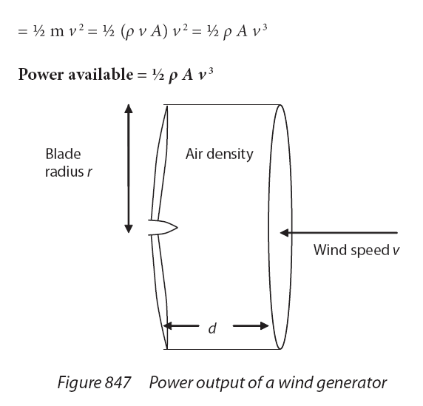

Slide 95
Air with a density of 1.3 kg m⁻³ is moving at 13.5 m/s across a wind turbine with a radius of 32.1 m. What is the theoretical wind power available to this turbine? If the generator actually generates 2.8 MW, what is the efficiency?
power = ¹/₂Aρv³ = ¹/₂π(32.1)²(1.3kg m⁻³)(13.5 m/s)³ = 5,176,957.499 W = 5.2 MW
efficiency = 2.8E6W/ 5,176,957.499 W = 0.540858216 = 0.54 or 54%
5.2 MW, 0.54

Slide 96
You have a wind turbine that is 49% efficient at a wind speed of 8.5 m/s. How long do the blades need to be so that you can generate 1.8 MW of electricity. Use the density of air to be 1.3 kg m⁻³.
0.49 = 1.8E6W/P_{theoretical}, P_{theoretical} = 3.6735E+06 W
power = ¹/₂Aρv³ = ¹/₂π(32.1)²(1.3kg m⁻³)(13.5 m/s)³ = 5,176,957.499 W = 5.2 MW
3.6735E+06 W = ¹/₂πr²(1.3kg m⁻³)(8.5 m/s)³
r = 54.12 = 54 m.
54 m

Slide 97
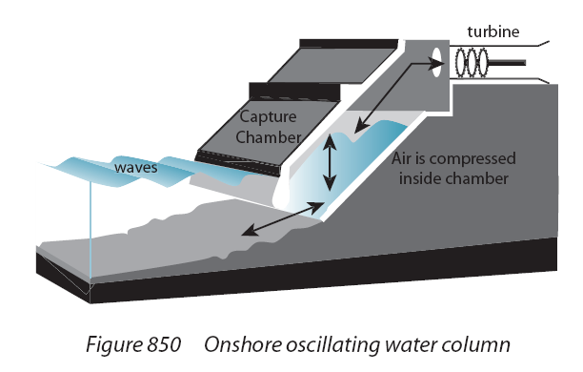
ρ = water density kg/m³
g = 9.81 N/kg
A = wave amplitude in m
v = wave speed
v = fλ, f = 1/T

Slide 98
Wave energy .
Wave energy solution
yah

Slide 99
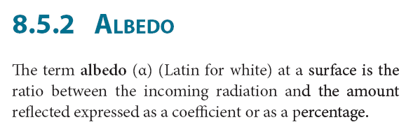
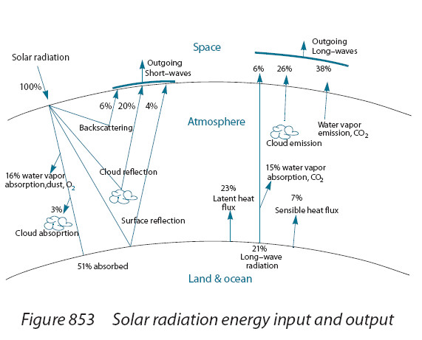
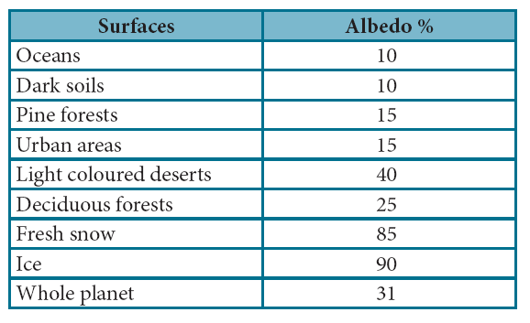

Slide 100
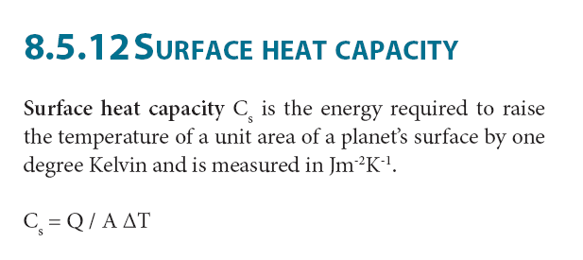
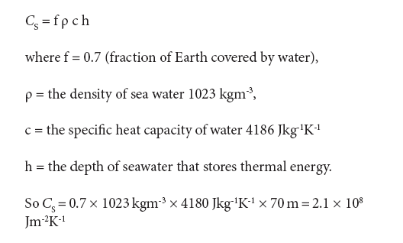

Slide 101
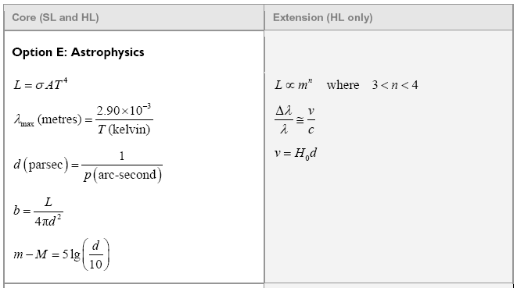
Astophysics

Slide 102
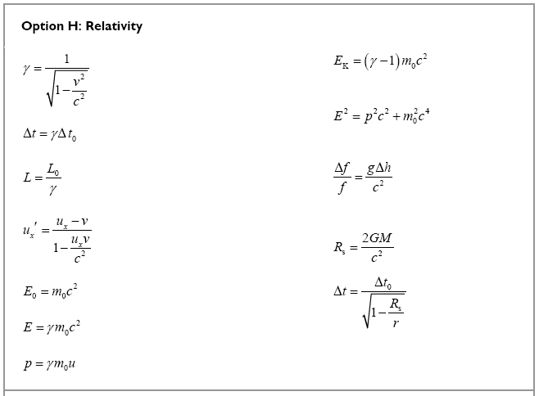
Relativity

