Slide 1
Energy, Power and Climate Change
Formulas

Slide 2
Wind Power

Slide 4
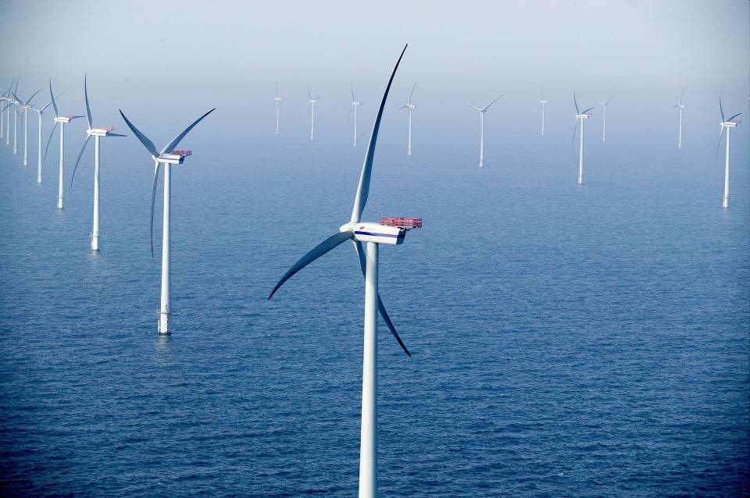

Slide 5
The formulas:
For wind power
A = frontal area (πr²) m²
ρ = density of air (≈1.3 kg/m³)
v = wind speed
Ex – What max power can you get from a wind turbine with 8.2 m long blades when the wind speed is about 5.4 m/s on the average? Use the density of air to be 1.2 kg/m³
2.0E4 Watts
Try this one:
What total frontal area do you need to generate 240MW in an area that has an average wind speed of 6.5 m/s? Use the density of air to be 1.2 kg/m³. How many turbines with a radius of 35 m would you need to use in your array?
1.45E6m², about 379 turbines

Slide 6
Global Warming

Slide 7
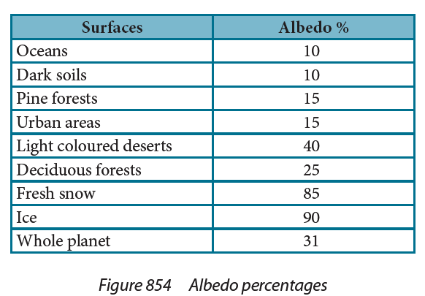
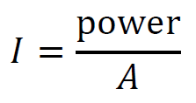
Ex – What is the power absorbed by a 235 m² patch of fresh snow when sunlight of intensity 1030 W/m² is shining straight down on the surface?
36kW
Try this one:
On a day when the solar constant is 1030 W/m², how much power per square meter is reflected off into space from the oceans? How much is absorbed?
103 W/m² 927 W/m²

Slide 8
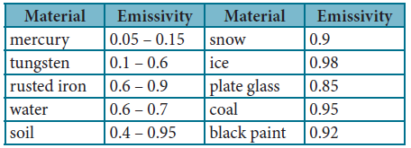
e = emissivity (0 < e < 1)
0 – reflective, 1 - totally absorptive
σ = 5.67 x 10⁻⁸ Wm⁻²K⁻⁴ (Stefan-Boltzmann constant)
A = Area m²
T = Temp in K
Ex – A person has a body surface temperature of about 35 ºC and is in a room where the walls are at 14 ºC. If they have a surface area 2.00 m², and an emissivity of 0.570, what is the rate of net heat lost to the room? (143 W)
Try this one:
A piece of freshly made glass (e = .85) at a temperature of 2600 K is placed in a oven at 1200 K. If it is initially losing heat at a rate of 5900 W, what is its area? (.0028 m²)
Notes:
The emissivity of a material (usually written ε or e) is the relative ability of its surface to emit energy by radiation. It is the ratio of energy radiated by a particular material to energy radiated by a black body at the same temperature. It is a measure of a material's ability to radiate absorbed energy. A true black body would have an while any real object would have . Emissivity is a dimensionless quantity, so it does not have units.
In general, the duller and blacker a material is, the closer its emissivity is to 1. The more reflective a material is, the lower its emissivity. Highly polished silver has an emissivity of about 0.02.

Slide 9
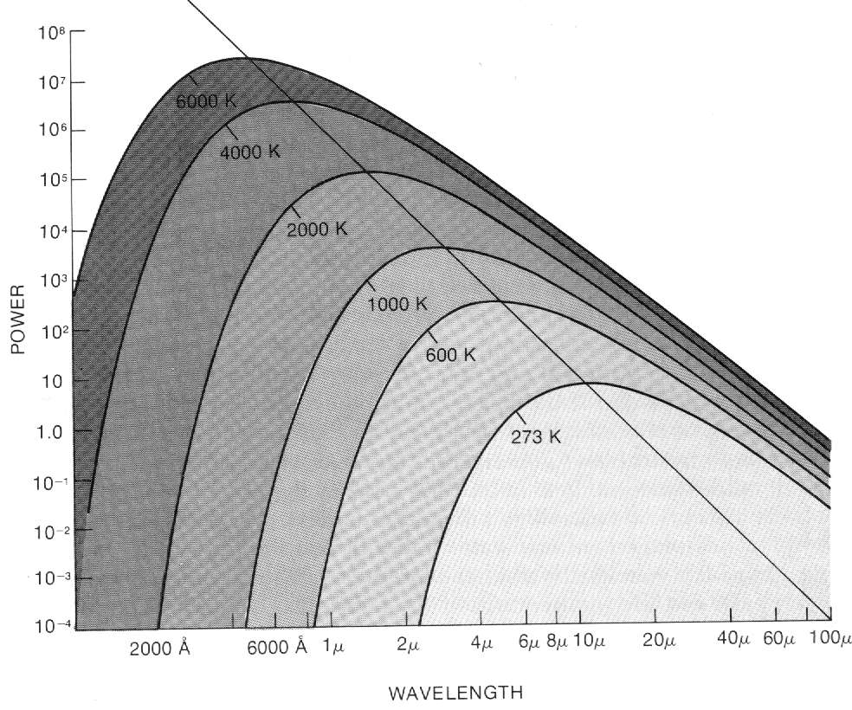
λ_{max}
From Jay Pasachoff’s Contemporary Astronomy

Slide 10
Temperature and peak Wavelength of a radiating body
λ_{max} = Peak black body wavelength
T = The star’s surface temperature in Kelvins
Ex: A star has a peak black body wavelength of 501 nm. What is its temperature? (5790 K)
What is the peak radiation of the surface of ocean water that is at 21.0 ºC?

