Slide 1
Wind Power:
For wind power
A = frontal area (πr²) m²
ρ = density of air (≈1.3 kg/m³)
v = wind speed
Ex – What max power can you get from a wind turbine with 8.2 m long blades when the wind speed is about 5.4 m/s on the average? Use the density of air to be 1.2 kg/m³
2.0E4 Watts
Try this one:
What total frontal area do you need to generate 240MW in an area that has an average wind speed of 6.5 m/s? Use the density of air to be 1.2 kg/m³. How many turbines with a radius of 35 m would you need to use in your array?
1.45E6m², about 379 turbines

Slide 2
Wave Power:
For wave power
A = Amplitude of wave in m
ρ = density of water (≈1030 kg/m³)
v = wave speed
Ex – A 210 m stretch of coastline has an average wave height of 2.3 m with waves that move 3.8 m/s. How much power is incident on this piece of coastline? Use the density of the water to be 1030 kg/m³
2.1E7W
Try this one:
From what length of coastline would you have to harvest the wave power from to generate 320 MW of power. Assume the waves are 2.9 m high, and move with a speed of 4.1 m/s. Use the density of the water to be 1030 kg/m³
1.8km

Slide 3
Energy delivered by sunlight/light
I = Intensity (W/m²)
power = Watts delivered (J/s)
A = Area (m²) (x Cosθ ?) – remember area is perp to surface
A
Ex – A 3.4 m x 15.2 m Solar panel is level. Sunlight of 1020 W/m² incident is coming from a point 52º above the horizon. What power is available for solar on the roof? If solar panels with an efficiency of 23% are installed over this area, what power would they generate?
42 kW, 9.6 kW
Try this one:
What level area would you need if the sun has an intensity of 850 W/m², and is 72º above the horizon when you need to have a power of 5.0 kW total?
6.2 m²

Slide 4
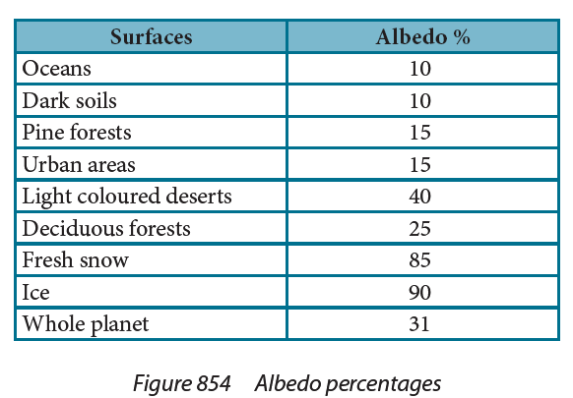
Ex – What is the power absorbed by a 235 m² patch of fresh snow when sunlight of intensity 1030 W/m² is incident at an angle of 65º with the surface?
33kW
Try this one:
On a day when the solar constant if 1030 W/m², how much power per square meter is reflected off into space from the oceans? How much is absorbed?
103 W/m² 927 W/m²

Slide 5
C_{s} = Surface heat capacity (J/m^{2o}C)
A = Area
Q = Heat Absorbed
ΔT = Temp increase
Ex – It takes 2.3E11 J to raise 24 m² of land surface 15 ºC, what is the surface heat capacity? (6.4E8 Jm⁻²K⁻¹)
Try this one:
If a surface has an albedo of .40, and there is 1030 W/m² incident (assume ┴) on a land surface with a C_{s} of 2.4E6 J Jm⁻²K⁻¹, what time would it take the surface to raise 2.0 ºC? (7800 s)

Slide 6
σ = 5.67 x 10⁻⁸ Wm⁻²K⁻⁴ (Stefan-Boltzmann constant)
A = Area m²
T = Temp in K
Ex – A 100. Watt bulb has a filament with an area of 3.4E-6m² What is the temperature of the bulb? (Assume a perfect black body radiation) (4800 K)
Try this one:
A spacecraft must dissipate a total of 6.4 kW of heat into space. If the highest safe temperature is 600. K, what area do you need for your heat dissipater? (Assume a perfect black body radiation) (0.87 m²)

Slide 7
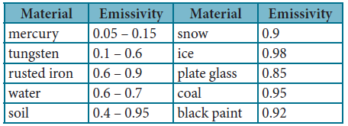
e = emissivity (0 < e < 1)
0 – reflective, 1 - totally absorptive
σ = 5.67 x 10⁻⁸ Wm⁻²K⁻⁴ (Stefan-Boltzmann constant)
A = Area m²
T = Temp in K
Ex – A person has a body surface temperature of about 35 ºC and is in a room where the walls are at 14 ºC. If they have a surface area 2.00 m², and an emissivity of 0.570, what is the rate of net heat lost to the room? (143 W)
Try this one:
A piece of freshly made glass (e = .85) at a temperature of 2600 K is placed in a oven at 1200 K. If it is initially losing heat at a rate of 5900 W, what is its area? (.0028 m²)
Notes:
The emissivity of a material (usually written ε or e) is the relative ability of its surface to emit energy by radiation. It is the ratio of energy radiated by a particular material to energy radiated by a black body at the same temperature. It is a measure of a material's ability to radiate absorbed energy. A true black body would have an while any real object would have . Emissivity is a dimensionless quantity, so it does not have units.
In general, the duller and blacker a material is, the closer its emissivity is to 1. The more reflective a material is, the lower its emissivity. Highly polished silver has an emissivity of about 0.02.

Slide 8
ΔT = Change in temperature (ºC)
Δt = Elapsed time (s)
I_{in} = Incoming radiation in W/m²
I_{out} = Outgoing radiation in W/m²
C_{s} = Surface heat capacity (J/m^{2o}C)
Ex – A surface is absorbing at a rate of 350 W/m², and radiating at a rate of 120 W/m². What is its surface heat capacity if the temperature rises by 0.20 ºC in a half hour? (2E6 J/m²K)
Try this one:
A surface is absorbing radiation at rate of 890 W/m², and it has a surface heat capacity of 3.5x10⁶ J/m²K. What is the rate of outgoing radiation if its temperature raises by 1.4 ºC in two hours? (210 W)
Notes:
The emissivity of a material (usually written ε or e) is the relative ability of its surface to emit energy by radiation. It is the ratio of energy radiated by a particular material to energy radiated by a black body at the same temperature. It is a measure of a material's ability to radiate absorbed energy. A true black body would have an while any real object would have . Emissivity is a dimensionless quantity, so it does not have units.
In general, the duller and blacker a material is, the closer its emissivity is to 1. The more reflective a material is, the lower its emissivity. Highly polished silver has an emissivity of about 0.02.

