Slide 1
Pair Production and photon-matter interactions
Contents:
Photoelectric effect
Compton scattering
Absorption
Pair production
Whiteboards

Slide 2
Photoelectric effect
Photon knocks electron from atom
Photon disappears in the process
TOC

Slide 3
Compton Scattering
Photon bounces off electron
Electron absorbs some energy
Photon has longer wavelength after collision
TOC

Slide 4
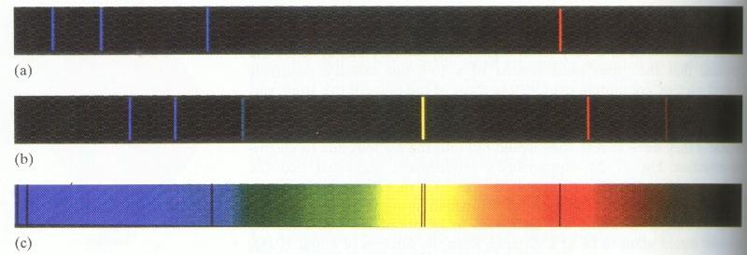
Absorption
Photon hits electron in orbital
Electron moves to excited state
Photon disappears in the process
Only for photons with the right energy
TOC

Slide 5
Pair production
Photon with sufficient energy passes near nucleus
Energy of photon turns into matter
Pair of matter/anti matter is created
Nucleus must carry off some momentum
Help me! I’m going to be annihilated presently!
Positron
m = 9.11 x 10⁻³¹ kg
Charge = +e
Electron
m = 9.11 x 10⁻³¹ kg
Charge = -e
TOC

Slide 6
Solving pair production
E = hf = hc/λ
E = mc²
E - Energy
m - mass
c = 3.00 x 10⁸ m/s
1 eV = 1.602 x 10⁻¹⁹ J
So matter can turn to energy and vice versa.
Example 1: What energy is needed to create a single electron in J and in MeV? (an MeV = 1 x 10⁶ eV)
TOC

Slide 7
Solving pair production
E = hf = hc/λ
E = mc²
E - Energy
m - mass
c = 3.00 x 10⁸ m/s
1 eV = 1.602 x 10⁻¹⁹ J
Example 2: What energy photon (in MeV) is needed to create a electron-positron pair each with a kinetic energy of .34 MeV? What is the wavelength of that photon?
Photon energy = energy to create matter + kinetic energy
TOC

Slide 8
Solving pair production
E = hf = hc/λ
E = mc²
E - Energy
m - mass
c = 3.00 x 10⁸ m/s
1 eV = 1.602 x 10⁻¹⁹ J
Example 3: A .00025 nm photon creates a electron positron pair. What is the kinetic energy of each particle?
TOC

Slide 9
Whiteboards:
Pair production
1 | 2 | 3
TOC

Slide 10
A photon creates a electron-positron pair each with a kinetic energy of .170 MeV. What is the energy of the photon? (in MeV)
photon energy = energy to create mass + kinetic energy
= .511 MeV + .511 MeV + .170 MeV + .170 MeV = 1.362 MeV
W
1.362 MeV

Slide 11
A 2134 MeV photon creates a proton, negatron pair, each with how much kinetic energy? (2)
Proton rest mass = 938 MeV
photon energy = energy to create mass + kinetic energy
2134 MeV = 938 MeV + 938 MeV + kinetic energy
kinetic energy = 258 MeV/(2 particles) = 129 MeV
W
129 MeV

Slide 12
A photon with a wavelength of 5.27113x 10⁻¹³ m creates a electron-positron pair with how much kinetic energy each? (answer in keV)
E = hf = hc/λ
E = hc/λ,
= (6.626 x 10⁻³⁴ Js)(3.00 x 10⁸ m/s)/(5.27113x 10⁻¹³ m)
= (3.77111x 10⁻¹³ J)/(1.602 x 10⁻¹⁹ J/eV) = 2354000 eV
= 2354 keV
photon energy = energy to create mass + kinetic energy
2354 keV= 511 keV + 511 keV + kinetic energy
kinetic energy = 1332 keV/(2 particles) = 666 keV
W
666 keV

Slide 13
So - is light a wave or a particle?
Particle behaviour:
Wave behaviour:
Photoelectric effect
Refraction
Compton scattering
Interference
Absorption
Diffraction
Pair production

Slide 14
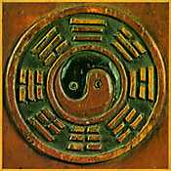
What is light?
Complementarity - Using a variety of models to describe a phenomenon.
Wave behaviour
Particle behaviour
Light is described totally by both wave and particle behaviour
For a given experiment, light is a wave xor a particle

