Slide 1
Binding Energy
He - 4
H-1
H-1
n
n

Slide 2
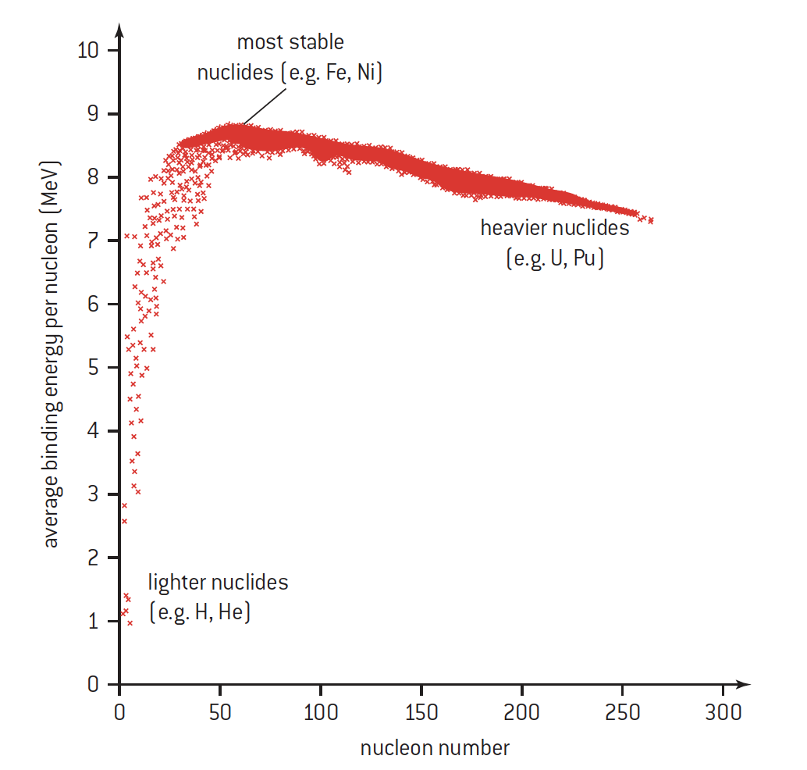

Slide 3
Q Value = energy released
Right side
Left side
Exoergic / + Q value / Mass converted to KE

Slide 4
Q Value = energy released
Left side
Right side
Endoergic / - Q value / KE converted to mass

Slide 5
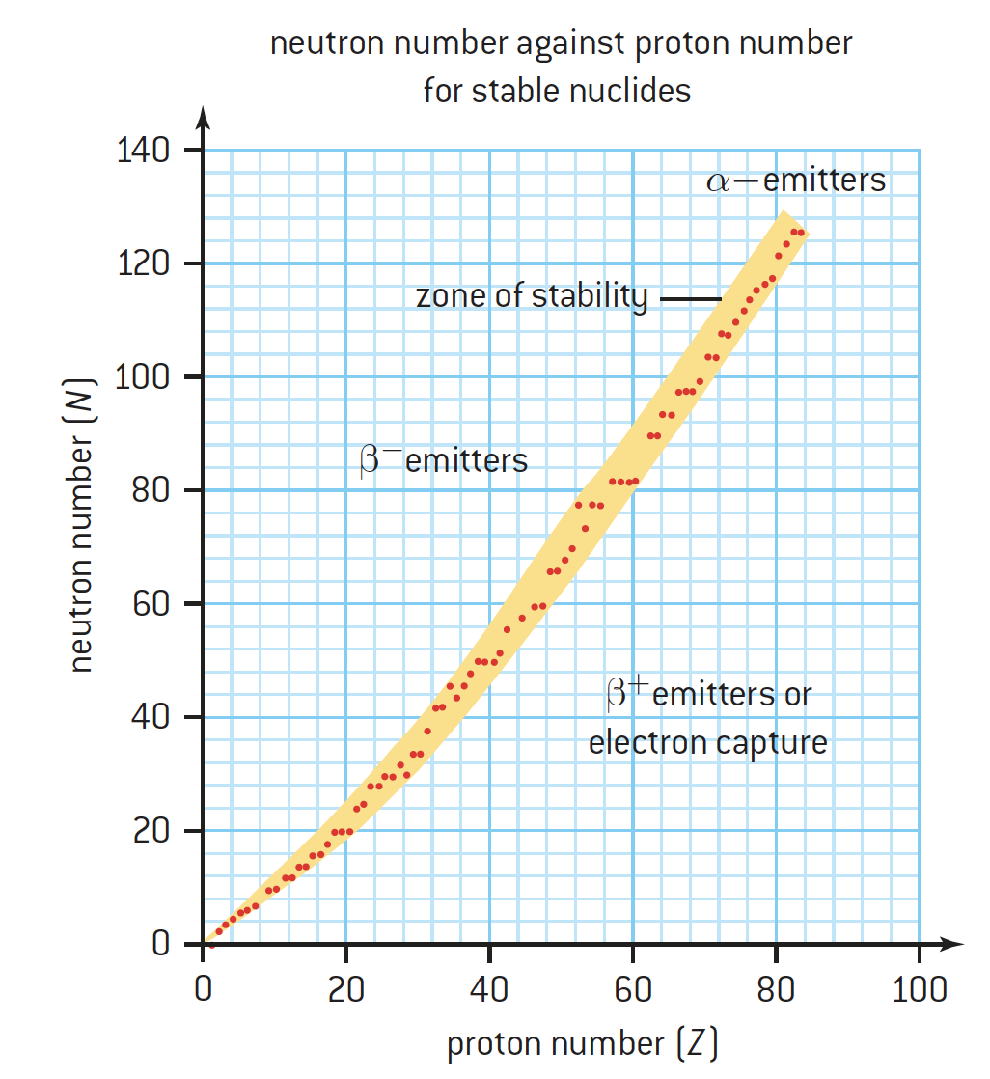
Radioactivity

