Slide 1
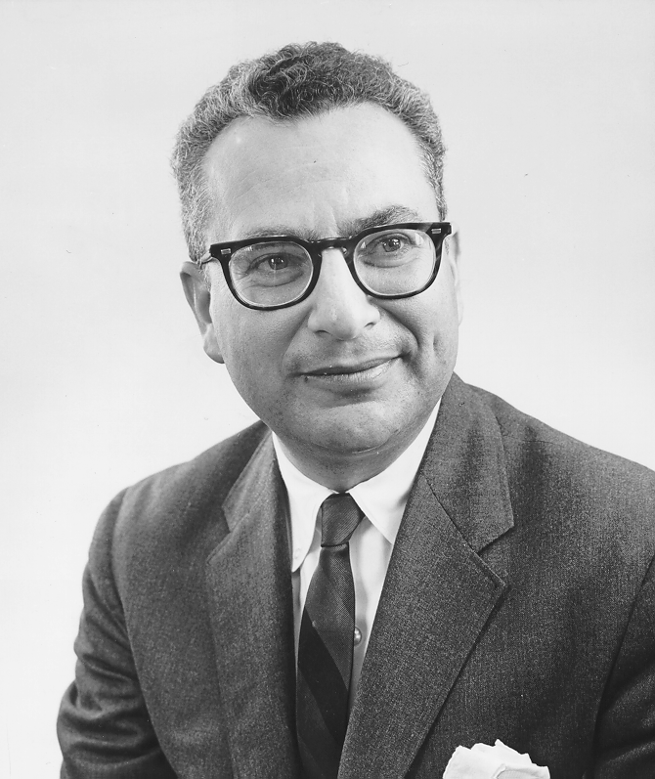
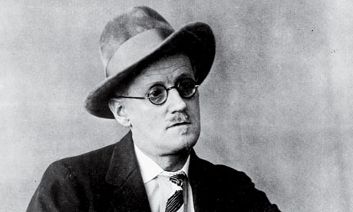
Quark Theory
1960s - Only 4 Leptons, but Hundreds of Hadrons
Leptons seemed elementary/small (<10⁻¹⁸ m)
Not all Hadrons could be elementary – SLAC experiments showed an internal structure
Murray Gell-Mann (b. 1929) suggests that Hadrons are made from quarks.
"three quarks for Muster Mark"
-James Joyce
(Finnegan’s Wake)
Notes:
Murray Gell-Mann thought up the name "quark" by taking it from a line from James Joyce's "Finnegan's Wake" where it says, "three quarks for Muster Mark." Gell-Mann said that initially he didn't know where he got the name, and then he realized where he had heard it. It seemed appropriate since at that time only three quarks, up, down, and strange, were theorized. Gell-Mann also said the line suggested to him, "three quarts for Mister Mark," implying a guy drinking at a pub. James Joyce invented the word "quark" after hearing seagulls cawing. James Joyce got the title "Finnegan's Wake" from a popular Irish folksong of the same name. Since I was little, on St. Patrick's Day, we would listen to Irish records, one of which had that song. I first heard the word "quarks" when I was in the 5th grade, watching Carl Sagan's "Cosmos." At the time, I never imagined a connection between those two things.

Slide 2
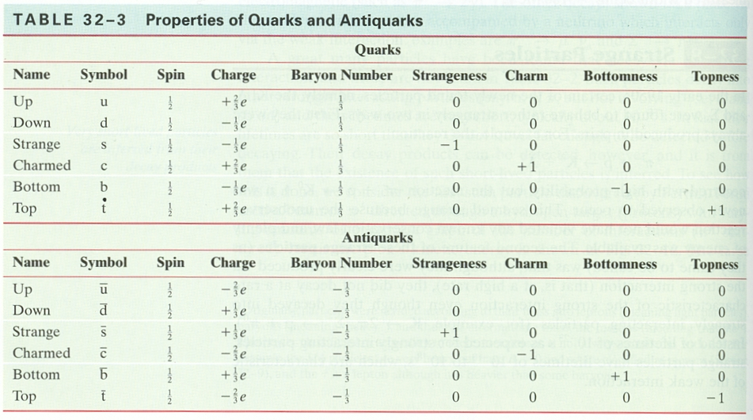
12 total particles/anti-quarks are opposite
Fractional charge
Baryons vs. Mesons
Held together by gluons – what happens when you separate
Notes:
Murray Gell-Mann thought up the name "quark" by taking it from a line from James Joyce's "Finnegan's Wake" where it says, "three quarks for Muster Mark." Gell-Mann said that initially he didn't know where he got the name, and then he realized where he had heard it. It seemed appropriate since at that time only three quarks, up, down, and strange, were theorized. Gell-Mann also said the line suggested to him, "three quarts for Mister Mark," implying a guy drinking at a pub. James Joyce invented the word "quark" after hearing seagulls cawing. James Joyce got the title "Finnegan's Wake" from a popular Irish folksong of the same name. Since I was little, on St. Patrick's Day, we would listen to Irish records, one of which had that song. I first heard the word "quarks" when I was in the 5th grade, watching Carl Sagan's "Cosmos." At the time, I never imagined a connection between those two things.

Slide 3
Quark Theory
Proton: +1 charge, B = 1
Neutron: 0 charge, B = 1
π⁺: +1 charge, B = 0
π-: -1 charge, B = 0
K-: -1 charge, B = 0
You should memorize the composition of n and p,
You will always be given meson compositions
Notes:
Murray Gell-Mann thought up the name "quark" by taking it from a line from James Joyce's "Finnegan's Wake" where it says, "three quarks for Muster Mark." Gell-Mann said that initially he didn't know where he got the name, and then he realized where he had heard it. It seemed appropriate since at that time only three quarks, up, down, and strange, were theorized. Gell-Mann also said the line suggested to him, "three quarts for Mister Mark," implying a guy drinking at a pub. James Joyce invented the word "quark" after hearing seagulls cawing. James Joyce got the title "Finnegan's Wake" from a popular Irish folksong of the same name. Since I was little, on St. Patrick's Day, we would listen to Irish records, one of which had that song. I first heard the word "quarks" when I was in the 5th grade, watching Carl Sagan's "Cosmos." At the time, I never imagined a connection between those two things.

Slide 4
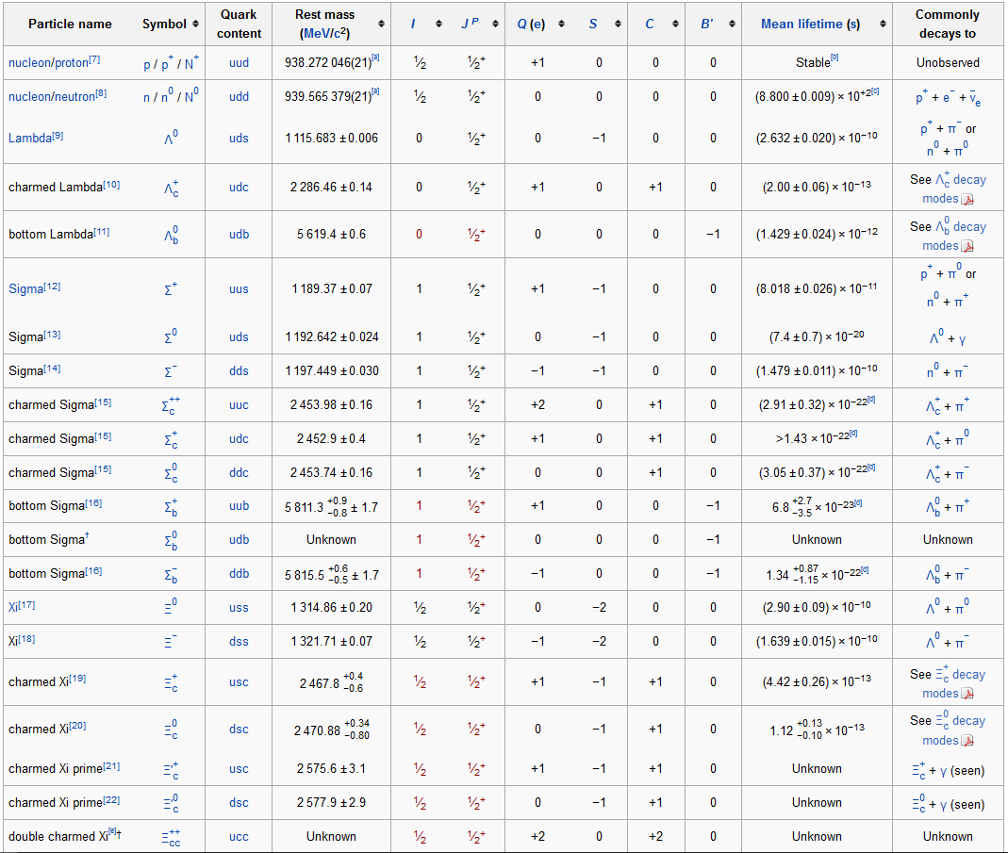
u
u

Slide 5
u
u
B S q

Slide 6
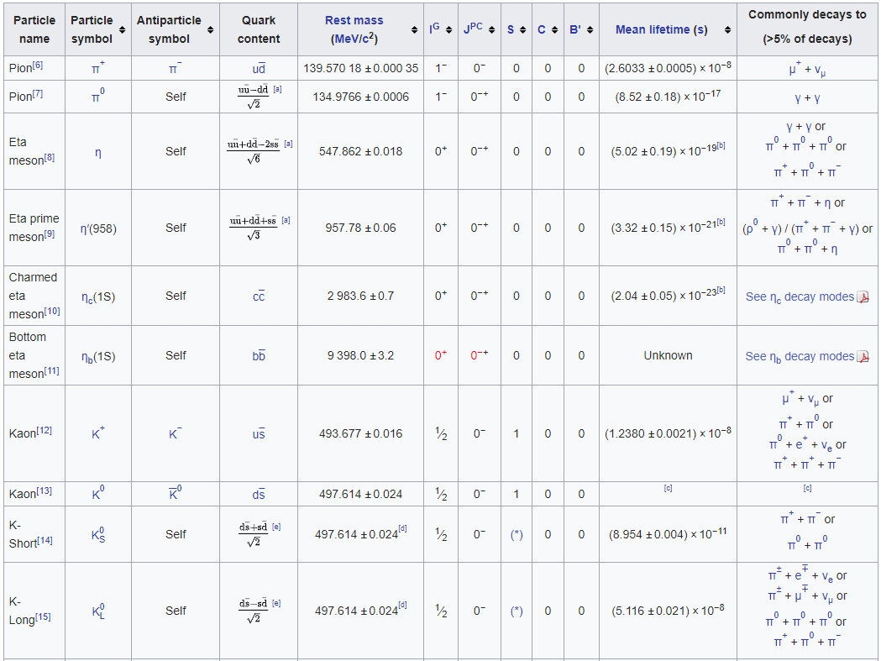
Mesons are quark anti-quark pairs
Notes:
Where are you seeing that they have fractional numbers of quarks? So far as I know, a meson by definition consists of two quarks.I think that the OP is referring to the "quark content" column of the tables of mesons, which contain factors like 1/√2, 1/√6. What you're running into there is a phenomenon called superposition. A π± meson can be viewed as a bound state of a down quark and an anti-up quark (or up and anti-down); if we could look at the quarks inside a π+ or π-, we'd find these two quarks 100% of the time. The π0 quark is fundamentally different: it's a superposition of two possible states, and is written mathematically as 1/√2 * (up & anti-up) - 1/√2 * (down & anti-down). What does this weird notation mean? Well, it's basically saying that if we were to look inside a π0 meson, we could either expect to find a up and an anti-up quark, or a down and an anti-down quark, but (here's the important part) not both at the same time. The probabilities of seeing each option are (by the laws of quantum mechanics) equal to the squares of those coefficients in front: (probablility of observing up & anti-up) = (1/√2)2 = 1/2 (probablility of observing down & anti-down) = (-1/√2)2 = 1/2 The probabilities for each option in the eta meson, eta-prime meson, etc., follow the same general principle. Oh, and to tie this back to something that non-experts might have heard of: You've heard about Schrödinger's cat being "both alive and dead", right? The way physicists would describe the state of the cat after one half-life of the radioactive atom is 1/√2 * (alive) + 1/√2 * (dead). Just like with the quarks, Schrödinger's cat is best described as being in a superposition of "alive" and "dead"; when we open the box and observe the cat, we've got a 50-50 chance of finding either of these options.

Slide 7
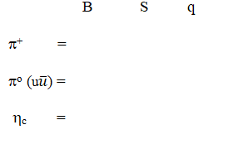
Notes:
Where are you seeing that they have fractional numbers of quarks? So far as I know, a meson by definition consists of two quarks.I think that the OP is referring to the "quark content" column of the tables of mesons, which contain factors like 1/√2, 1/√6. What you're running into there is a phenomenon called superposition. A π± meson can be viewed as a bound state of a down quark and an anti-up quark (or up and anti-down); if we could look at the quarks inside a π+ or π-, we'd find these two quarks 100% of the time. The π0 quark is fundamentally different: it's a superposition of two possible states, and is written mathematically as 1/√2 * (up & anti-up) - 1/√2 * (down & anti-down). What does this weird notation mean? Well, it's basically saying that if we were to look inside a π0 meson, we could either expect to find a up and an anti-up quark, or a down and an anti-down quark, but (here's the important part) not both at the same time. The probabilities of seeing each option are (by the laws of quantum mechanics) equal to the squares of those coefficients in front: (probablility of observing up & anti-up) = (1/√2)2 = 1/2 (probablility of observing down & anti-down) = (-1/√2)2 = 1/2 The probabilities for each option in the eta meson, eta-prime meson, etc., follow the same general principle. Oh, and to tie this back to something that non-experts might have heard of: You've heard about Schrödinger's cat being "both alive and dead", right? The way physicists would describe the state of the cat after one half-life of the radioactive atom is 1/√2 * (alive) + 1/√2 * (dead). Just like with the quarks, Schrödinger's cat is best described as being in a superposition of "alive" and "dead"; when we open the box and observe the cat, we've got a 50-50 chance of finding either of these options.

Slide 8
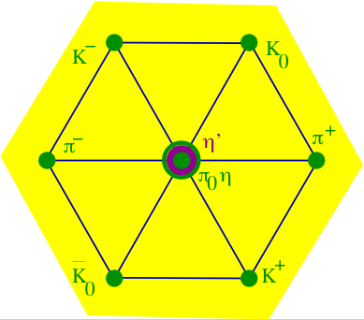
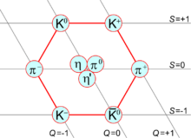
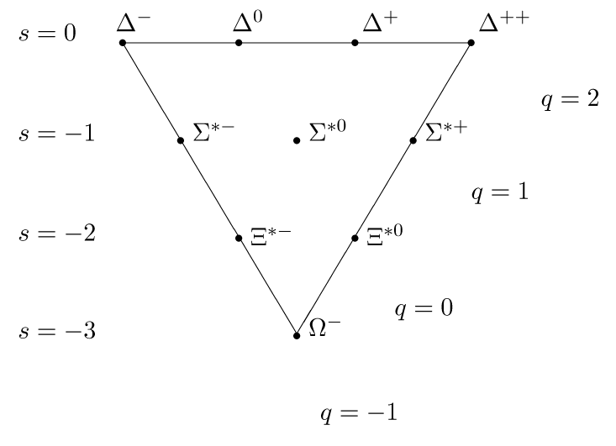
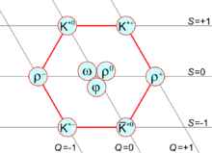

Slide 9
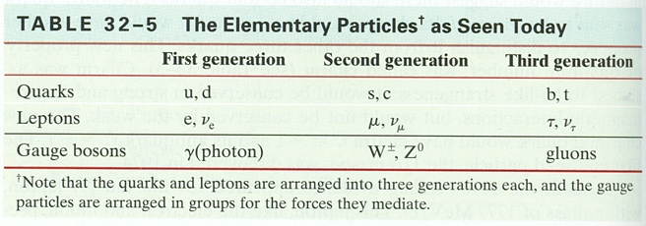
Truly Fundamental particles
Generally accepted fundamental particles
Three generations
Top quark = 173.1 GeV/c²
Higgs Boson…
Notes:
Murray Gell-Mann thought up the name "quark" by taking it from a line from James Joyce's "Finnegan's Wake" where it says, "three quarks for Muster Mark." Gell-Mann said that initially he didn't know where he got the name, and then he realized where he had heard it. It seemed appropriate since at that time only three quarks, up, down, and strange, were theorized. Gell-Mann also said the line suggested to him, "three quarts for Mister Mark," implying a guy drinking at a pub. James Joyce invented the word "quark" after hearing seagulls cawing. James Joyce got the title "Finnegan's Wake" from a popular Irish folksong of the same name. Since I was little, on St. Patrick's Day, we would listen to Irish records, one of which had that song. I first heard the word "quarks" when I was in the 5th grade, watching Carl Sagan's "Cosmos." At the time, I never imagined a connection between those two things.

Slide 10
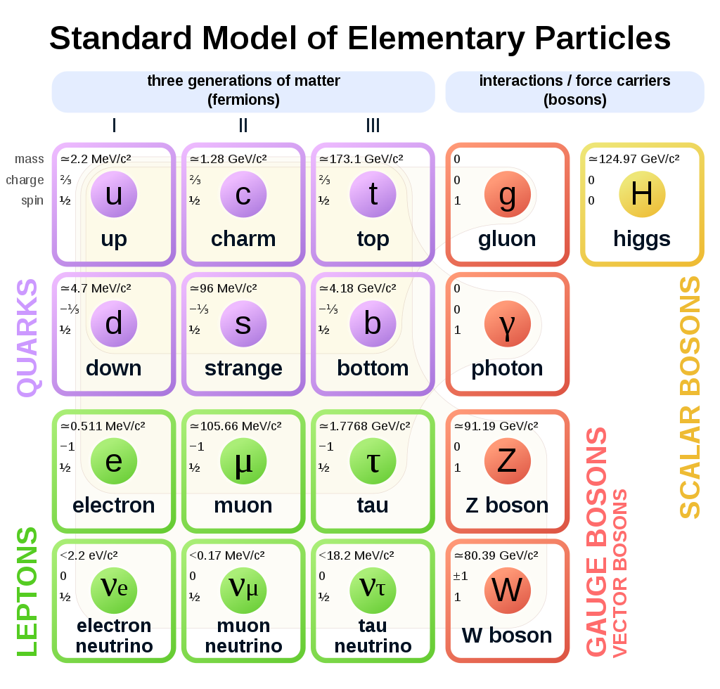

Slide 11
