Slide 1
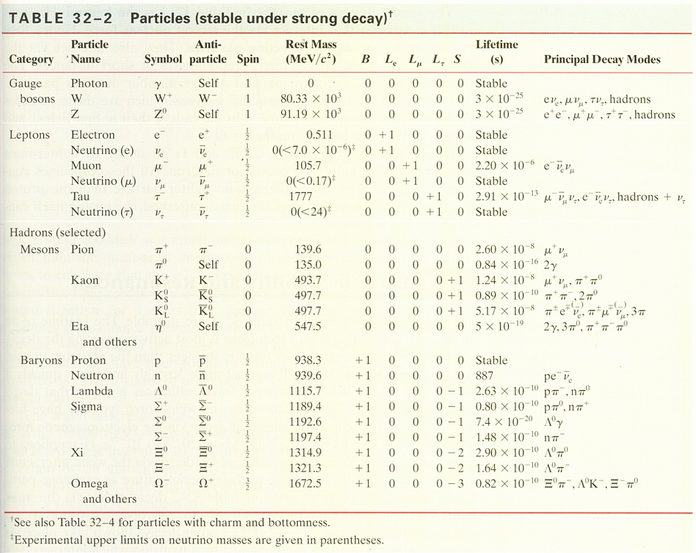

Slide 3
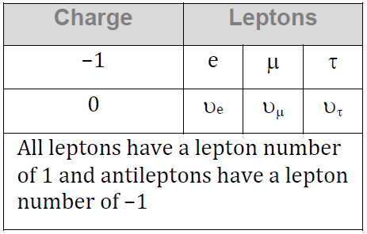
Conservation Laws - Lepton Number
Lepton number is conserved too
L_{e} - Electron/electron neutrino
L_{μ} - Muon/muon neutrino
L_{τ} - Tau/Tau neutrino
Remember - anti particles have negative lepton numbers
Neutrinos are believed to have mass

Slide 4
Can the following decay occur?
τ⁻ → π⁻ + πº + υ_{τ}
Charge:
Mass/Energy:
L_{τ}:
Does it have enough mass?
Can a Muon decay into mesons
Could a Tau decay into a baryon/meson?
18>1

Slide 5
What is the missing decay product?
τ⁻ → υ_{τ} + e- + ??
Charge:
Mass/Energy:
L_{τ}:
19>1

Slide 6
Can the following decay occur?
τ⁺ → π⁻ + π⁺ + π⁺ + πº + υ_{τ}
Charge:
Mass/Energy:
L_{τ}:
no

Slide 7
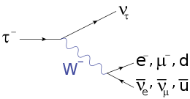
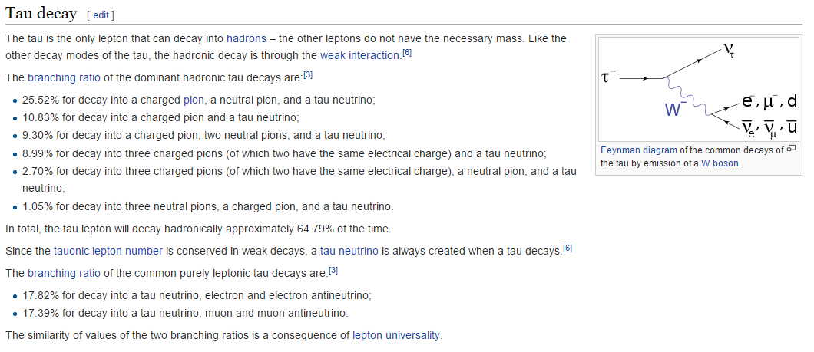

Slide 8
L_{e} L_{μ} L_{τ}
Electron e- +1 0 0
Neutrino (e) ν_{e} +1 0 0
Beta Decay:
Emission of an electron neutrino allowed L_{e} to be conserved:
⁶⁰₂₇Co ⁶⁰₂₈Ni + β- + ν_{e}
¹³₇N ¹³₆C + β+ + ν_{e}

Slide 9
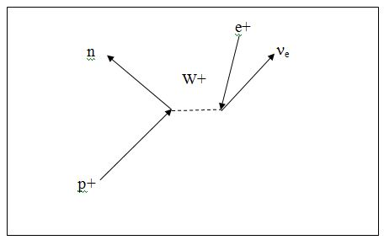
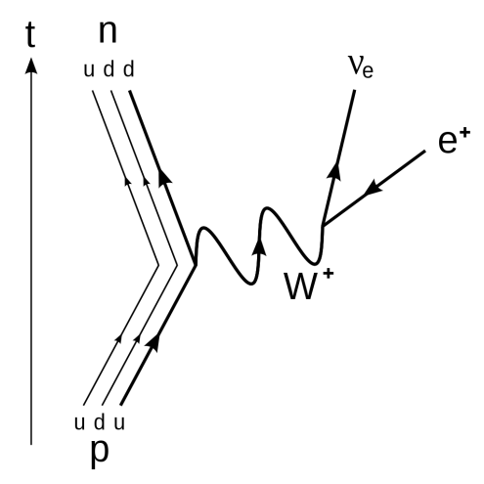
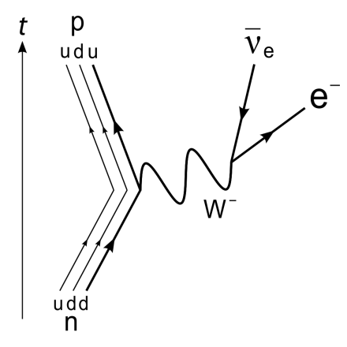

Slide 10
Whiteboards:
Is the Decay Possible?
1-5

Slide 11
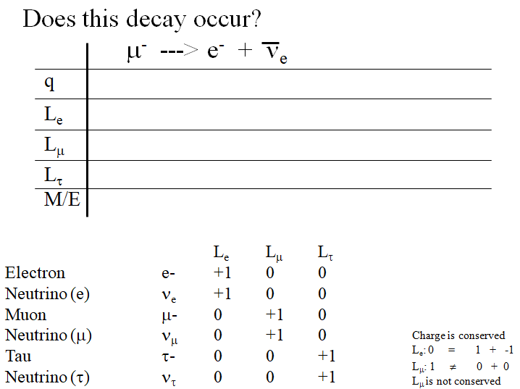

Slide 12
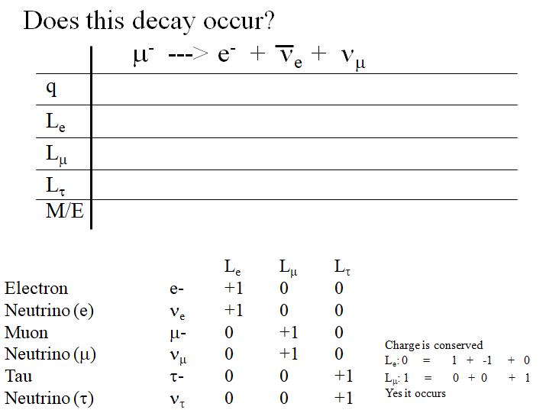

Slide 13
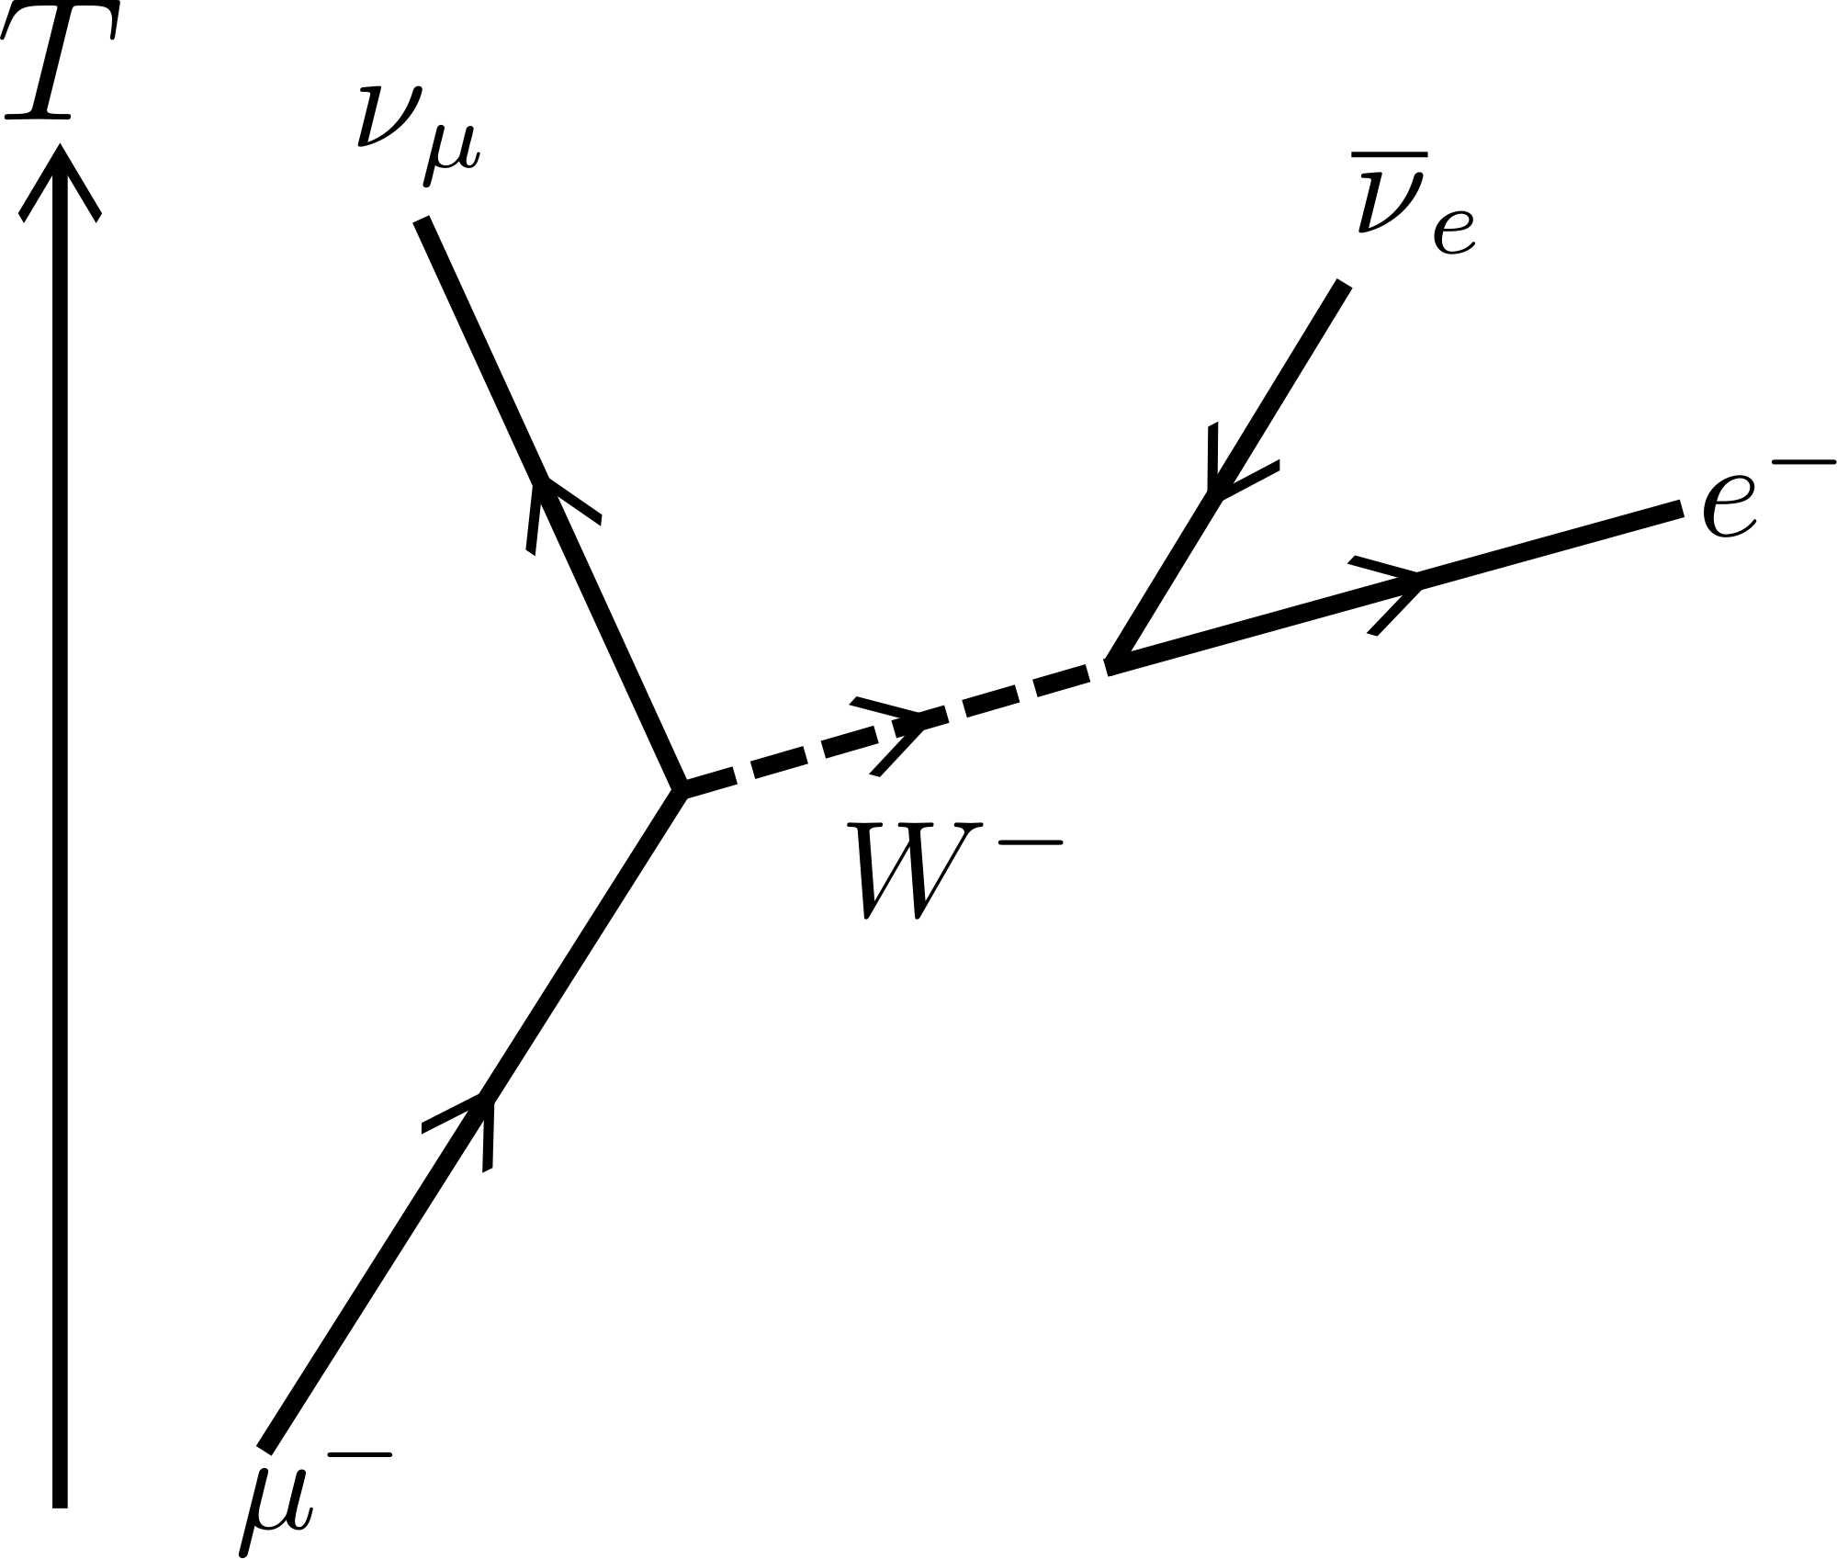
μ⁻ ---> e⁻ + ν_{e} + ν_{μ}

Slide 14
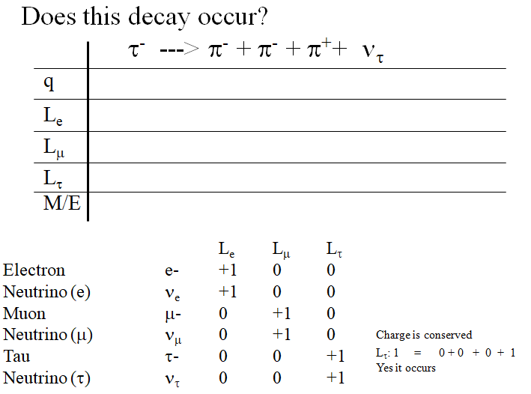

Slide 15
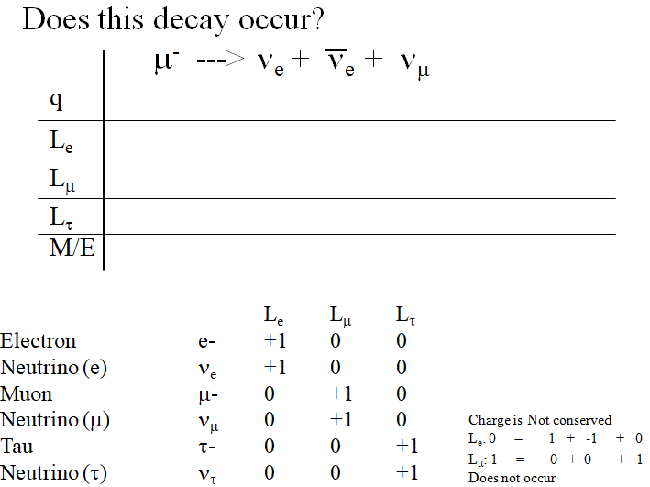

Slide 16
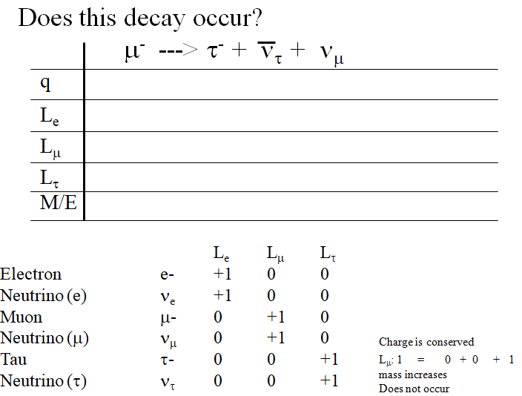

Slide 17
Whiteboards:
Find the missing decay product
1-5

Slide 18
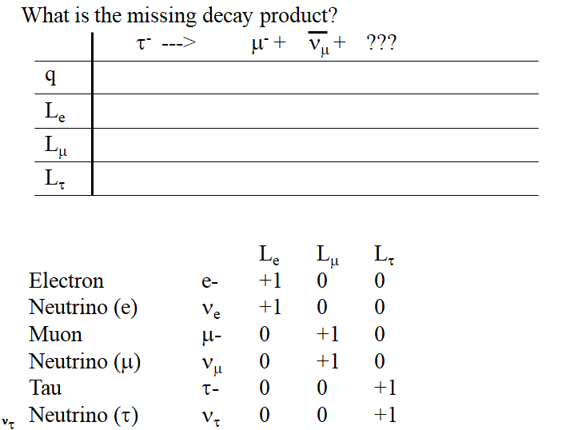

Slide 19
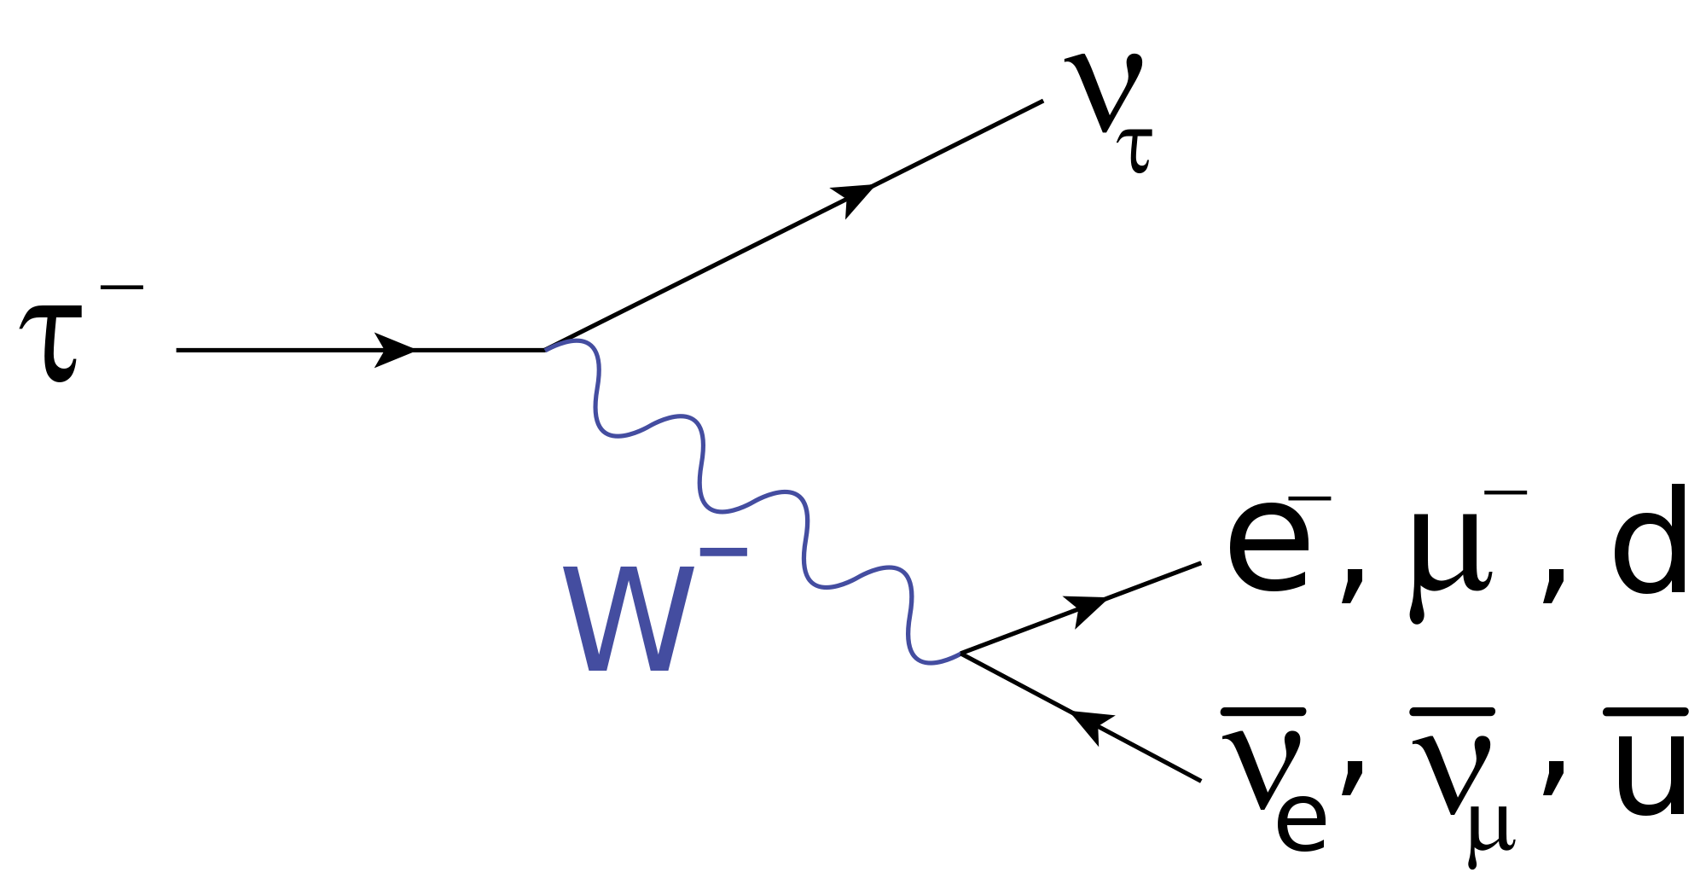

Slide 20
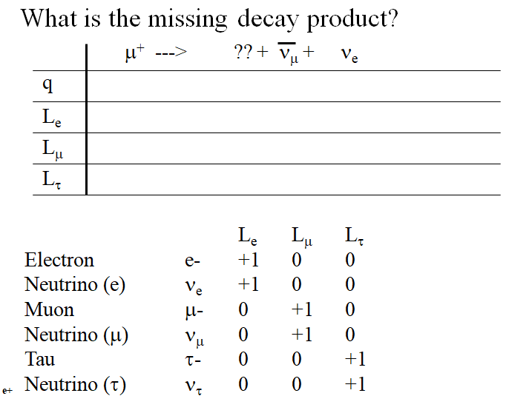

Slide 21
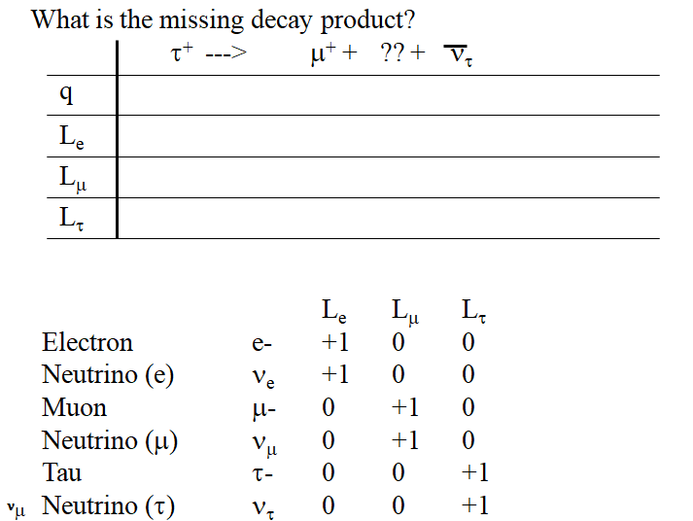

Slide 22
