Slide 1
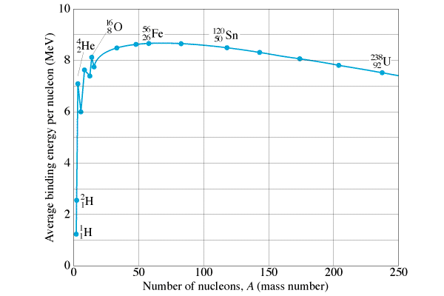
The curve of binding energy
Binding energy per nucleon
Going to more tightly bound releases energy
Fission - splitting nuclei
Fusion - joining nuclei
Most tightly bound
Fission releases energy
Fusion releases energy

Slide 2
Nuclear Fission (Splitting)
n + ²³⁵₉₂U ---> ¹⁴¹₅₆Ba + ⁹²₃₆Kr + 3n (typical)
Releases about 200 MeV of energy

Slide 3
Nuclear Fusion - joining of Nuclei
Fusion powers the sun:
Energy comes primarily from the Proton-Proton cycle:
¹H + ¹H = ²H + e⁺ + ν
¹H + ²H = ³He + γ
³He + ³He = ⁴He + ¹H + ¹H
(requires heat and pressure)

Slide 4
Nuclear Fusion - joining of Nuclei
Helium can also fuse:
⁴He + ⁴He = ⁸Be + γ
⁴He + ⁸Be = ¹²C + γ
Carbon can fuse as well:
¹²C + ¹²C = ²⁴Mg + γ
¹⁶O + ¹⁶O = ²⁸Si + ⁴He

Slide 5
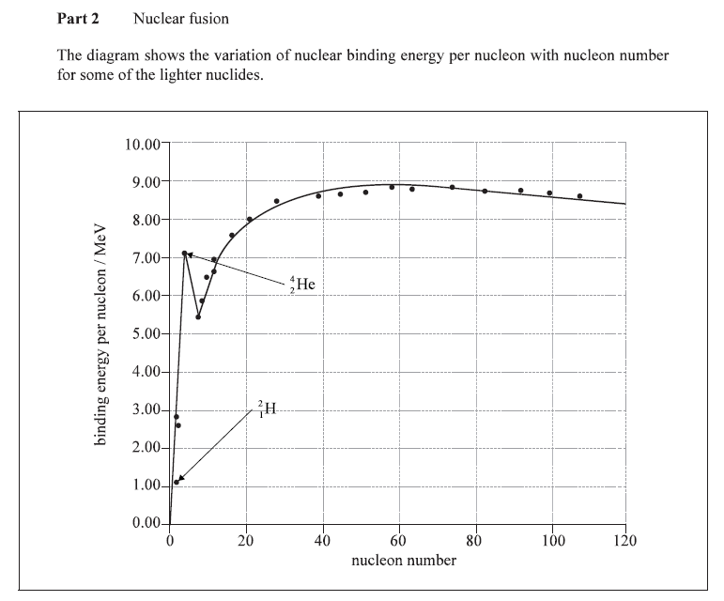

Slide 6
