Slide 1
Alpha Decay - Energy of alpha particle
1 u = 931.5 MeV
He (neutral atom) = 4.002603 u
Calculating mass defect of alpha decay (5.414 MeV) 92-U-232 --> 90-Th-228 + Alpha
232.037131 --> 228.028716 + 4.002603

Slide 2
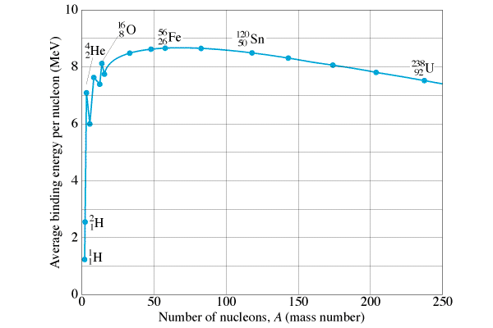
Why Alpha Decay
Only possible if mass products < parent
Tendency to reduce potential energy
Larger nuclei
He nucleus is rather tightly bound
He Nucleus

Slide 4
²⁴⁷₉₇Bk --> ²⁴³₉₅Am + α
247.070300 --> 243.061373 + 4.002603
What is energy of alpha?
5.891 MeV

Slide 5
²⁴³₉₅Am --> ²³⁹₉₃Np + α
243.061373 -->239.052932 + 4.002603
(It’s a decay series!!!)
What is energy of alpha? (in MeV and J)
What is the velocity of the alpha? (Assume? that the alpha gets all the kinetic energy) m_{α} = 6.64x10⁻²⁷ kg
5.438 MeV, 8.712 x 10⁻¹³ J, 1.62 x 10⁷ m/s

