Slide 1
Problems with the Rutherford Atom
Acceleration/Radiation
Spectral Lines

Slide 2
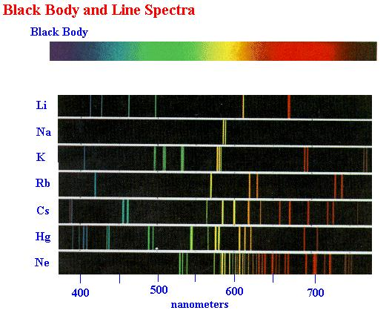

Slide 3
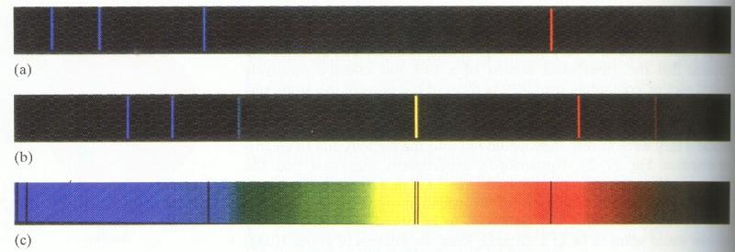
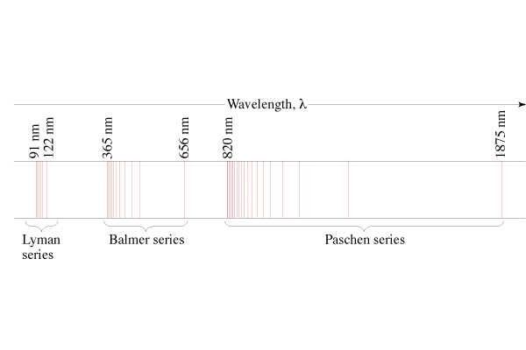
Spectral lines
Energy from excited atoms
Rydberg’s Formula: (FYI)
¹/_{λ} = R(¹/₂2 - ¹/_{n}2), n = 3, 4, ...(Balmer) (Visible)
¹/_{λ} = R(¹/₁2 - ¹/_{n}2), n = 2, 3, ...(Lyman) (UV)
¹/_{λ} = R(¹/₃2 - ¹/_{n}2), n = 4, 5, ...(Paschen) (IR)
(R = 1.097 x 10⁻⁷ m⁻¹)
H
He
Sun

Slide 4
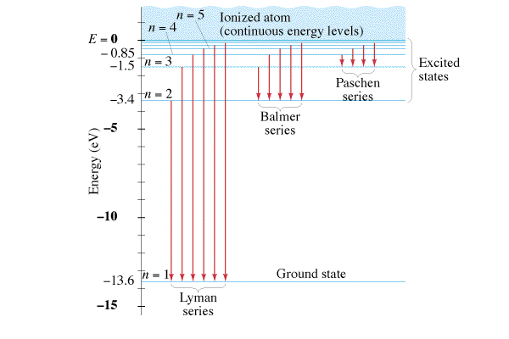
Assumptions of Bohr’s Quantum Atom
Only certain orbits are allowed “stationary states”
Electron transitions create photons
¹/_{λ} = R(¹/₂2 - ¹/_{n}2), n = 3, 4, ...(Balmer) (Visible)
¹/_{λ} = R(¹/₁2 - ¹/_{n}2), n = 2, 3, ...(Lyman) (UV)
¹/_{λ} = R(¹/₃2 - ¹/_{n}2), n = 4, 5, ...(Paschen) (IR)

Slide 5
Example 1: What is the wavelength of the first Lyman line? (122 nm)

Slide 6
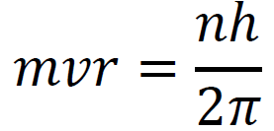
3. Angular momentum is quantised:
Example 2: Show that mvr = L = Iω

Slide 7
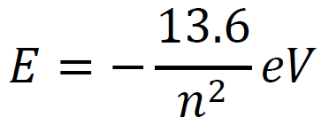
Ultimately, the energy levels can be simplified to:
Example 3: What is the energy level of the 4th orbital, and the 2nd orbital?
What wavelength of light corresponds to a 4 to 2 transition for a Hydrogen atom? (The 2nd Balmer line)

Slide 8
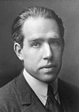
Limitations of Bohr’s model
Works well for H, but doesn’t even work for He
Did not explain
Spectral fine structure
Brightness of lines
Molecular bonds
Theory was not complete.
But otherwise it generally kicked tuckus

Slide 10
What is the wavelength of the photon associated with an electron transition from n = 6 to n = 1 in a hydrogen atom? Is the photon being absorbed, or emitted?
93.8 nm, emitted

Slide 11
What is the wavelength of the photon associated with an electron transition from n = 2 to n = 3 in a hydrogen atom? Is the photon being absorbed, or emitted?
657 nm, absorbed

