Slide 1
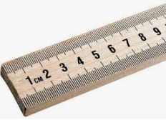
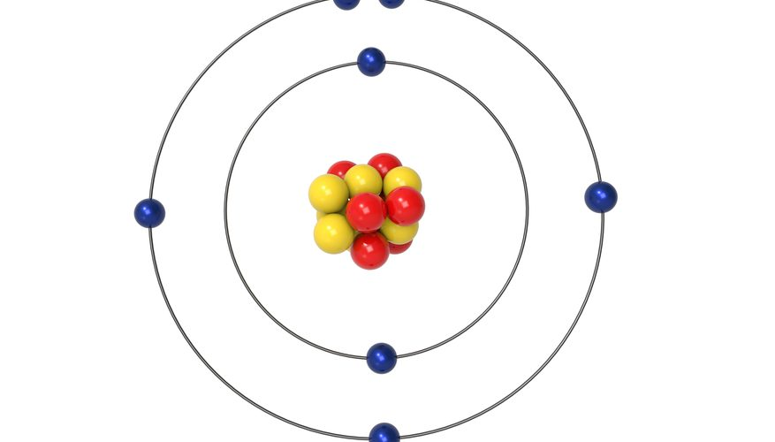
Atoms are ≈ 10⁻¹⁰ m in radius
can see 10⁻⁴ m
100 sheets of paper = 1 cm
10,000 sheets = 1 m
1,000,000 sheets = soccer field (100m)
Nuclei are ≈ 10⁻¹⁵ m in radius

Slide 2
Nuclear Radius
R - Nuclear radius (m)
R_{o} - Fermi Radius (1.20x10⁻¹⁵ m)
A - Mass # (#p +#n)
Example 1: What is the radius of a Uranium 235 nucleus? (A = 235) (7.4 fm)

Slide 3
Whiteboards:
Closest Approach and Radius
1-3

Slide 4
What is the radius of a Carbon-12 nucleus?
2.75 fm

