Slide 1
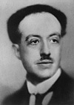
Louis de Broglie
Light is acting as both particle and wave
Matter perhaps does also
p = momentum (p = mv)
h = Planck’s constant (6.626 x 10⁻³⁴ Js)
λ = de Broglie wavelength

Slide 2
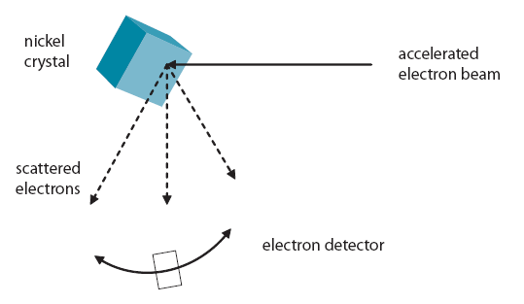
Davisson-Germer
(Interference)

Slide 3
p = momentum (p = mv)
h = Planck’s constant (6.626 x 10⁻³⁴ Js)
λ = de Broglie wavelength
Example 1: What is the de Broglie wavelength of a 0.145 g ball going 40. m/s? (1.1 x 10⁻³⁴ m) (too small)

Slide 4
p = momentum (p = mv)
h = Planck’s constant (6.626 x 10⁻³⁴ Js)
λ = de Broglie wavelength
Example 2: What is the velocity of a proton (m = 1.673x10⁻²⁷ kg) with a de Broglie wavelength of 600 nm? (0.660 m/s)

Slide 5
p = momentum (p = mv)
h = Planck’s constant (6.626 x 10⁻³⁴ Js)
λ = de Broglie wavelength
Example 3: Through what potential must you accelerate an electron so that it has a wavelength of 1.0 nm? (1.504 V)

Slide 7
What is the mass of a particle that has a de Broglie wavelength of 450 nm, and a velocity of 40.0 m/s?
3.68x10⁻²⁹ kg

