Slide 1
FA

Slide 2
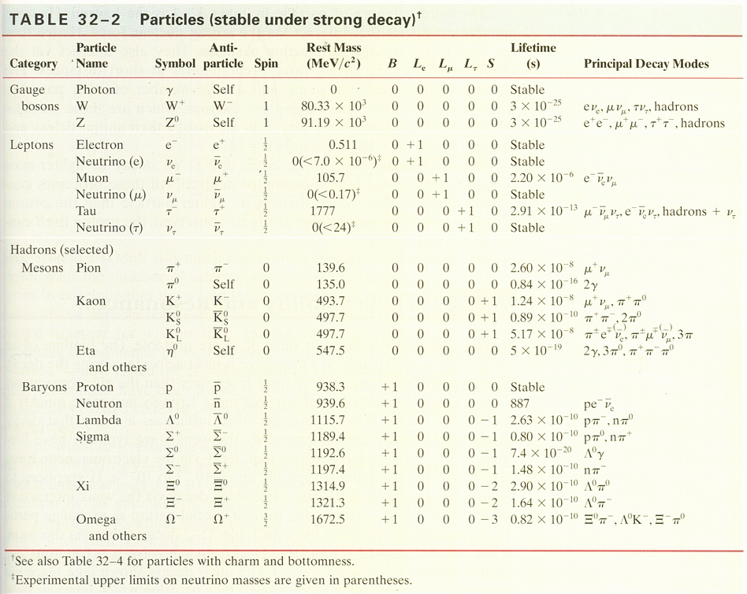
yes

Slide 3
No, Charge and Strangeness

Slide 4
P27.2

Slide 5
Missing particles

Slide 6
1

Slide 7
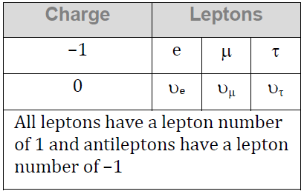

Slide 11
2

Slide 16
3

Slide 21
Reactions

Slide 22
1

Slide 27
2

Slide 32
3

Slide 37
4

Slide 42
quarks

