Slide 1
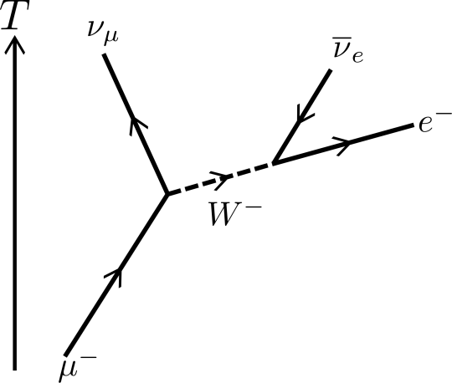
Particle Physics Part 2
"three quarks for Muster Mark"
-James Joyce
(Finnegan’s Wake)
Contents:
Conservation Laws
Types of Particles
Strange Things and Quark Theory

Slide 2
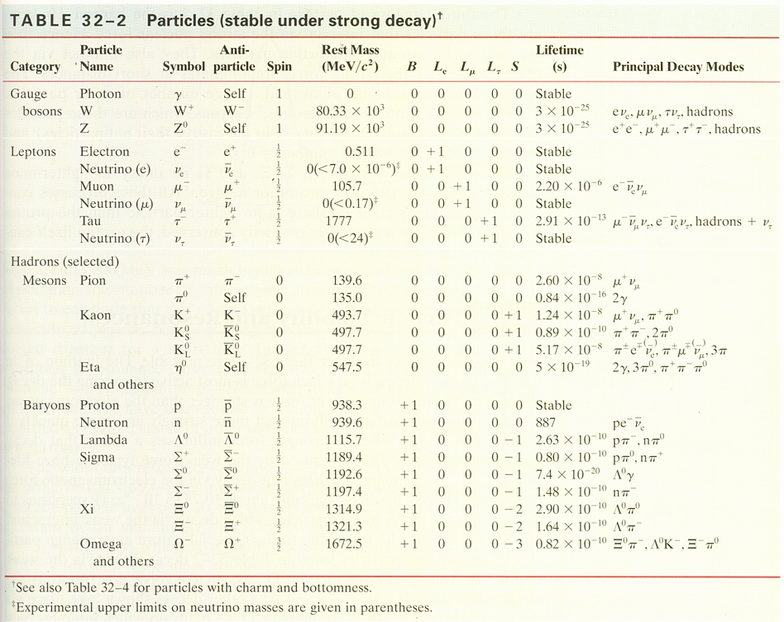

Slide 4
Conservation Laws - Baryon Number
Conservation of charge
Conservation of mass/energy
Conservation of nucleon....
In general, baryon number is conserved:

Slide 5
Can the following reaction occur?
p + n → p + p +
charge
mass energy
Baryon #

Slide 6
Conservation Laws - Baryon Number
Heavy baryons decay to lighter ones
Proton is lightest - must be stable

Slide 7
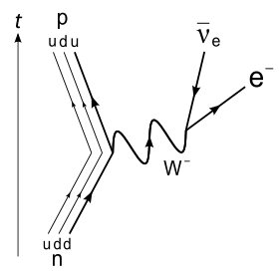
Decay of a free neutron: (Bound neutrons are stable…)

Slide 8
Whiteboards:
Conservation of Baryon Number
1 | 2 | 3 | 4

Slide 9
What is the total Baryon number of
p + n + n + Ω⁺
1 + 1 + -1 + -1 = 0
0

Slide 10
What is the total Baryon number of
Ξ⁺ + Σ⁺ + Λº + π⁺
-1 + -1 + 1 + 0 = -1
-1

Slide 11
Can this reaction occur?
p + p ---> Ω⁻ + Ξ⁺ + K_{s}º
1 +-1 = 1 + -1 + 0
yes

Slide 12
Can this reaction occur?
p + n ---> Σº + Σ⁺
1 +-1 ≠ -1 + -1
no

Slide 13
Can this reaction occur?
Λº + n ---> Σº + Σ⁺
B: 1 +-1 = 1 + -1
C: 0 + 0 != 0 + 1
no

Slide 14
This reaction occurs with high probability:
π⁻ + p → K_{L}º + Λº
This reaction is never observed:
π⁻ + p → K_{L}º + n
Look at the strangeness…
Produced at a high rate (Via the strong force)

Slide 15
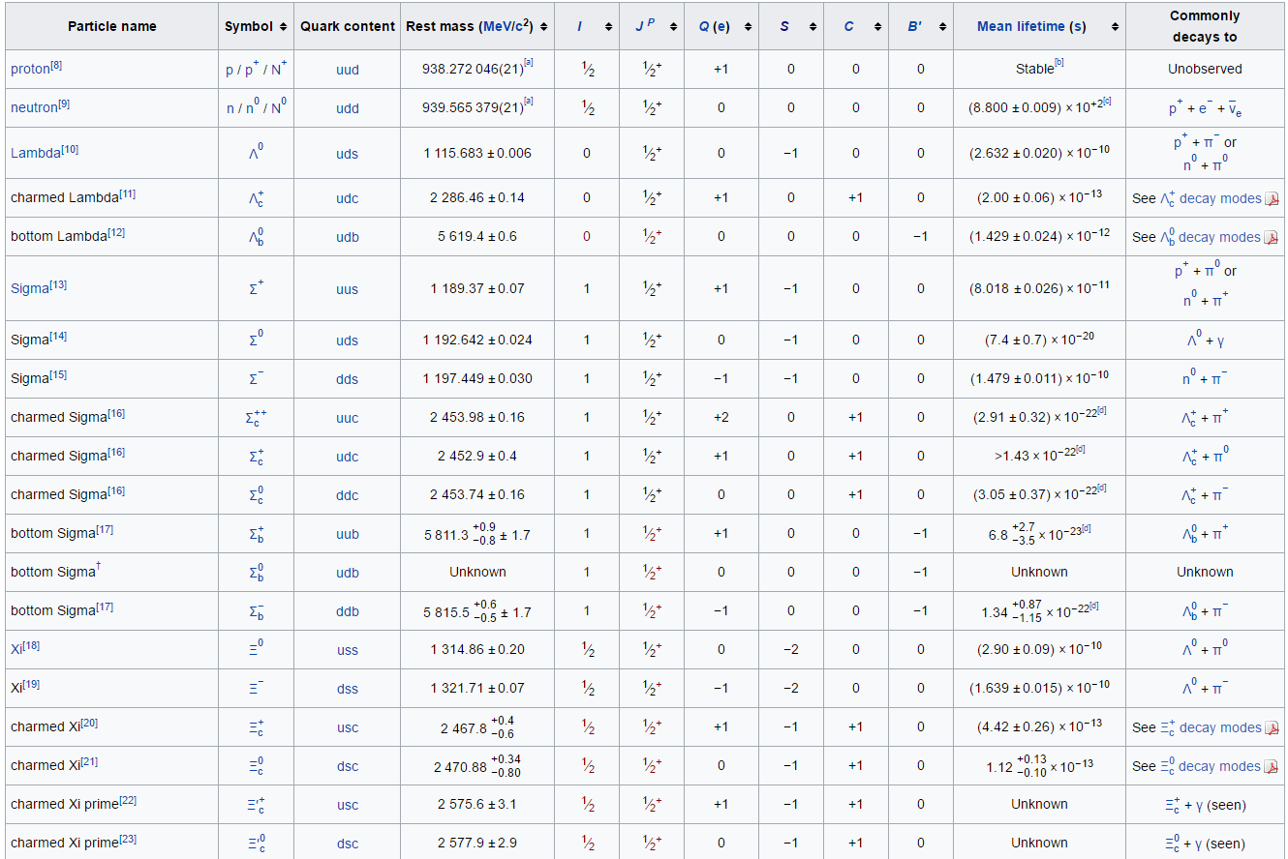
Strange particles have “long” lives/Can be not conserved via weak interaction

Slide 16
Does this reaction conserve strangeness? (we already showed that is conserves B)
p + p ---> Ω⁻ + Ξ⁺ + K_{s}º
0 + 0 = -3 + 2 + 1
yes

Slide 17
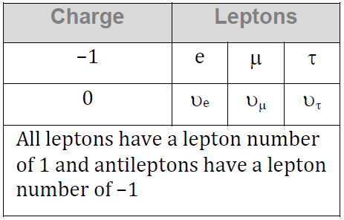
Conservation Laws - Lepton Number
Lepton number is conserved too
L_{e} - Electron/electron neutrino
L_{μ} - Muon/muon neutrino
L_{τ} - Tau/Tau neutrino
Remember - anti particles have negative lepton numbers
Neutrinos are believed to have mass

Slide 18
Can the following decay occur?
τ⁻ → π⁻ + πº + υ_{τ}
Charge:
Mass/Energy:
L_{τ}:
Does it have enough mass?
Can a Muon decay into mesons
Could a Tau decay into a baryon?
slide 13/slide 2

Slide 19
What is the missing decay product?
τ⁻ → υ_{τ} + e- + ??
Charge:
Mass/Energy:
L_{τ}:
slide 13/slide 2

Slide 20
Can the following decay occur?
τ⁺ → π⁻ + π⁺ + π⁺ + πº + υ_{τ}
Charge:
Mass/Energy:
L_{τ}:
slide 13/slide 2

Slide 21
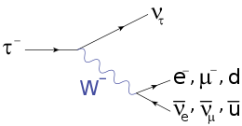
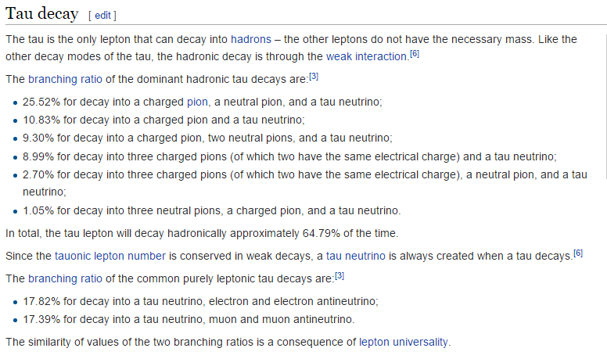

Slide 22
Conservation Laws - Lepton Number
L_{e} L_{μ} L_{τ}
Electron e- +1 0 0
Neutrino (e) ν_{e} +1 0 0
Muon μ- 0 +1 0
Neutrino (μ) ν_{μ} 0 +1 0
Tau τ- 0 0 +1
Neutrino (τ) ν_{τ} 0 0 +1
Beta Decay:
Emission of an electron neutrino allowed L_{e} to be conserved:
⁶⁰₂₇Co ⁶⁰₂₈Ni + β- + ν_{e}
¹³₇N ¹³₆C + β+ + ν_{e}

Slide 23
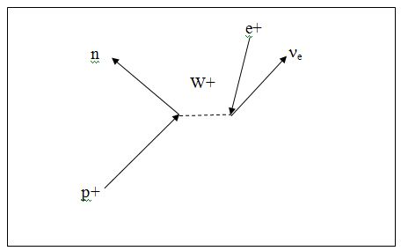
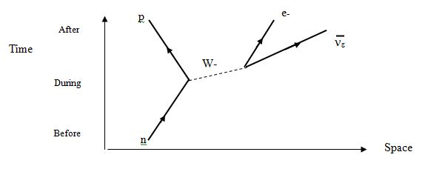

Slide 24
Whiteboards:
Is the Decay Possible?
1-5

Slide 25
Does this decay occur?
μ⁻ ---> e⁻ + ν_{e}
q
L_{e}
L_{μ}
L_{τ}
M/E
L_{e} L_{μ} L_{τ}
Electron e- +1 0 0
Neutrino (e) ν_{e} +1 0 0
Muon μ- 0 +1 0
Neutrino (μ) ν_{μ} 0 +1 0
Tau τ- 0 0 +1
Neutrino (τ) ν_{τ} 0 0 +1
Charge is conserved
L_{e}: 0 = 1 + -1
L_{μ}: 1 ≠ 0 + 0
L_{μ} is not conserved

Slide 26
Does this decay occur?
μ⁻ ---> e⁻ + ν_{e} + ν_{μ}
q
L_{e}
L_{μ}
L_{τ}
M/E
L_{e} L_{μ} L_{τ}
Electron e- +1 0 0
Neutrino (e) ν_{e} +1 0 0
Muon μ- 0 +1 0
Neutrino (μ) ν_{μ} 0 +1 0
Tau τ- 0 0 +1
Neutrino (τ) ν_{τ} 0 0 +1
Charge is conserved
L_{e}: 0 = 1 + -1 + 0
L_{μ}: 1 = 0 + 0 + 1
Yes it occurs

Slide 27
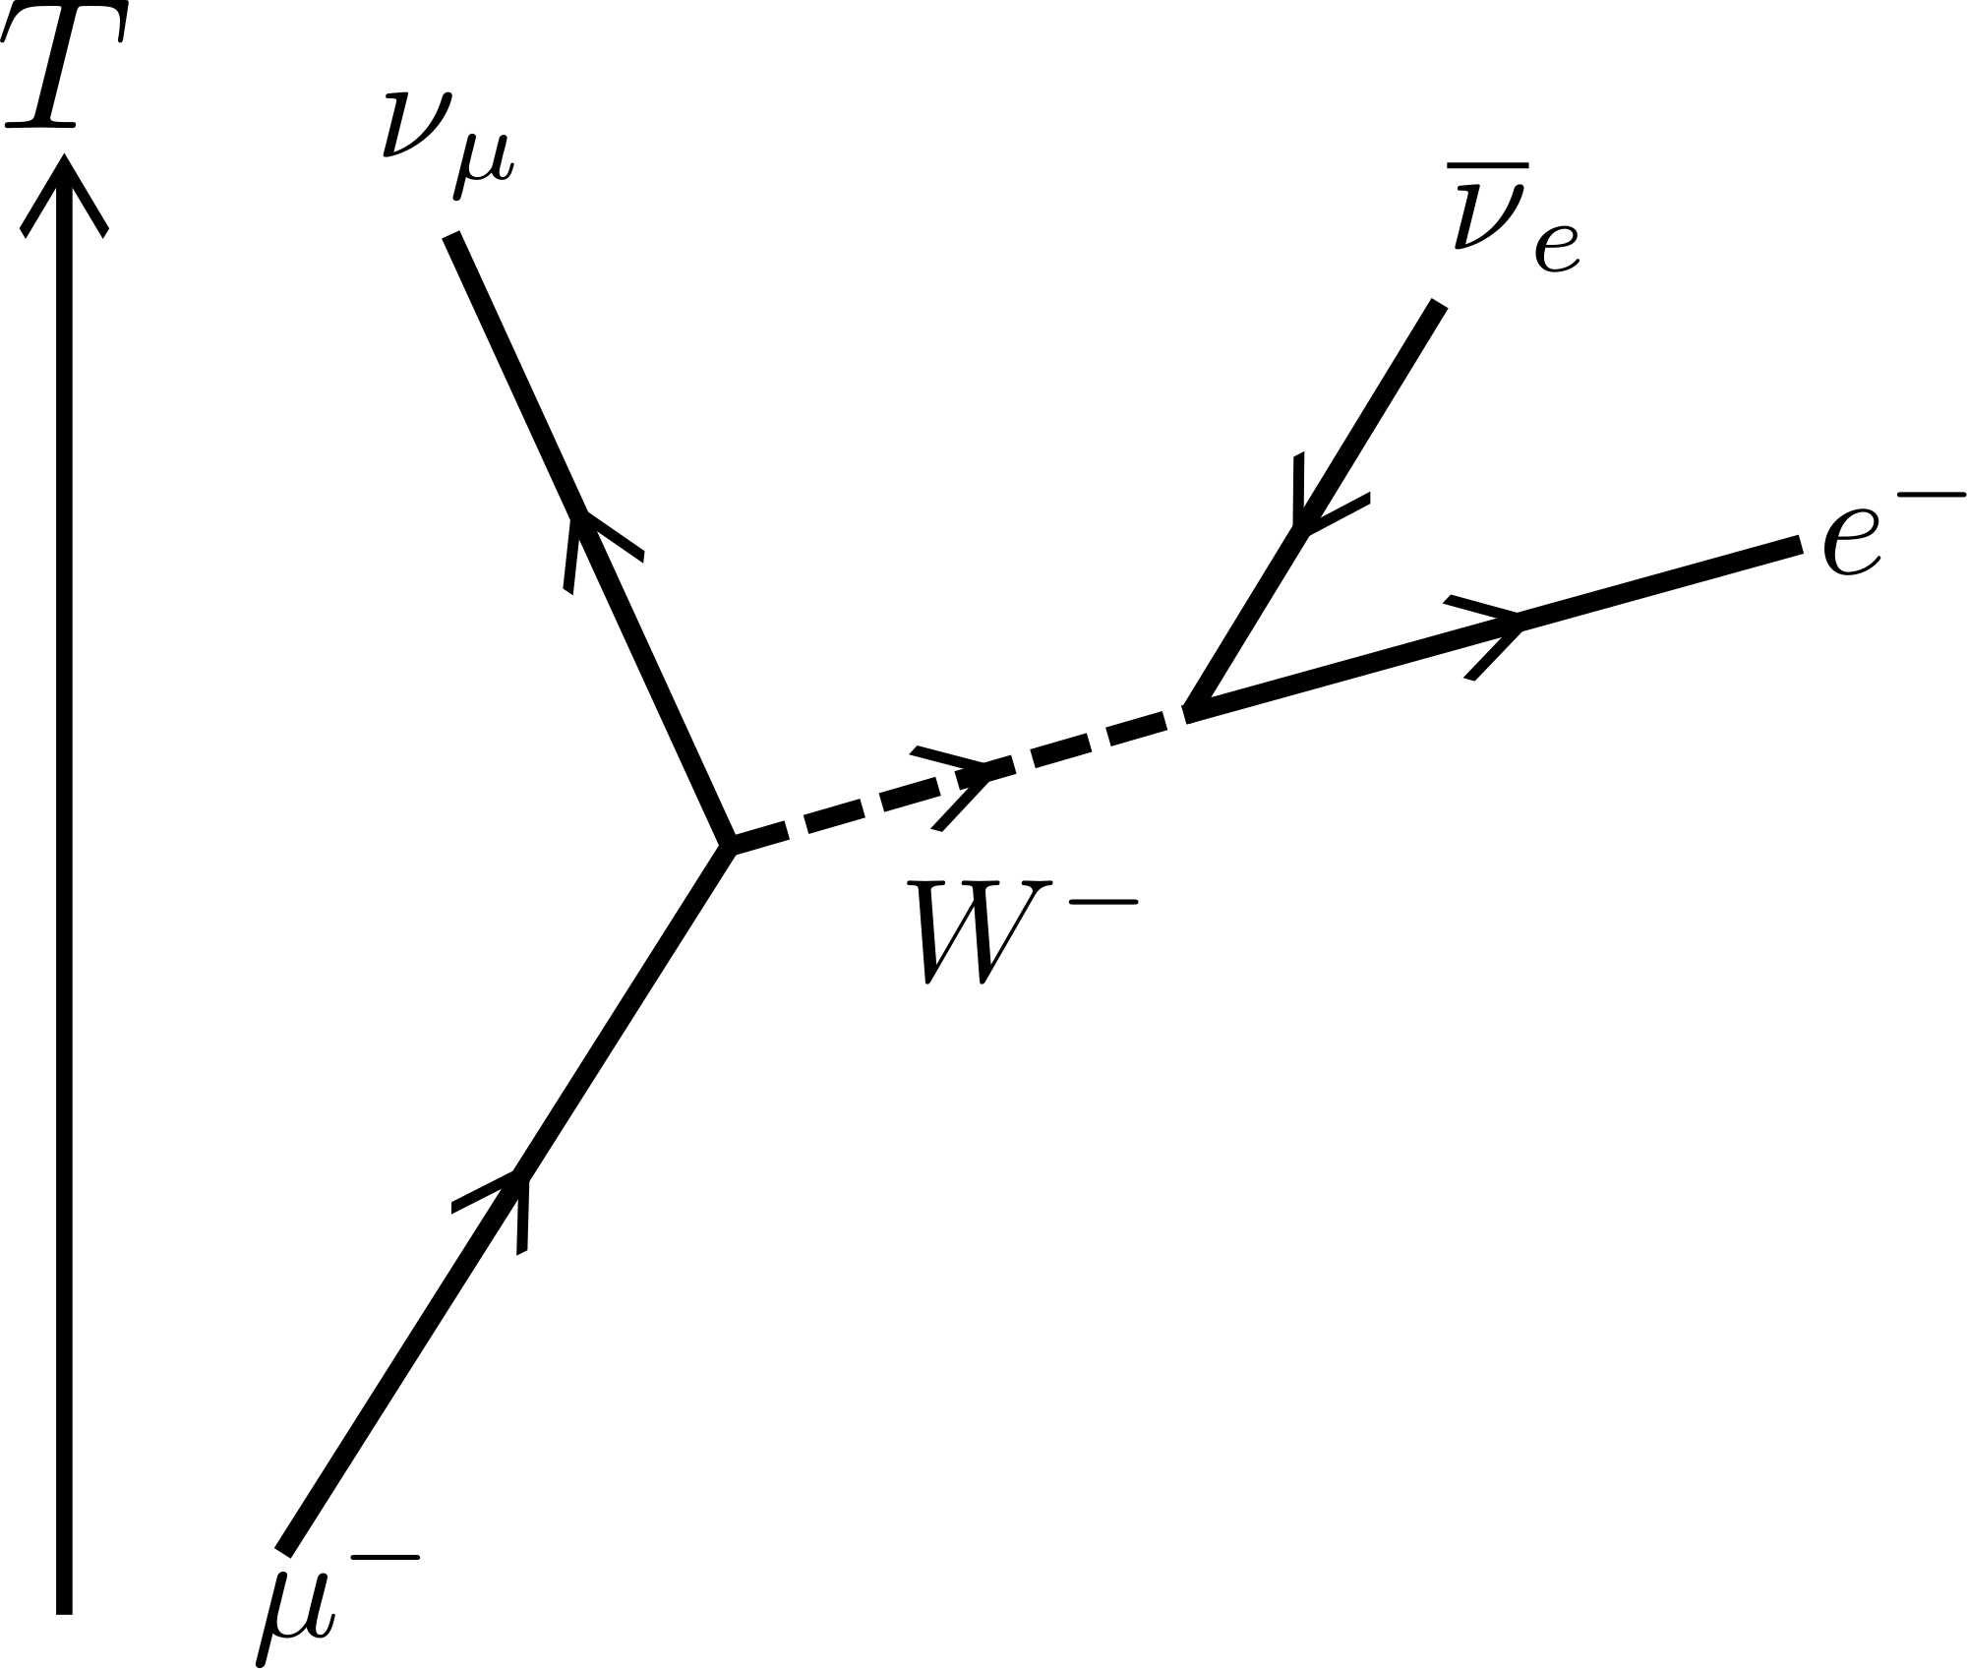
μ⁻ ---> e⁻ + ν_{e} + ν_{μ}

Slide 28
Does this decay occur?
τ⁻ ---> π⁻ + π⁻ + π⁺+ ν_{τ}
q
L_{e}
L_{μ}
L_{τ}
M/E
L_{e} L_{μ} L_{τ}
Electron e- +1 0 0
Neutrino (e) ν_{e} +1 0 0
Muon μ- 0 +1 0
Neutrino (μ) ν_{μ} 0 +1 0
Tau τ- 0 0 +1
Neutrino (τ) ν_{τ} 0 0 +1
Charge is conserved
L_{τ}: 1 = 0 + 0 + 0 + 1
Yes it occurs

Slide 29
Does this decay occur?
μ⁻ ---> ν_{e} + ν_{e} + ν_{μ}
q
L_{e}
L_{μ}
L_{τ}
M/E
L_{e} L_{μ} L_{τ}
Electron e- +1 0 0
Neutrino (e) ν_{e} +1 0 0
Muon μ- 0 +1 0
Neutrino (μ) ν_{μ} 0 +1 0
Tau τ- 0 0 +1
Neutrino (τ) ν_{τ} 0 0 +1
Charge is Not conserved
L_{e}: 0 = 1 + -1 + 0
L_{μ}: 1 = 0 + 0 + 1
Does not occur

Slide 30
Does this decay occur?
μ⁻ ---> τ⁻ + ν_{τ} + ν_{μ}
q
L_{e}
L_{μ}
L_{τ}
M/E
L_{e} L_{μ} L_{τ}
Electron e- +1 0 0
Neutrino (e) ν_{e} +1 0 0
Muon μ- 0 +1 0
Neutrino (μ) ν_{μ} 0 +1 0
Tau τ- 0 0 +1
Neutrino (τ) ν_{τ} 0 0 +1
Charge is conserved
L_{μ}: 1 = 0 + 0 + 1
mass increases
Does not occur

Slide 31
Whiteboards:
Find the missing decay product
1-5

Slide 32
What is the missing decay product?
τ⁻ ---> μ⁻ + ν_{μ} + ???
q
L_{e}
L_{μ}
L_{τ}
L_{e} L_{μ} L_{τ}
Electron e- +1 0 0
Neutrino (e) ν_{e} +1 0 0
Muon μ- 0 +1 0
Neutrino (μ) ν_{μ} 0 +1 0
Tau τ- 0 0 +1
Neutrino (τ) ν_{τ} 0 0 +1
ν_{τ}

Slide 33
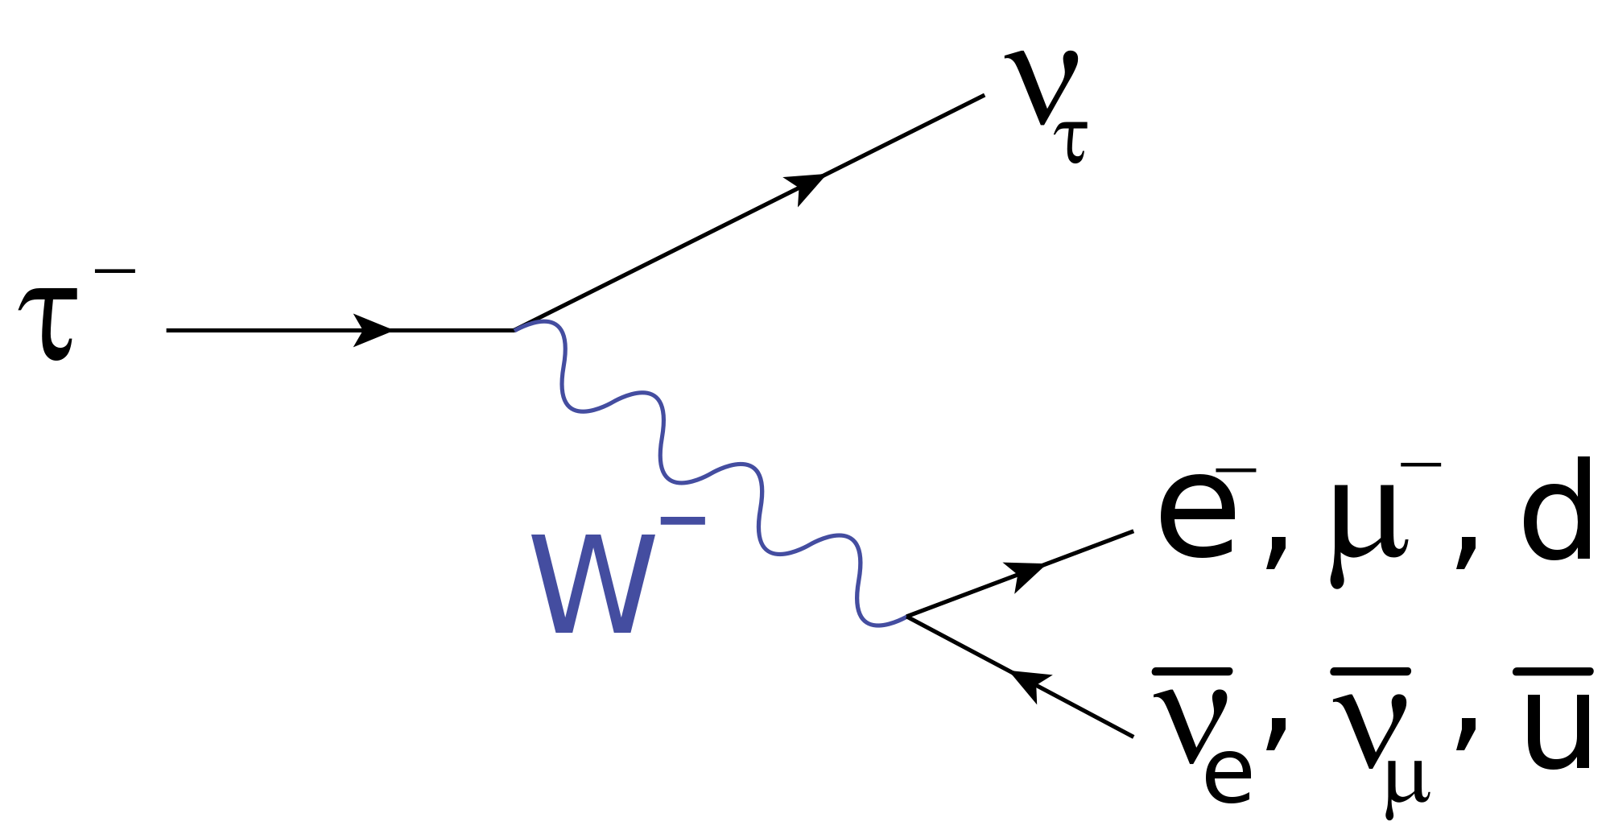

Slide 34
What is the missing decay product?
μ⁺ ---> ?? + ν_{μ} + ν_{e}
q
L_{e}
L_{μ}
L_{τ}
L_{e} L_{μ} L_{τ}
Electron e- +1 0 0
Neutrino (e) ν_{e} +1 0 0
Muon μ- 0 +1 0
Neutrino (μ) ν_{μ} 0 +1 0
Tau τ- 0 0 +1
Neutrino (τ) ν_{τ} 0 0 +1
e+

Slide 35
What is the missing decay product?
τ⁺ ---> μ⁺ + ?? + ν_{τ}
q
L_{e}
L_{μ}
L_{τ}
L_{e} L_{μ} L_{τ}
Electron e- +1 0 0
Neutrino (e) ν_{e} +1 0 0
Muon μ- 0 +1 0
Neutrino (μ) ν_{μ} 0 +1 0
Tau τ- 0 0 +1
Neutrino (τ) ν_{τ} 0 0 +1
ν_{μ}

Slide 36
What is the missing particle?
?? ---> e- + ν_{e} + ν_{μ}
q
L_{e}
L_{μ}
L_{τ}
L_{e} L_{μ} L_{τ}
Electron e- +1 0 0
Neutrino (e) ν_{e} +1 0 0
Muon μ- 0 +1 0
Neutrino (μ) ν_{μ} 0 +1 0
Tau τ- 0 0 +1
Neutrino (τ) ν_{τ} 0 0 +1
_{μ-}

Slide 37
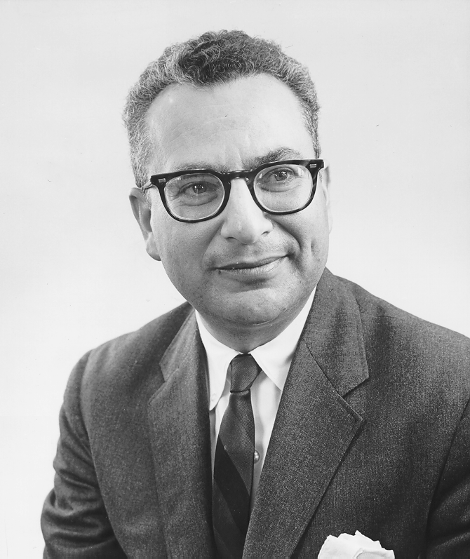
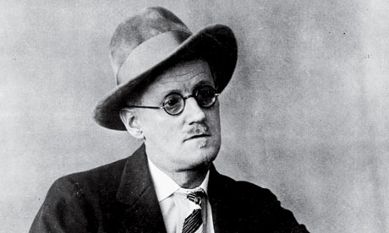
Quark Theory
1960s - Only 4 Leptons, but Hundreds of Hadrons
Leptons seemed elementary/small (<10⁻¹⁸ m)
Not all Hadrons could be elementary – SLAC experiments showed an internal structure
Murray Gell-Mann (b. 1929) suggests that Hadrons are made from quarks.
"three quarks for Muster Mark"
-James Joyce
(Finnegan’s Wake)
Notes:
Murray Gell-Mann thought up the name "quark" by taking it from a line from James Joyce's "Finnegan's Wake" where it says, "three quarks for Muster Mark." Gell-Mann said that initially he didn't know where he got the name, and then he realized where he had heard it. It seemed appropriate since at that time only three quarks, up, down, and strange, were theorized. Gell-Mann also said the line suggested to him, "three quarts for Mister Mark," implying a guy drinking at a pub. James Joyce invented the word "quark" after hearing seagulls cawing. James Joyce got the title "Finnegan's Wake" from a popular Irish folksong of the same name. Since I was little, on St. Patrick's Day, we would listen to Irish records, one of which had that song. I first heard the word "quarks" when I was in the 5th grade, watching Carl Sagan's "Cosmos." At the time, I never imagined a connection between those two things.

Slide 38
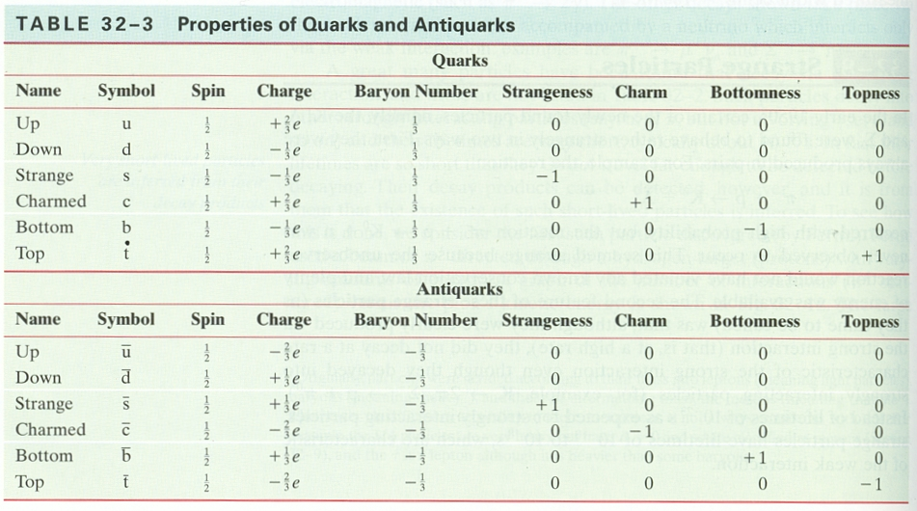
12 total particles/anti-quarks are opposite
Fractional charge
Baryons vs Mesons
Held together by gluons – what happens when you separate
Notes:
Murray Gell-Mann thought up the name "quark" by taking it from a line from James Joyce's "Finnegan's Wake" where it says, "three quarks for Muster Mark." Gell-Mann said that initially he didn't know where he got the name, and then he realized where he had heard it. It seemed appropriate since at that time only three quarks, up, down, and strange, were theorized. Gell-Mann also said the line suggested to him, "three quarts for Mister Mark," implying a guy drinking at a pub. James Joyce invented the word "quark" after hearing seagulls cawing. James Joyce got the title "Finnegan's Wake" from a popular Irish folksong of the same name. Since I was little, on St. Patrick's Day, we would listen to Irish records, one of which had that song. I first heard the word "quarks" when I was in the 5th grade, watching Carl Sagan's "Cosmos." At the time, I never imagined a connection between those two things.

Slide 40
Quark Theory
Proton: +1 charge, B = 1
Neutron: 0 charge, B = 1
π⁺: +1 charge, B = 0
π-: -1 charge, B = 0
K-: -1 charge, B = 0
You should memorize the composition of n and p,
You will always be given meson compositions
Notes:
Murray Gell-Mann thought up the name "quark" by taking it from a line from James Joyce's "Finnegan's Wake" where it says, "three quarks for Muster Mark." Gell-Mann said that initially he didn't know where he got the name, and then he realized where he had heard it. It seemed appropriate since at that time only three quarks, up, down, and strange, were theorized. Gell-Mann also said the line suggested to him, "three quarts for Mister Mark," implying a guy drinking at a pub. James Joyce invented the word "quark" after hearing seagulls cawing. James Joyce got the title "Finnegan's Wake" from a popular Irish folksong of the same name. Since I was little, on St. Patrick's Day, we would listen to Irish records, one of which had that song. I first heard the word "quarks" when I was in the 5th grade, watching Carl Sagan's "Cosmos." At the time, I never imagined a connection between those two things.

Slide 41
What are the properties of the following Baryons:
q s c b
udd
uud
udb
ddc

Slide 42
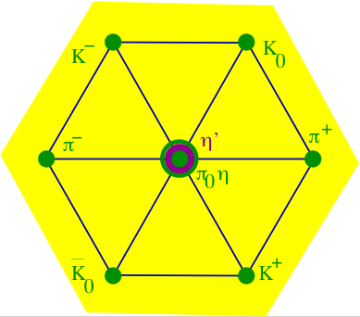
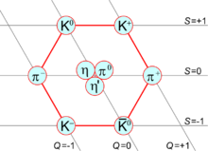
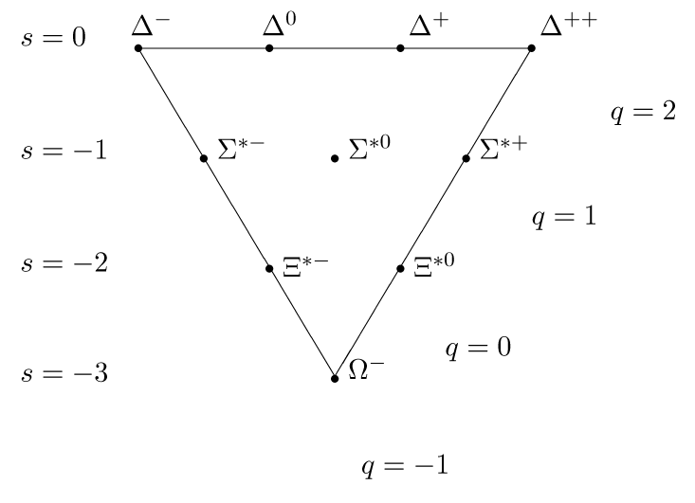
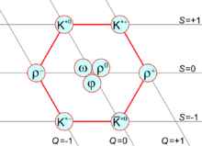

Slide 43
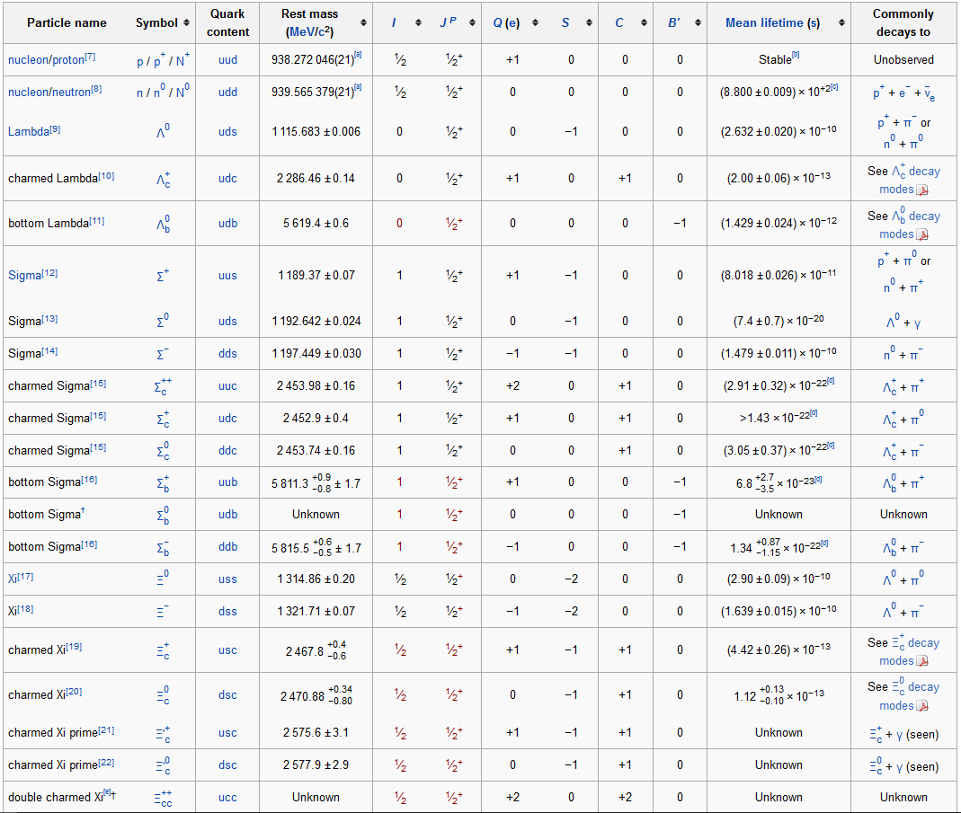

Slide 44
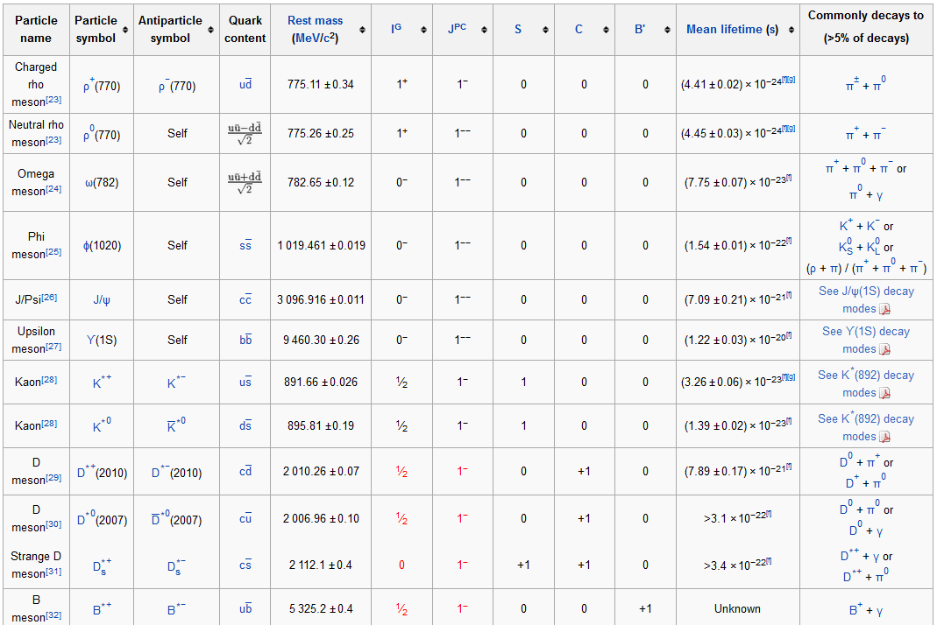
Mesons are quark anti-quark pairs

Slide 45
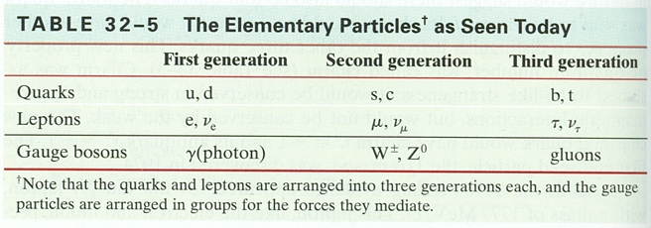
Truly Fundamental particles
Generally accepted fundamental particles
Three generations
Top quark = 200 GeV/c²
Higgs Boson…
Notes:
Murray Gell-Mann thought up the name "quark" by taking it from a line from James Joyce's "Finnegan's Wake" where it says, "three quarks for Muster Mark." Gell-Mann said that initially he didn't know where he got the name, and then he realized where he had heard it. It seemed appropriate since at that time only three quarks, up, down, and strange, were theorized. Gell-Mann also said the line suggested to him, "three quarts for Mister Mark," implying a guy drinking at a pub. James Joyce invented the word "quark" after hearing seagulls cawing. James Joyce got the title "Finnegan's Wake" from a popular Irish folksong of the same name. Since I was little, on St. Patrick's Day, we would listen to Irish records, one of which had that song. I first heard the word "quarks" when I was in the 5th grade, watching Carl Sagan's "Cosmos." At the time, I never imagined a connection between those two things.

