Slide 1
Particle Physics Part 1
"three quarks for Muster Mark"
-James Joyce
(Finnegan’s Wake)
Contents:
Particle Accelerators
Quantum Electrodynamics and Feynman diagrams
The Yukawa Particle
Particles and Antiparticles
Types of Particles

Slide 2
Particle Accelerators
Basic concept - Vq = ¹/₂mv²
Provide energy for nuclear reactions
Create particles from energy (E = mc²)
Experiments
+150,000 V
Vacuum
Proton Source
Beam Steering
(RevereWare)

Slide 3
Particle discoveries:
1877: Electron – JJ Thomson and “Cathode Rays” (they have charge)
1930: Bothe and Becke eject a neutron by bombarding beryllium with alphas
1932: Anderson detects Positron in cosmic ray collisions. (Predicted to exist by Dirac)
1936: Anderson detects the Muon in a cosmic ray collision
1955: Anti protons created with 6 GeV protons:
p + p → p + p + p +

Slide 4
SLAC - electron accelerator
Potential switches
50 GeV - mass?

Slide 5
Cyclo/Synchro-trons
In a magnetic field to curve path/radius
Potential switches
Mass dilates as v->c
Synchrotrons - Fermilab(1.0 km), CERN (8.5 km)

Slide 6
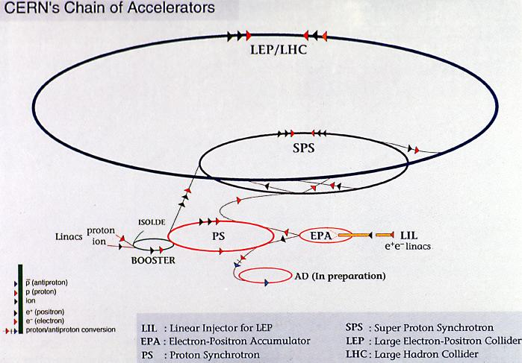
8.5 km in diameter

Slide 7
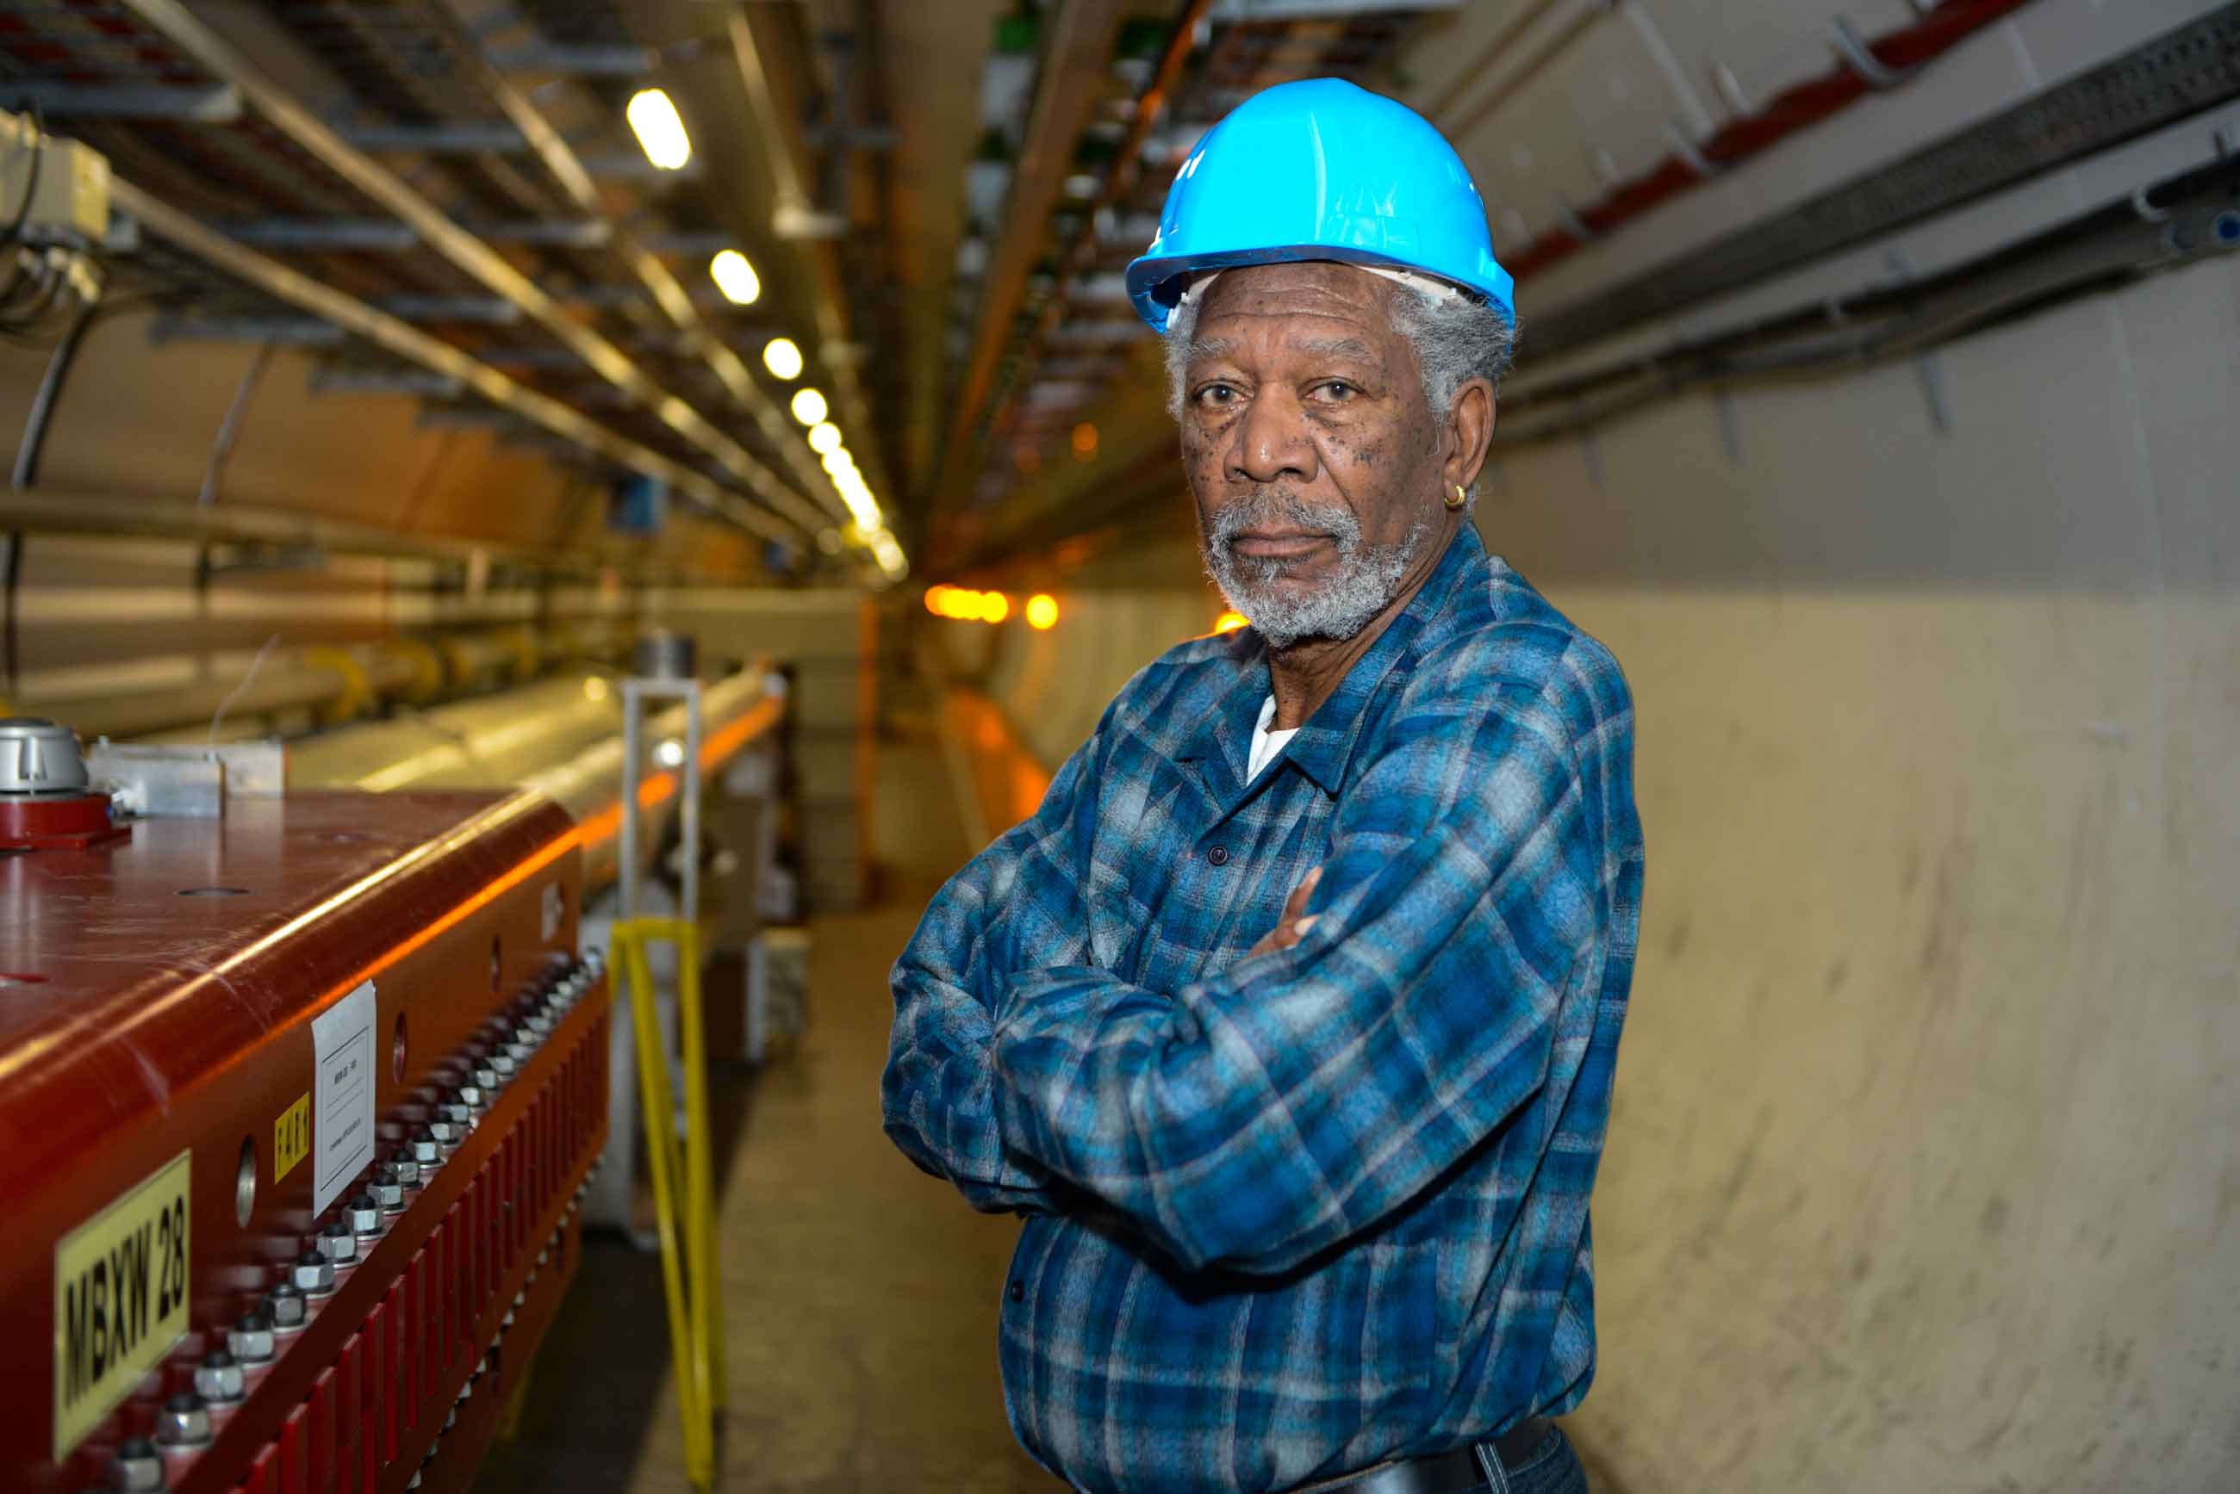
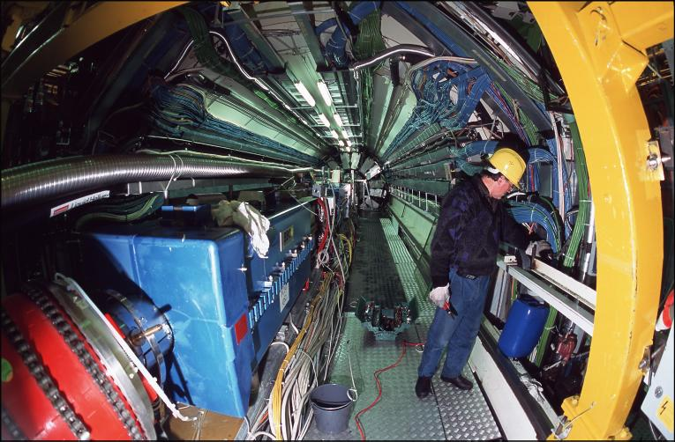

Slide 8
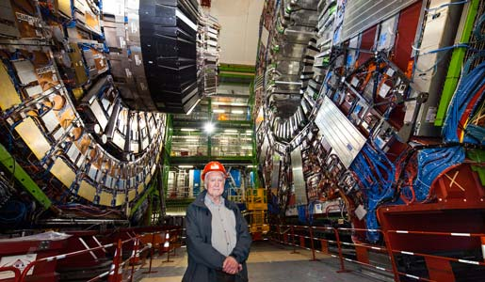
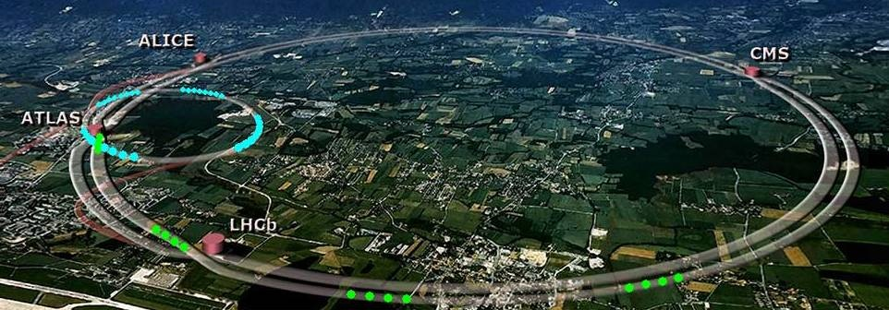
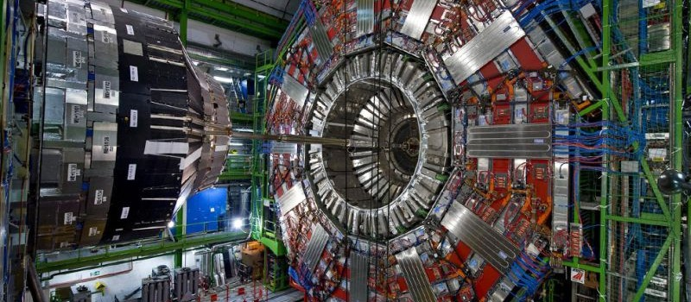

Slide 9
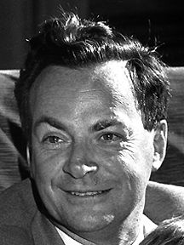
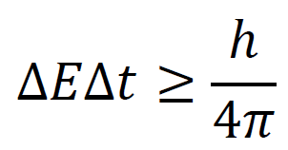
Quantum Electrodynamics
Coulomb’s law - Force fields
Richard Feynman - EM forces are mediated by photons:
Richard Feynman
1918-1988
Time
Feynman Diagram
Virtual photons: large E vs small
Charge is the ability to generate virtual photons
Exist for so short a time - never detected
QED reason for accelerating charges radiating

Slide 10
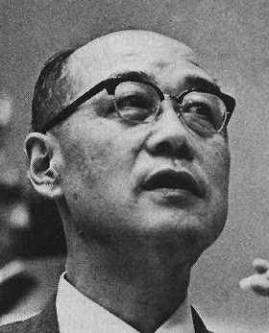
The Yukawa Particle
Photons mediate the EM force
Yukawa proposes a particle to mediate strong nuclear force
Hideki Yukawa
1907-1981
He names it the meson - (between electron and proton)
ΔEΔt = ΔE(^{d}/_{c}) = ^{h}/_{4π}
ΔE ≈ 130 MeV

Slide 11
The Yukawa Particle
Muon discovered in cosmic radiation
m = 106 MeV - doesn’t interact (not it)
The pi meson (pion) is discovered in 1947 in cosmic rays (3 charge states):
π⁺ - 139.6 MeV/c²
πº - 135.0 MeV/c²
π⁻ - 139.6 MeV/c²
p + p --> p + p + πº
p + p --> p + n + π⁺
(conservation of charge)
Hideki Yukawa
1907-1981

Slide 12
The Four Forces of Nature
Type
Strong Nuclear
Electromagnetic
Weak Nuclear
Gravitational
Relative Strength
1
10⁻²
10⁻⁶
10⁻³⁸
Field Particle
Gluons (pions)
Photon (γ)
W⁺ and Zº
Graviton?

Slide 13
Particles and Antiparticles
Name Particle Antiparticle
Electron e⁻ e⁺
Proton p p
Pion π⁺ π⁻
Some particles have no antiparticle (They are their own anti particle)
+ and - are electron charges
Two different notations…
When particle meets antiparticle - annihilation (rest mass + E_{k} turns to energy or other particles)

Slide 14
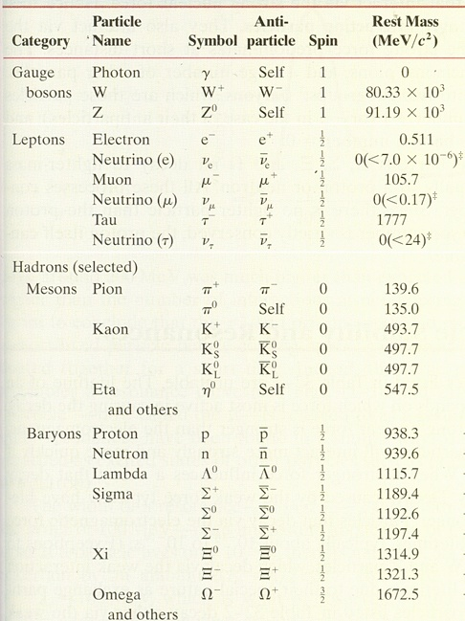
Selected list (there are hundreds of hadrons)
Self as antiparticle…
+ and - are electron charges….
Types of Particles
Gauge Bosons - carry the electro-weak force
Leptons - interact via weak and EM (charged) force
Hadrons - interact via strong nuclear force
Mesons (quark/anti quark pairs)
Baryons (three quarks)

