Slide 1
Absence 12-18-2020

Slide 3
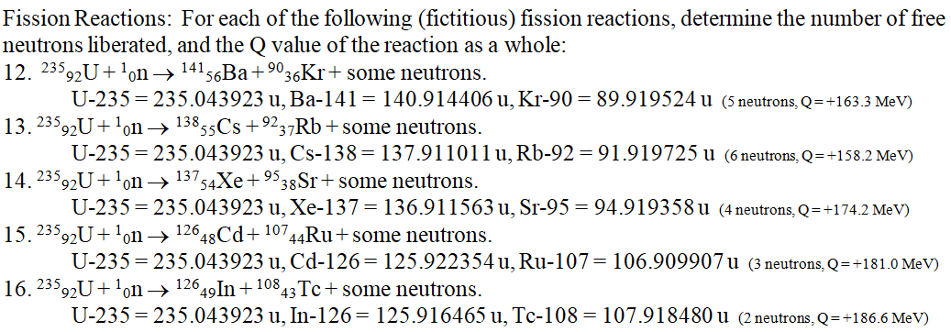

Slide 4
