Slide 1
Formative Assessment

Slide 2
1 u = 1.6605E-27 kg = 931.5 MeV, ¹₁H = 1.007825 u, ¹₀n = 1.008665 u
1. What is the binding energy and the binding energy per nucleon of Ca-44? (381.0 MeV, 8.658 MeV/nucleon)

Slide 3
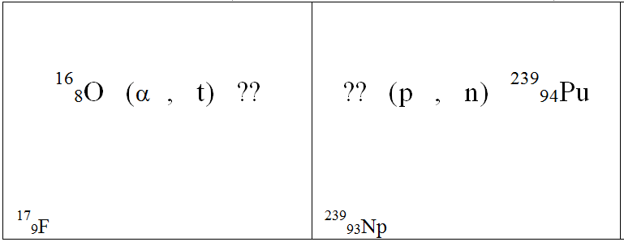
2. Fill in the table (not all these reactions occur)

Slide 4
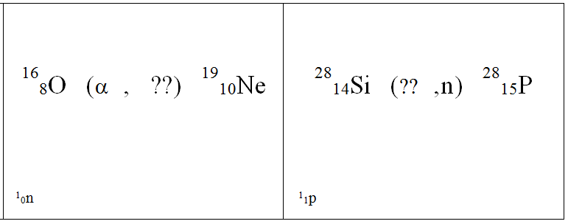
2. Fill in the table (not all these reactions occur)

Slide 5
3. Find the Q value for this nuclear reaction: ⁷₃Li(t,n)⁹₄Be. Label the reaction as either energy requiring (endoergic) or energy releasing (exoergic) (you will have to look up the masses in the table...) (Exoergic Q = +10.44 MeV)

Slide 6
4-5: Consider this fission reaction:
²³⁵₉₂U + ¹₀n → ¹⁴⁸₅₇La + ⁸⁵₃₅Br + some neutrons
U-235 = 235.043923 u, La-148 = 147.932191 u, Br-85 = 84.915608 u (These masses will be given to you here)
4. How many neutrons are released? (3)
5. What is the Q value for this reaction? (166.5 MeV - your answer should have 4 sig figs)

Slide 7
question

