Slide 1
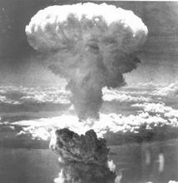
Nuclear Stability
Contents:
The curve of binding energy
Forces in the nucleus
Protons vs. neutrons

Slide 2
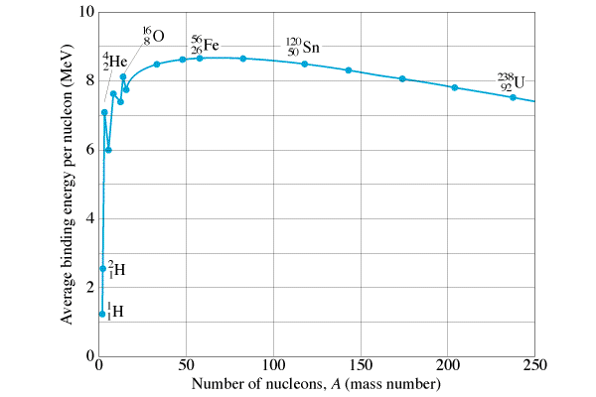
The curve of binding energy
Binding energy per nucleon
Going to more tightly bound releases energy
Fission - splitting nuclei
Fusion - joining nuclei
Most tightly bound
Fission releases energy
Fusion releases energy

Slide 3
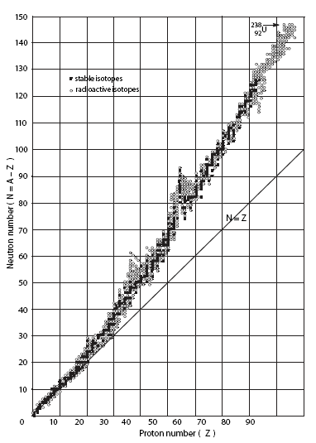
Nuclear Stability
Coulombic force tries to tear apart nucleus
Strong Nuclear force holds it together (force between nucleons)
Strong Nuclear is very short range
As nucleus gets bigger
Strong nuclear gets weaker
Coulombic gets stronger
n
p
p
p
n
n
p
Neutrons add strong force, don’t repel
Trend with heavier elements
At some point neutrons don’t cut it
The crazy man at UMn

Slide 4
Nuclear Stability
Where β- and β+ occur
Where α occurs
Weird patterns:
Even numbers are more stable
50% both are even
only 5 have both odd
p# or n# = 2, 8, 20, 28, 50, 82, 126
strangely stable
abundant in the universe
n
p
p
p
n
n
p

Slide 5
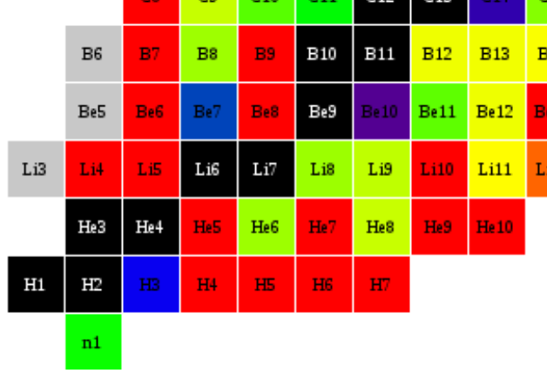
Big Bang Nucleosynthesis:
No stable A = 5, or 8
Big bang created H and He
Stars create up to Fe and Ni
Supernovae create heavier

