Slide 1
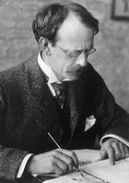
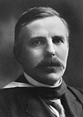
Early Models of the Atom
Contents:
J. J. Thomson
The electron
Plum pudding model of the atom
Rutherford
Gold foil experiment
Nucleus model
Solving closest approach problems
Whiteboard

Slide 2
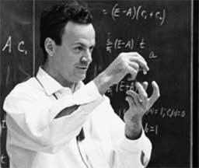
Richard Feynman:
“If, in some cataclysm, all of scientific knowledge were to be destroyed, and only one sentence passed on to the next generation of creatures, what statement would contain the most information in the fewest words? I believe it is the atomic hypothesis that all things are made of atoms — little particles that move around in perpetual motion, attracting each other when they are a little distance apart, but repelling upon being squeezed into one another. In that one sentence, you will see, there is an enormous amount of information about the world, if just a little imagination and thinking are applied.”

Slide 3
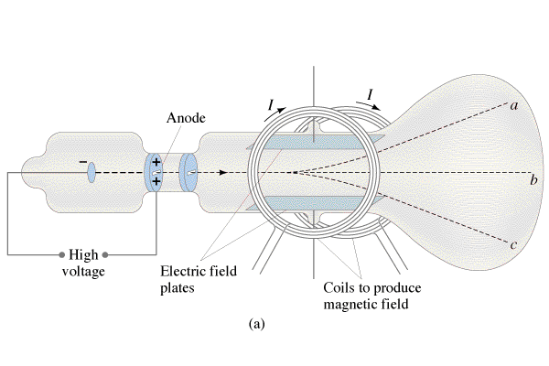
J.J. Thomson 1856 - 1940
Discovers the electron
e/m ratio
“Plum Pudding” model

Slide 4
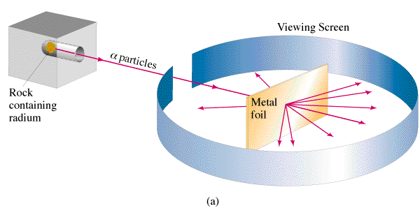
Ernest Rutherford (1871-1937)
Scattering of α (an α is 2p2n – He nucleus)
surprising results:

Slide 5
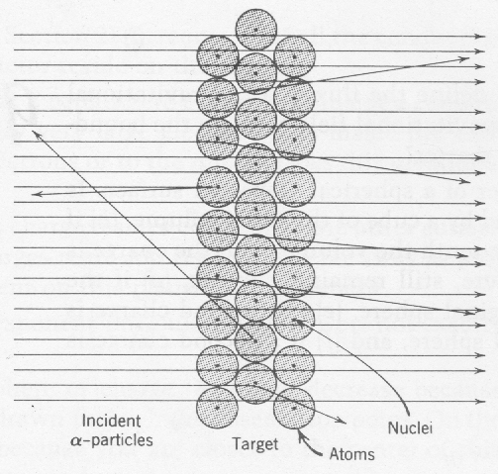
Most Alphas are not deflected much
More deflection closer to nuclei

Slide 6
Ernest Rutherford (1837-1937)
Rutherford’s atom:
(It has a nucleus)
But is also has problems:
Why doesn’t the electron radiate energy?
How does this explain the spectral lines they had been observing?
I won’t Bohr you with the solution to this right now…
Size of atoms – you can see E-4 m
cm, mm, .1 mm, 100 papers, 1m paper
100 m paper,
Notes:
You can see cm, mm even .1 mm on a meter stick and that’s about it. So the smallest thing visible to you is about 1E-4 m, and atoms are about a million times smaller than that. So to picture that, know that a 1 cm stack of paper is 100 sheets, so a meter stack is 10,000 sheets, and therefore a 100 m stack would be a million sheets of paper. so one in a million is one sheet of paper compared to a stack 100 m tall.
If the atom is as wide as a soccer field, the nucleus is 1 mm wide.

Slide 7
Nuclear Radius
R - Nuclear radius (m)
R_{o} - Fermi Radius (1.20x10⁻¹⁵ m)
A - Mass # (#p +#n)
Example 1: What is the radius of a Uranium 235 nucleus? (A = 235)

Slide 8
Solving closest approach
r
Q_{p}
Q_{N}
Example 2: What is the closest approach of an alpha particle
(m = 6.644x10⁻²⁷ kg) going 2.6 x 10⁶ m/s if it approaches a carbon nucleus head on?

Slide 9
Solving closest approach
r
Q_{p}
Q_{N}
Example 3: Through what potential must you accelerate an alpha particle to penetrate a Uranium-235 (Z = 92) nucleus? (r = 7.4 fm)
(1 fm = 1x10⁻¹⁵ m)
PE
r

Slide 10
Solving closest approach
E_{k} = ¹/₂mv²
V = W/q, W = Vq
V = kq/r
Vq_{p} = ¹/₂mv²
kinetic = potential
¹/₂mv² = q_{p}(kq_{N}/r)
r
Q_{p}
Q_{N}
Example 2: What is the closest approach of an alpha particle (m = 6.644x10⁻²⁷ kg) going 2.6 x 10⁶ m/s if it approaches a carbon nucleus head on?
E_{k} = ¹/₂mv² = ¹/₂ (6.644x10⁻²⁷ kg)(2.6 x 10⁶ m/s)²
= 2.24567E-14 J
PE = Q_{p}(kQ_{N}/r), r = Q_{p}(kQ_{N}/PE) =
(2x1.602E-19)(8.99E9)(6x1.602E-19)/(2.24567E-14 J) =
1.23288E-13 m from center of the nucleus

Slide 11
Solving closest approach
E_{k} = ¹/₂mv²
V = W/q, W = Vq
V = kq/r
Vq_{p} = ¹/₂mv²
kinetic = potential
¹/₂mv² = q_{p}(kq_{N}/r)
PE
r
Example 3: Through what potential must you accelerate an alpha particle to penetrate a Uranium (Z = 92) nucleus? (r = 7.4 fm) (1 fm = 1x10⁻¹⁵ m).
Ek = V(2e) = (2e)(kq_{N}/r) so
V = (kq_{N}/r) = (8.99E9)(92*1.602E-19)/(7.4E-15) = 17,905,164.32 V
or about 18 MV

Slide 12
Whiteboards:
Closest Approach and Radius
1-3

Slide 13
What is the closest approach in nm of an Alpha particle going 15,000 m/s to a Gold nucleus. (3)
Mα = 6.644x10⁻²⁷ kg
Z = 79 for Gold
¹/₂mv² = Q_{p}(kQ_{N}/r)
E_{k} = ¹/₂mv² = ¹/₂(6.644E-27)(15000)² = 7.4745E-19 J
E_{k} = (kQ_{N}/r)Q_{α}, r = kQ_{N}Q_{α}/E_{k}
= (8.99E9)(79*1.602E-19)(2*1.602E-19)/(7.4745E-19)
= 4.87708E-08 m = 49 nm
49 nm

Slide 14
What is the radius of a Carbon-12 nucleus?
Mα = 6.644x10⁻²⁷ kg
Z = 79 for Gold
¹/₂mv² = Q_{p}(kQ_{N}/r)
E_{k} = ¹/₂mv² = ¹/₂(6.644E-27)(15000)² = 7.4745E-19 J
E_{k} = (kQ_{N}/r)Q_{α}, r = kQ_{N}Q_{α}/E_{k}
= (8.99E9)(79*1.602E-19)(2*1.602E-19)/(7.4745E-19)
= 4.87708E-08 m = 49 nm
2.75 fm

Slide 15
An Alpha particle’s closest approach brings it to within 47 fm of a Gold nucleus. What is its energy in eV (3)
1 fm = 1x10⁻¹⁵ m
Z = 79
Find V at that distance, the alpha energy is twice that in eV because it has twice the charge of an electron.
V = kQ/r = (8.99E9)(79*1.602E-19)/(47E-15) = 2,420,758.34 V
= 2.42 MV
so
the alpha energy is 4.84 MeV
4.8 MeV

