Slide 1
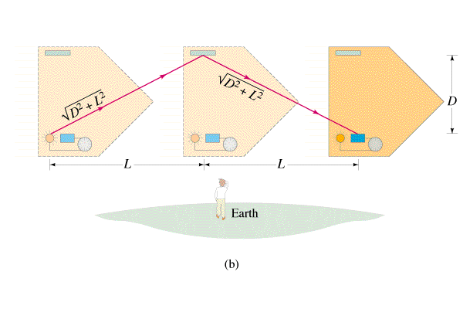
Deriving Time Dilation

Slide 2
Example 1: If you drive by the school at 40.0 m/s, how long do we see your watch take to register 10.0 seconds? What about 40,000. m/s? 0.200 c? 0.500 c?
?, ?, 10.2 s, 11.5 s

Slide 3
Example 2: If we see your watch take 12 seconds to register 10. seconds, how fast are you going?
^{(Show solution for c)}
0.55c

Slide 4
Example 3: Example 3: A car going past us at 0.60 c is 5.0 m long. How long would it be at rest?
6.25 m

Slide 5
Example 4: What is the speed of an electron if it has a mass of 0.634 MeV. (Its rest mass is 0.511 MeV) (What is its kinetic energy? through what potential was it accelerated?)
0.592 c

