Slide 1
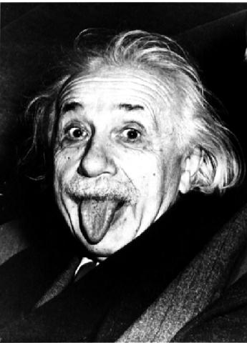
General Relativity

Slide 2
General Relativity
Principle of equivalence:
There is no experiment that will discern the difference between the effect of gravity and the effect of acceleration.
Or…
Gravitational and inertial mass are equivalent

Slide 3
Principle of equivalence:
On Earth:
In space: a = 9.8 m/s/s

Slide 4
Principle of equivalence:
You feel Zero “g”s in free fall

Slide 6
Apparent Curvature of light:
Not accelerating
Accelerating up so fast the lady’s a goner

Slide 7
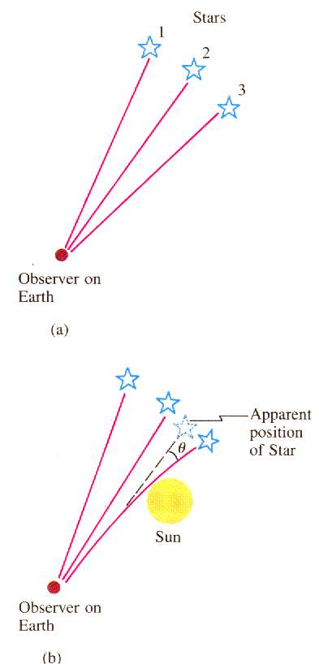
Apparent Curvature of light:
In 1919, Sir Arthur Eddington
Eclipse
Light was bent twice as much as Newton’s theory predicted, supporting General Relativity
Notes:
The sun is too bright normally

Slide 8
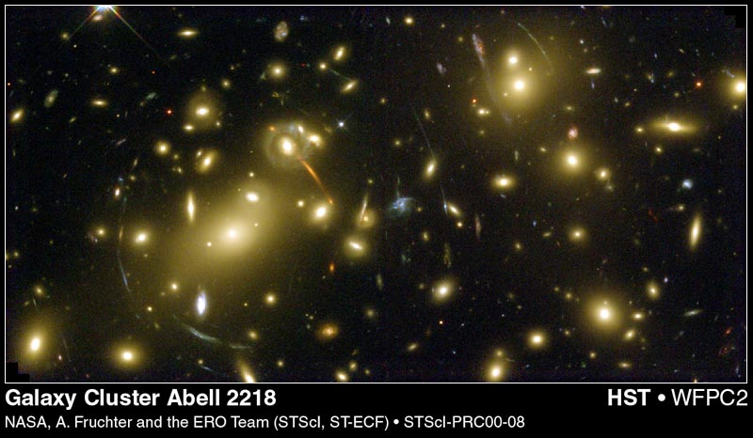
Gravitational Lensing:

Slide 9
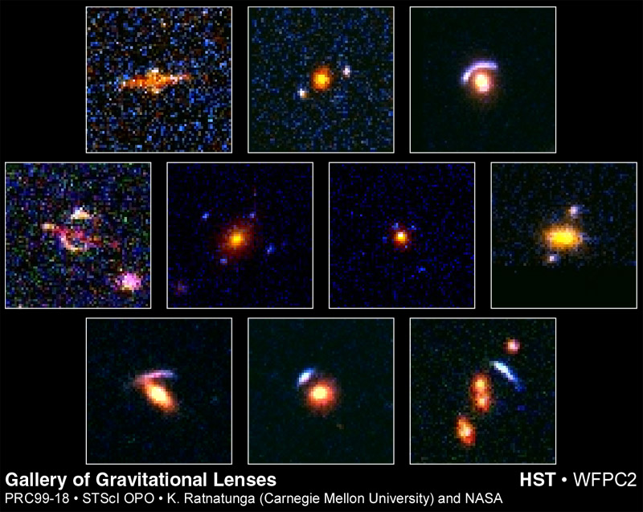
Gravitational Lensing:

Slide 10
Curvature of Space:
Now that you understand that gravity bends light…
Understand that it does not.
Light travels in a straight line.
The space itself near a massive object is curved.
Light is the absolute.
It travels at the speed of light.
It travels in a straight line.
Do not adjust your television set…
Re-adjust your brain.

Slide 11
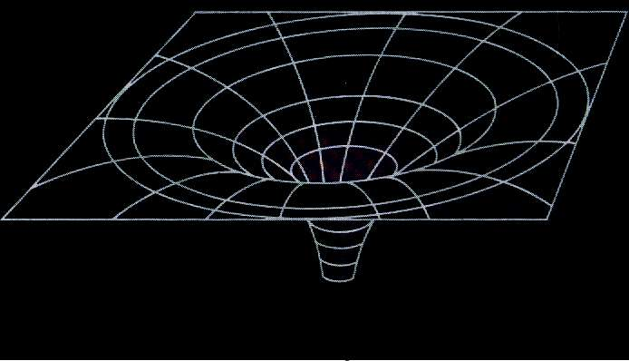
Curvature of Space:
Mass distorts space Analogy for dimensions…

Slide 12
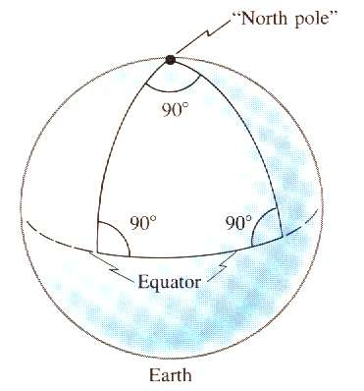
Curvature of Space:
Geometry is Non-Euclidian
Were the sphere large enough…
Riemann and Einstein… (Science itself)

Slide 14
Black Holes:
Light cannot escape…

Slide 15
Black Holes:
Black Holes become so by getting smaller
As r gets smaller, v gets bigger, when v = c it is a black hole
Were the Earth 0.35” in radius it would be a black hole
The sun would be 1.9 miles in radius.
The sun and the earth will never become black holes.
Not all by themselves…

Slide 16
Put this in your notes: What is the maximum radius of a black hole that is 30. million times the mass of the sun?
Msun = 1.99 x 10³⁰ kg
8.8x10¹⁰ m
Notes:
R = 2*6.67E-11*1.44*1.99E30/3E8² = 4247.456 m

Slide 17
What is the mass of a black hole the size of the earth?
r = 6.38 x 10⁶ m
4.3E33 kg
Notes:
M = rc2/(2G) = 6.38E6*3E82/(2*6.67E-11) = 4.3E33 kgc

Slide 19
Clocks and gravitation:
General relativity predicts that clock A will run faster than clock B…
From Feynman Lectures in Physics

Slide 20
Clocks and gravitation:
From Feynman Lectures in Physics

Slide 21
Clocks and gravitation:
Principle of equivalence says gravity must also cause this.
This ->
From Feynman Lectures in Physics

Slide 22
Clocks and gravitation:
Principle of equivalence says gravity must also cause this.
Is the same as
This ->
g = 9.8 m/s/s
From Feynman Lectures in Physics

Slide 23
Clocks and gravitation:
Gravity affects the rate clocks run
High clocks run faster
Low clocks run slower
The twin paradox
Flying in a circle paradox
Red shifted radiation from Quasars

Slide 24
Clocks and gravitation:
Approximate formula for small changes of height:
Δf ₌ gΔh
f c²
Δf - change in frequency
f - original frequency
g - gravitational field strength
Δh - change in height
c - speed of light

Slide 25
Put this in your notes: A radio station at the bottom of a 320 m tall building broadcasts at 93.4 MHz. What is the change in frequency from bottom to top?
What frequency do they tune to at the top?
3.3E-6 Hz lower – basically the same frequency

Slide 26
A radio station at the bottom of a 320 m tall building near a black hole where g = 2.5 x 10¹³ m/s/s broadcasts at 93.4 MHz. What is the change in frequency from bottom to top?
What frequency do they tune to at the top?
8.3x10⁶ Hz, 85.1 MHz

Slide 27
Two trombonists, one at the top of a 215 m tall tower, and one at the bottom play what they think is the same note. The one at the bottom plays a 256.0 Hz frequency, and hears a beat frequency of 5.2 Hz. What is the gravitational field strength?? For us to hear the note in tune, should the top player slide out, or in? (Are they sharp or flat)
8.5 x 10¹² m/s/s, out, sharp

Slide 29
Gravitational Time Dilation
Δt - Dilated time interval
Δt_{o} - Original time interval
R_{s} - Schwarzschild radius
r - Distance that the clock is from the black hole

Slide 30
Put this in your notes: A graduate student is 5.5 km beyond the event horizon of a black hole with a Schwarzschild radius of 9.5 km. If they are waving (in their frame of reference) every 3.2 seconds, how often do we see them waving if we are far away?
5.3 s

Slide 31
A graduate student is in orbit 32.5 km from the center of a black hole. If they have a beacon that flashes every 5.00 seconds, and we (from very far away) see it flashing every 17.2 seconds, what is the Schwarzschild radius of the black hole?
29.8 km

Slide 32
A graduate student is in orbit 316 km from the center of a black hole with a Schwarzschild radius of 186 km.
We (from very far away) see their beacon flashing every 7.8 seconds. How fast do they see it flashing?
5.0 s

