Slide 1
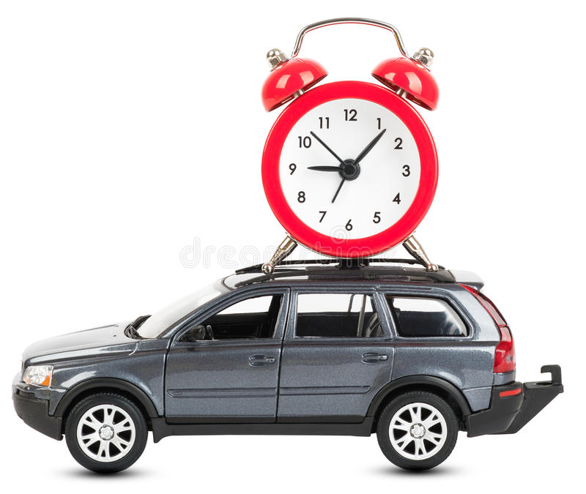
At rest:
Length = 6.0 m
Mass = 2000 kg
Second hand = 1 s
Moving left at 0.866 c
Length = 3.0 m
Mass = 4000 kg
Second hand = 2 s

Slide 2
A 26 cm diameter clock has a mass of 2.0 kg, and it travels horizontally past us at 0.90 c.
a) How has the shape of the clock changed? (calculate its new dimensions)
b) What is the mass of the clock as we observe it?
c) How much time (in our frame of reference) does it take the clock to register 100. seconds?
d) If we see the clock for 1.0 sec (in our reference frame), how much time does the clock tick through?
At high speeds:
Clocks run slower
Length contracts
Mass increases

Slide 3
The height of the clock does not change, but it is only about 11 cm wide now
Its mass is 4.6 kg
It takes 229 s to register 100. seconds.
Since it runs slower, only about 0.44 sec has ticked by on the clock

