Slide 1
The Big Bang
Or…
The Standard Model
Notes:
Fred Hoyle and the term “Big Bang”
While having no argument with the Lemaître theory (later confirmed by Edwin Hubble's observations) that the universe was expanding, Hoyle disagreed on its interpretation. He found the idea that the universe had a beginning to be pseudoscience, resembling arguments for a creator, "for it's an irrational process, and can't be described in scientific terms" (see Kalam cosmological argument).^{[7]} Instead, Hoyle, along with Thomas Gold and Hermann Bondi (with whom he had worked on radar in World War II), argued for the universe as being in a "steady state". The theory tried to explain how the universe could be eternal and essentially unchanging while still having the galaxies we observe moving away from each other. The theory hinged on the creation of matter between galaxies over time, so that even though galaxies get further apart, new ones that develop between them fill the space they leave. The resulting universe is in a "steady state" in the same manner that a flowing river is - the individual water molecules are moving away but the overall river remains the same.
The theory was one alternative to the Big Bang which agreed with key observations of the day, namely Hubble's red shift observations, and Hoyle was a strong critic of the Big Bang. He is responsible for coining the term "Big Bang" on BBC radio's Third Programme broadcast at 1830 GMT on 28 March 1949. It is popularly reported that Hoyle intended this to be pejorative, but the script from which he read aloud shows that he intended the expression to help his listeners.^{[8]} Hoyle explicitly denied that he was being insulting and said it was just a striking image meant to emphasize the difference between the two theories for the radio audience.^{[9]}
Hoyle had a famously heated argument with Martin Ryle of the Cavendish Radio Astronomy Group about Hoyle's steady state theory, which somewhat restricted collaboration between the Cavendish group and the Cambridge Institute of Astronomy during the 1960s.^{[10]}
Hoyle, unlike Gold and Bondi, offered an explanation for the appearance of new matter by postulating the existence of what he dubbed the "creation field", or just the "C-field", which had negative pressure in order to be consistent with the conservation of energy and drive the expansion of the universe. These features of the C-field anticipated the later development of cosmic inflation. They jointly argued that continuous creation was no more inexplicable than the appearance of the entire universe from nothing, although it had to be done on a regular basis. In the end, mounting observational evidence convinced most cosmologists that the steady state model was incorrect and that the Big Bang was the theory that agreed best with observations, although Hoyle continued to support and develop his theory. In 1993, in an attempt to explain some of the evidence against the steady state theory, he presented a modified version called "quasi-steady state cosmology" (QSS), but the theory is not widely accepted.
The evidence that resulted in the Big Bang's victory over the steady state model, at least in the minds of most cosmologists, included the discovery of the cosmic microwave background radiation in the 1960s, the distribution of "young galaxies" and quasars throughout the Universe in the 1980s, a more consistent age estimate of the universe and most recently the observations of the COBE satellite in the 1990s and the Wilkinson Microwave Anisotropy Probe launched in 2001, which showed unevenness in the microwave background in the early universe, which corresponds to currently observed distributions of galaxies. Hoyle died in 2001 never accepting the expanding universe theory.
These energy levels, while needed to produce carbon in large quantities, were statistically very unlikely. Hoyle later wrote:
Would you not say to yourself, "Some super-calculating intellect must have designed the properties of the carbon atom, otherwise the chance of my finding such an atom through the blind forces of nature would be utterly minuscule. A common sense interpretation of the facts suggests that a superintellect has monkeyed with physics, as well as with chemistry and biology, and that there are no blind forces worth speaking about in nature. The numbers one calculates from the facts seem to me so overwhelming as to put this conclusion almost beyond question."
—Fred Hoyle^{[4]}

Slide 2
Precepts of the standard model
The laws of Physics are the same throughout the Universe.
The Universe is expanding
The Universe is isotropic and homogeneous
General relativity works.
The early Universe was hotter than it is today
The Universe is evolving.
The cosmological principle.

Slide 3
A bit of history...
1916 Einstein’s General relativity predicts that the Universe is either expanding or contracting
1920s Hubble discovers the expansion of the Universe.
1940s Gamow et al work on a Big Bang model:
If space is expanding, then it was once small
If it was small, it was hot. (Adiabatic expansion cools)
If it was once hot, it should be a little warm now.

Slide 4
A bit of history...
They (Gamow) predicted that we should still be able to see radiation from the young Universe. (This is known as the cosmic microwave background radiation or CMBR)
The radiation should have a Wien temperature of about 5 K
Display a black body curve
Be the same in all directions
Nobody paid any attention to these predictions

Slide 5
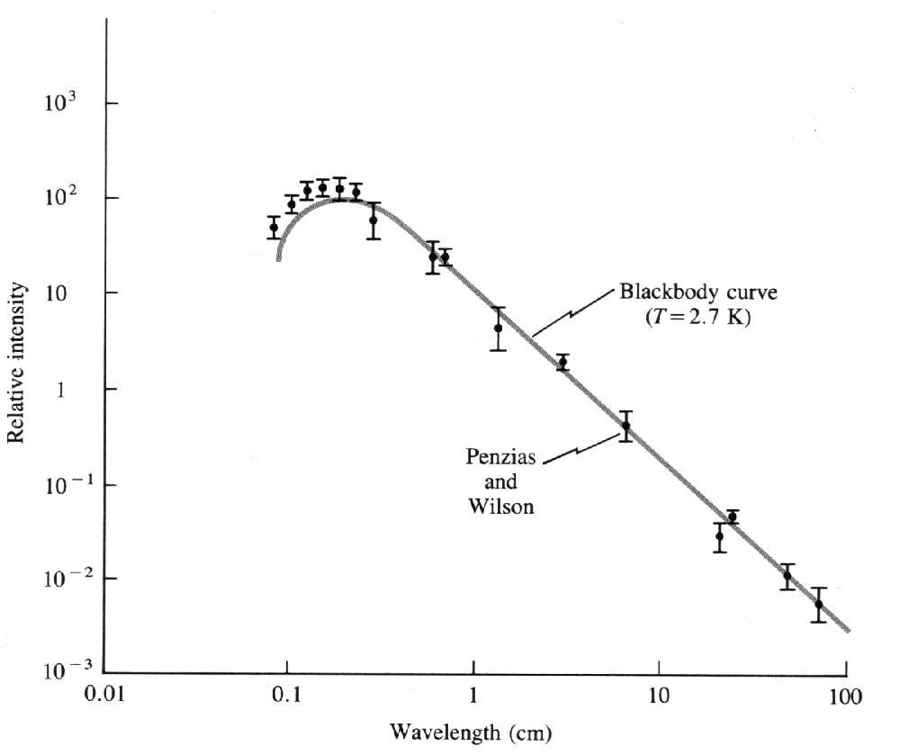
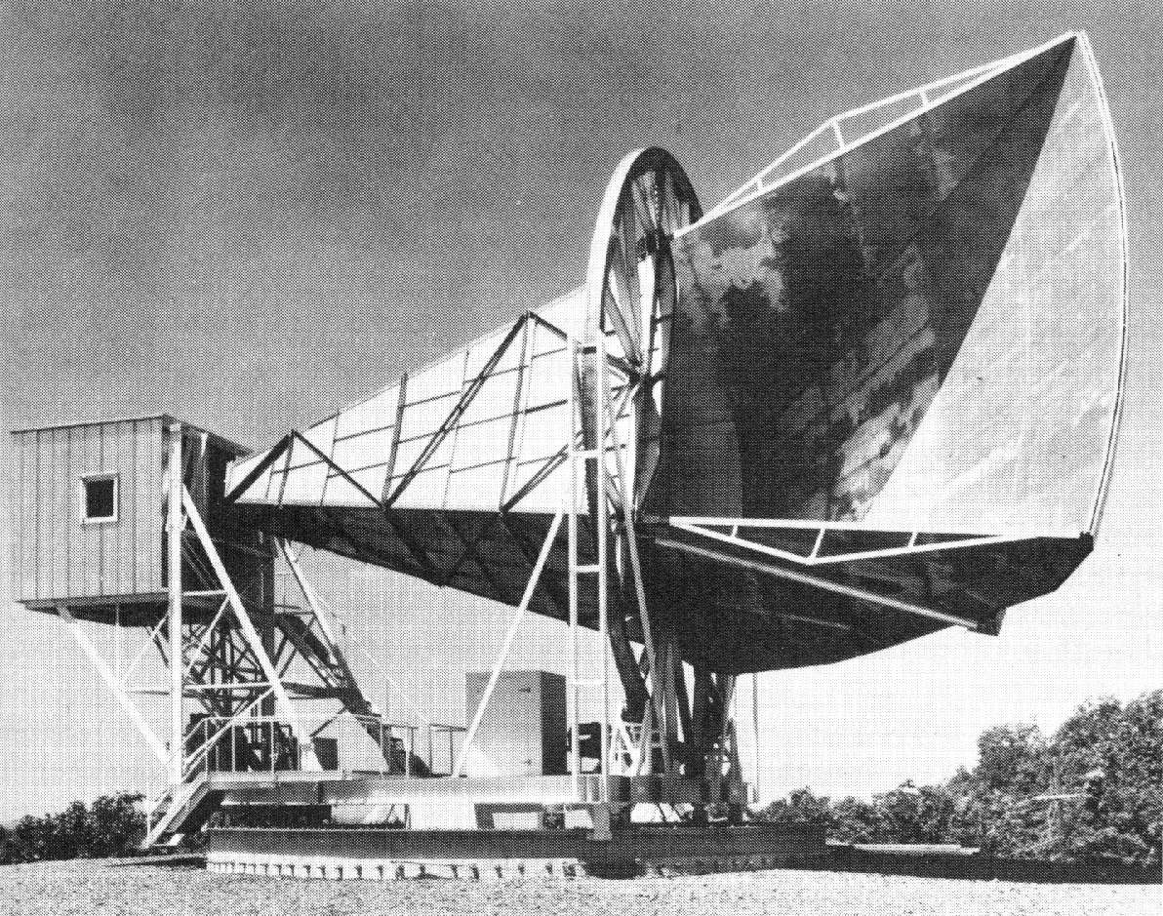
A bit of history...
1965 Arno Penzias and Richard Wilson are having “noise” problems with their radio telescope:
7.35 cm radiation is everywhere.
At first they think it is their equipment
But it’s coming from “out there”

Slide 6
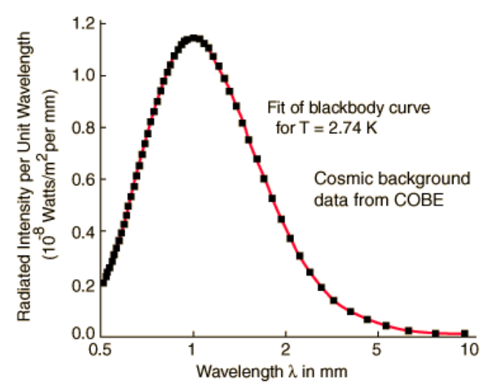
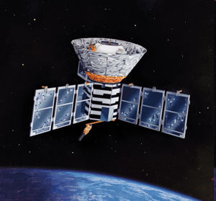
A bit of history...
1989 The Cosmic Background Explorer (COBE) spacecraft measures the CMBR.
The radiation is isotropic
It has a Wien temperature of 2.736 K
It is exactly black body as predicted by the big bang: (error bars, put λmax in notes)

Slide 7
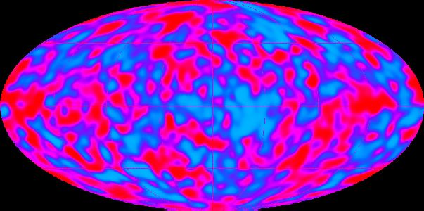
A bit of history...
1992 The Cosmic Background Explorer (COBE) measures miniscule fluctuations (anisotropies) in the CMBR.
The anisotropies are exactly what the big bang model predicts from the Heisenberg uncertainty of the early Universe: - (Smoot and the “eye of God”)

Slide 8
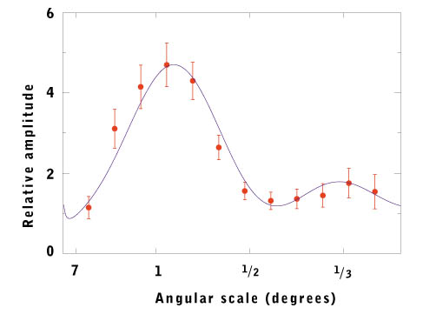
A bit of history...
Spherical Harmonics. - the ringing of the universe
Spring 2000, Boomerang measures primordial sound waves:

Slide 9
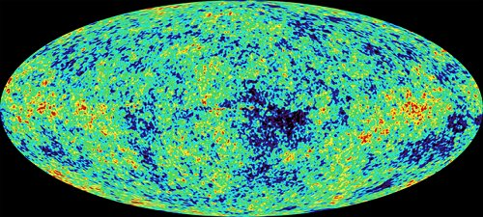
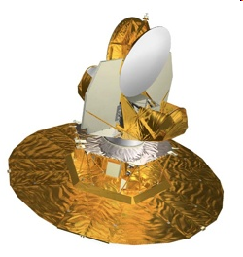
As of 2003/6 The WMAP Probe:
1) the universe was 13.7 billion years old, plus or minus about 200 million years,
2) it is composed of 4% matter, 22% dark matter, and 74% dark energy (later)
3) the Hubble Constant is 71.0(km/sec)/MPc +/- 2.5, not 50 or 100 as some researchers had suggested, and
4) the universe is flat (similar to what the BOOMERANG craft had seen).
Notes:
Hubble's law is the name for the astronomical observation in physical cosmology first made by American astronomer Edwin Hubble, that: (1) all objects observed in deep space (interstellar space) are found to have a doppler shift observable relative velocity to Earth, and to each other; and (2) that this doppler-shift measured velocity, of various galaxies receding from the Earth is proportional to their distance from the Earth and all other interstellar bodies. In effect, the space-time volume of the observable universe is expanding (from a smaller past to a larger future); and Hubble's law is the direct physical observation of this process, as it unfolds.[1] The law was first derived from the General Relativity equations byGeorges Lemaître in 1927.[2] Edwin Hubble derived it empirically in 1929[3] after nearly a decade of observations. The recession velocity of the objects was inferred from their redshifts, many measured earlier by Vesto Slipher (1917) and related to velocity by him.[4] It is considered the first observational basis for the expanding space paradigm and today serves as one of the pieces of evidence most often cited in support of theBig Bang model.
The law is often expressed by the equation v = H0D, with H0 the constant of proportionality (the Hubble constant) between the "proper distance" D to a galaxy (which can change over time, unlike the comoving distance) and its velocity v (i.e. the derivative of proper distance with respect to cosmological time coordinate; see Comoving distance#Uses of the proper distance for some discussion of the subtleties of this definition of 'velocity'). The SI unit of H0 is s−1 but it is most frequently quoted in (km/s)/Mpc, thus giving the speed in km/s of a galaxy one megaparsec away. The reciprocal of H0 is the Hubble time.
A recent 2011 estimate of the Hubble constant, which used a new infrared camera on the Hubble Space Telescope (HST) to measure the distance and redshift for a collection of astronomical objects, gives a value of H0 = 73.8 ± 2.4 (km/s)/Mpc.[5][6] An observational determination of the Hubble constant obtained in 2010[7] based upon measurements of gravitational lensing by using the HST yielded a value ofH0 = 72.6 ± 3.1 (km/s)/Mpc. WMAP seven-year results, also from 2010, gave an estimate of H0 = 71.0 ± 2.5 (km/s)/Mpc based on WMAP data alone, and an estimate of H0 = 70.4 +1.3 −1.4 (km/s)/Mpc based on WMAP data with Gaussian priors based on earlier estimates from other studies.[8] In 2009 also using the Hubble Space Telescope the measure was 74.2 ± 3.6 (km/s)/Mpc.[9] The results agree closely with an earlier measurement, based on observations by the HST of Cepheid variable stars, of H0 = 72 ± 8 km/s/Mpc obtained in 2001.[10] In August 2006, a less-precise figure was obtained independently using data from NASA's Chandra X-ray Observatory: H0 = 77 (km/s)/Mpc or about 2.5×10−18 s−1with an uncertainty of ± 15%.[11] NASA's WMAP site summarizes existing data to indicate a constant of 70.8 ± 1.6 (km/s)/Mpc if space is assumed to be flat, or 70.8 ± 4.0 (km/s)/Mpc otherwise,[12] although these estimates have been on the site since January 2007[13] and may not

Slide 10
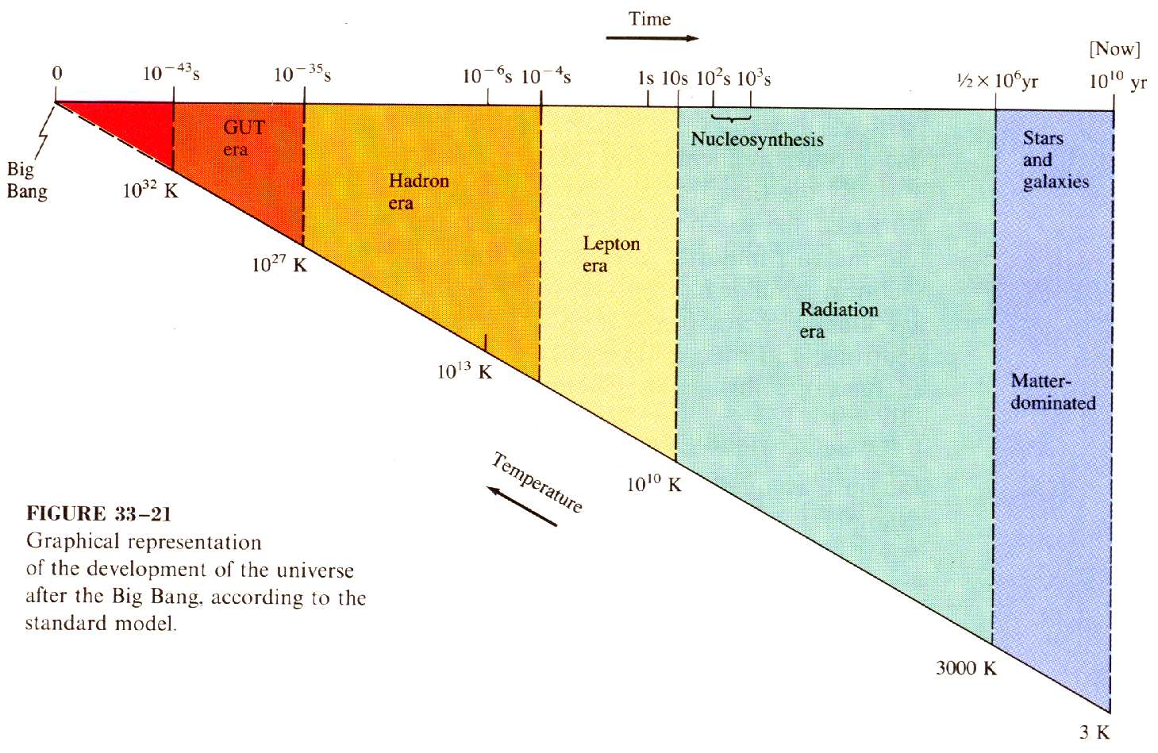
The Standard Model
Thermal Energy decreases
(Allows creation of things
with less and less mass)
Like condensation
(particle accelerators)
Now
Bang

Slide 11
The Standard Model
Basic concepts:
Adiabatic expansion
Stretching of radiation
Matter becoming energy, Energy becoming matter
Matter as “condensed” energy
Wien’s Law/ ”Temp”/ energy per photon
Now
Bang

Slide 12
Types of Particles
Gauge Bosons
Leptons
Hadrons (made of quarks)
Masses
Heavier particles decay into lighter…

Slide 13
Put this in your notes:
Key Photon energy thresholds:
2x938 MeV ≈ 2 GeV – energy to create the lightest Hadron. (proton)
2x0.511 MeV ≈ 1 MeV – energy to create the lightest Lepton (electron)
1.3 eV – energy to ionize atoms (plasma vs not plasma)
Calculate the Wien Temperature of each of these energies.
E = hf = hc/λ = (6.626E-34 Js)(3.00E8 m/s)/ λ
λ_{max} (metres) = 2.90 x 10^{-3 m}/_{K}
T (Kelvin)
1 eV = 1.602x10⁻¹⁹ J
1 MeV = 1x10⁶ eV

Slide 14
Put this in your notes:
Key Photon energy thresholds:
2x938 MeV ≈ 2 GeV – energy to create the lightest Hadron. (proton)
E = hf = hc/λ,
T = 2.90 x 10^{-3 mK}
λ

Slide 16
Put this in your notes:
Key Photon energy thresholds:
2x0.511 MeV ≈ 1 MeV – energy to create the lightest Lepton (electron)
E = hf = hc/λ,
T = 2.90 x 10^{-3 mK}
λ

Slide 18
Put this in your notes:
Key Photon energy thresholds:
1.3 eV – energy to ionize atoms (plasma vs not plasma)
E = hf = hc/λ,
T = 2.90 x 10^{-3 mK}
λ

Slide 20
The Standard Model
Before 10⁻⁴³ seconds:
General Relativity doesn’t work
Don’t yet have a quantum theory of gravity
We think the four forces of nature were unified.
(Um… Gravity, Electromagnetic, Weak Nuclear, and Strong Nuclear)

Slide 21
The Standard Model
10⁻⁴³ seconds to 10⁻³⁵ seconds:
Gravity has “condensed” out
No distinction between fundamental particles.

Slide 22
The Standard Model
10⁻³⁵ seconds to 10⁻⁴ seconds:
Strong Nuclear Separate
Quarks are confined
Hadron era (Protons and Neutrons are Hadrons)
Energy of photons…
Roughly equal Matter and Anti matter being created and destroyed.
Slight imbalance of Matter
(1 in 10⁹)

Slide 23
The Standard Model
10⁻⁴ seconds to 10 seconds:
Photon Energy drops below mass of Hadrons
Hadron matter annihilates Hadron anti matter
Lepton era (electrons, positrons, neutrinos) (there are also photons around)
Lepton eat lepton universe

Slide 24
The Standard Model
10 seconds to .38 x 10⁶ years:
Thermal Energy drops below mass of Leptons
Lepton matter annihilates Lepton anti matter
Slight imbalance of Matter persists to this day(1 in 10⁹)
Radiation era (neutrinos, photons)

Slide 25
The Standard Model
.38 x 10⁶ years to Present:
Thermal energy drops below binding energy of atomic electrons
Atoms are born
Photons de-couple from matter (To become CMBR)
Expansion of the Universe stretches out radiation
Universe is now matter dominated.
Soon after atoms form, stars and galaxies form as well.

Slide 26
The Standard Model
Meanwhile back at the ranch:
About 2 or 3 minutes after the Big Bang, fusion occurs.
¹H, ²H, ³H, ⁴He…maybe some Lithium…are created (No A = 5 or 8)
BBN theory predicts that 75% of matter be Hydrogen, and 25% Helium.
This is what we see today.
Stars forge heavy elements later.
Older stars should have fewer heavy elements than new ones.
This is what we see today.

Slide 27
