Slide 1
1General Relativity and Expansion of Universe
Curved space (33-3)
Rate of clocks running (like whiteboards)
Black Holes (33-3)
Red Shift (33:29)
Hubble’s Law (33:25)

Slide 2
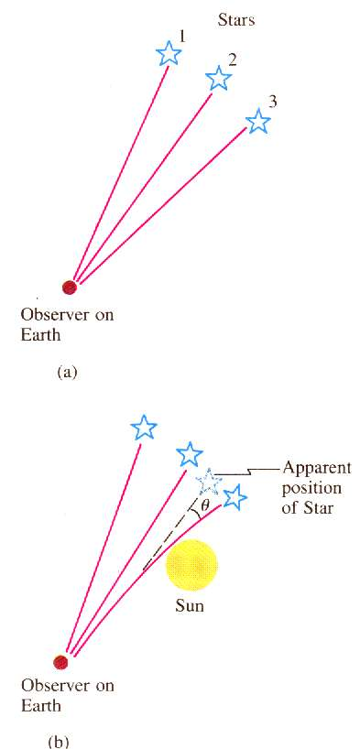
Apparent Curvature of light:
In 1919, Sir Arthur Eddington measured the deflection of light near the sun during an eclipse.
Light was bent twice as much as Newton’s theory predicted, supporting General Relativity
Notes:
The sun is too bright normally

Slide 3
Two trombonists, one at the top of a 215 m tall tower, and one at the bottom play what they think is the same note. The one at the bottom plays a 256.0 Hz frequency, and hears a beat frequency of 5.2 Hz. What is the gravitational field strength?? For us to hear the note in tune, should the top player slide out, or in? (Are they sharp or flat)
Δf/f = gΔh/c², g = Δfc²/fΔh
8.5 x 10¹² m/s/s
8.5 x 10¹² m/s/s, out, sharp
Notes:
93.4E6*2.5E6*320/3E8² = 8.3E6 Hz
Low clocks run slow, so the frequency of the radio station at the bottom would be 8.3 Mhz lower than 93.4 MHz so it would be 85.1 MHz

Slide 4
Black Holes:
Gravitational Potential per unit mass:
V = -GM so PE = Vm
r
At escape velocity, kinetic = potential
¹/₂mv² = GMm substituting c for v:
r
r = 2GM where r is the Schwarzschild radius
c²

Slide 5
Black Holes:
At escape velocity, kinetic = potential
¹/₂mv² = GMm substituting c for v:
r
v = (2GM/r)^{1/2}
As r gets smaller, v gets bigger
Were the Earth .35” in radius it would be a black hole
The sun would be 1.9 miles in radius.
The sun and the earth will never become black holes.
Not all by themselves…

Slide 6
What is the recession rate of a galaxy that is 26 Mpc away?
(Use H = 50 ^{km/s}/_{Mpc} )
26 Mpc*(50 ^{km/s}/_{Mpc}) = 1300 km/s
1300 km/s
Notes:
1300 km/s

Slide 7
What is the distance to a galaxy that has a 480 nm line that comes in at 497 nm?
(Use H = 50 ^{km/s}/_{Mpc} )
(497-480)/480*3E5 = 10625 km/s
10625 km/s /(50 ^{km/s}/_{Mpc}) = 212.5 Mpc
210 Mpc
Notes:
(497-480)/480*3E5/50 = 212.5 Mpc

Slide 8
2. H-R Diagrams and star types
HR Diagrams (general) (33-2)
HR Diagrams (conceptual) (33-2)
Types of stars (33-2)
H-R Diagrams (33:36)
Spectral type/Dark line spectra (from lecture, 27-9)

Slide 9
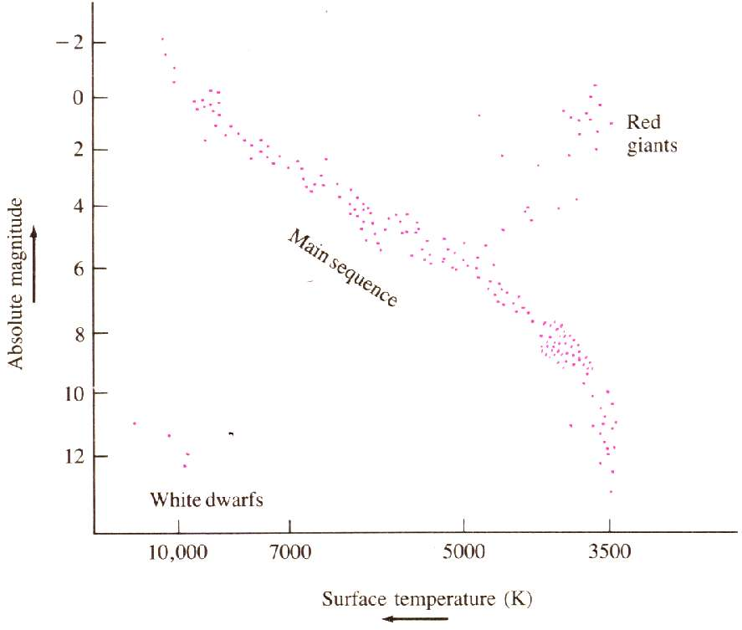
Concept 4 – H-R diagrams
In 1910, Enjar
Hertzsprung of
Denmark, and
Henry Norris Russell
at Princeton plotted M
vs T in independent
research.
Most stars fell on a diagonal band, called the main
sequence. Our sun falls on the main sequence. New
and old stars are off the main sequence.
From Douglas Giancoli’s Physics

Slide 10
Bright
Dim
Hot
Cooler
From Douglas Giancoli’s Physics

Slide 11
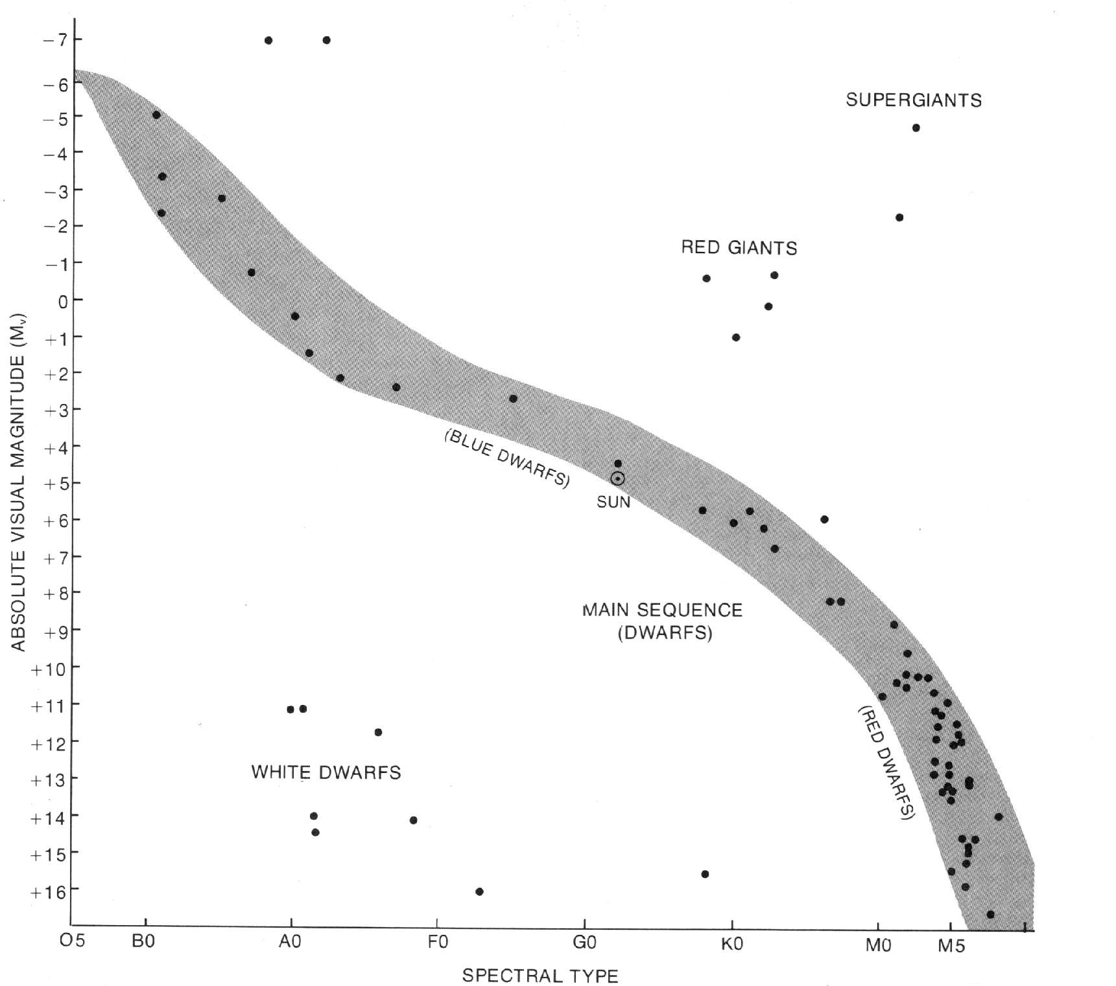
Bright
Dim
Hot
Cooler
From Jay Pasachoff’s Contemporary Astronomy

Slide 12
The death of a star:
Helium displaces Hydrogen in core
Star Cools
Heat energy no longer balances gravity.
Gravity collapses the He core.
Implosion spurs hydrogen fusion
Star is puffed up
It is now a Red Giant
Sun expands orbit of Venus or Earth
Star 8 solar masses -> 1 or 2 residual

Slide 13
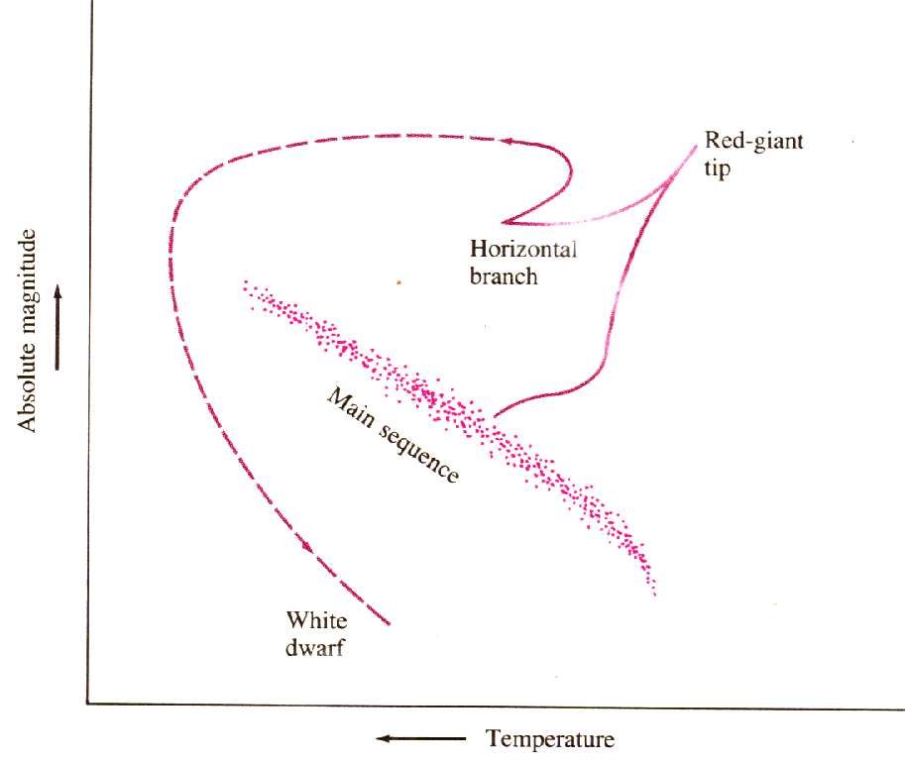
Collapse of the He Core:
Expands
Cools Down

Slide 14
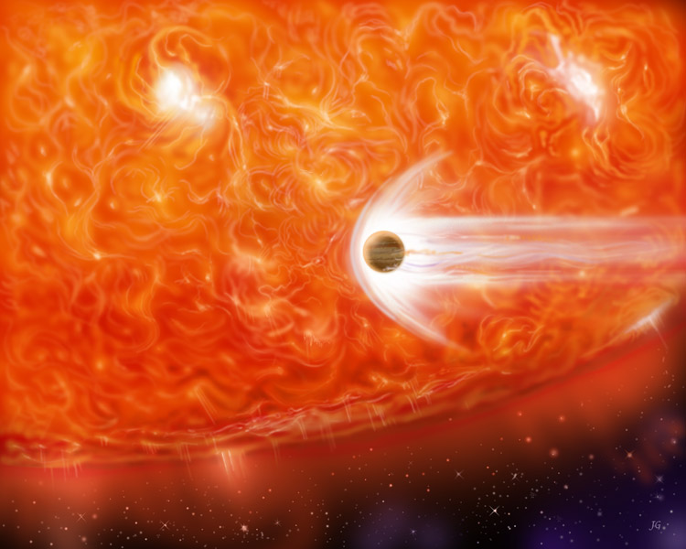

Slide 15
If the residual mass of the star is less than 1.4 times the current mass of the sun, our story ends here.
A star with the mass of the sun becomes a White dwarf about the size of the earth.
The Pauli exclusion principle prevents the star from collapsing any further.
It gradually runs out of Carbon fuel, getting dimmer and dimmer, until it becomes a black dwarf.

Slide 16
Neutron Stars:
Supernova remnant is composed almost entirely of neutrons.
White Dwarfs are the size of planets.
Neutron stars are the size of towns.
Some Neutron stars spin a thousand times a second.
The pressure is so high in the core atomic nuclei cannot exist.
The outer envelope is about a mile thick - a crust of nuclei and electrons.
The core is a super-fluid.

Slide 17
Picture of a Neutron Star:
Ticks are 5 seconds
In 1967, Antony Hewish of Cambridge University in England was studying the scintillation of radio sources due to the solar wind.
A graduate student named Jocelyn Bell Burnell discovered a strong night time source of “twinkling”.
Its location was fixed with respect to the stars.
From Jay Pasachoff’s “Contemporary Astronomy”

Slide 18
Pulsars:
Pulsars emit pulses some as short as 1/40th of a second.
There are many things they could not be.
The only thing small enough, and rotating fast enough was a neutron star

Slide 19
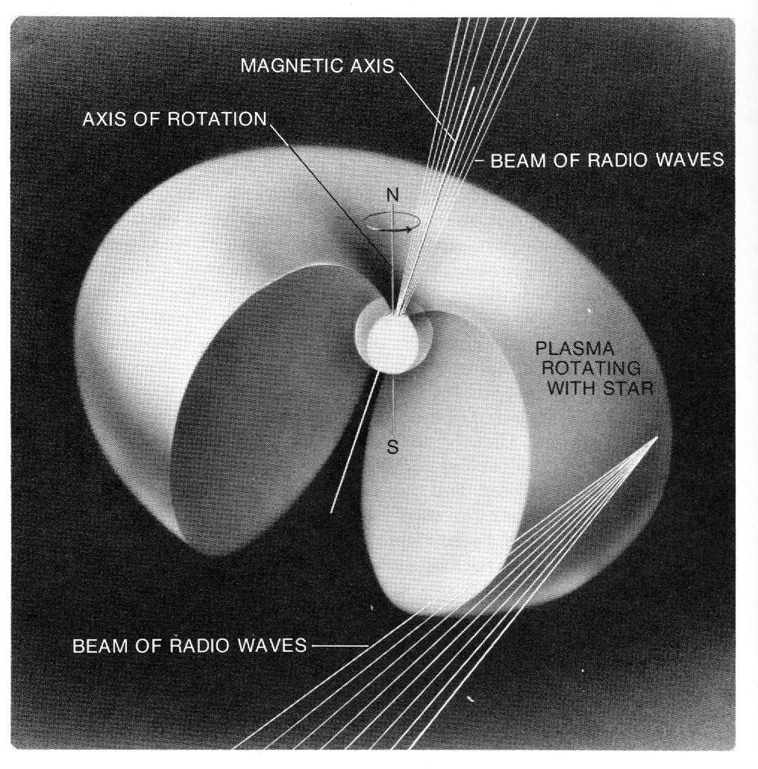
From Jay Pasachoff’s “Contemporary Astronomy”

Slide 20
Quasars: (Quasi-stellar radio source)
Massively bright. (10% in-falling mass converted)
Intense radio source.
Red shifted radiation.
Black holes eating matter.
Usually located in the centers of galaxies

Slide 21
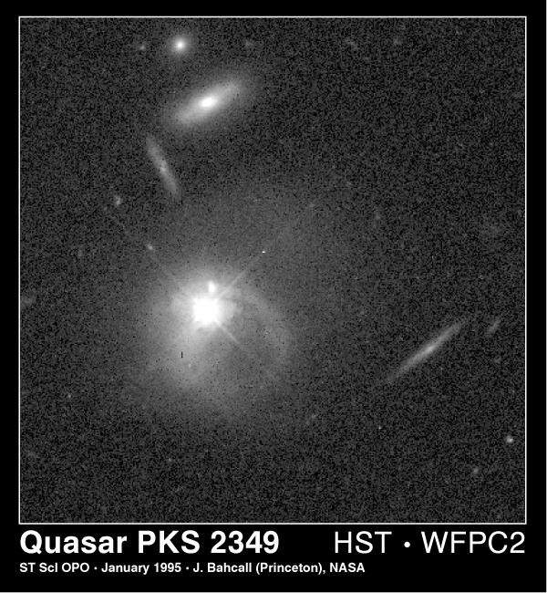
Notes:
EMBARGOED UNTIL 3:30 p.m. MST, January 11, 1995 SURPRISING HUBBLE IMAGES CHALLENGE QUASAR THEORY Astronomers report today that new observations from NASA's Hubble Space Telescope challenge thirty years of scientific theory about quasars, the most energetic objects in the universe. Hubble images show, to the surprise of researchers, that the environment surrounding quasars is far more violent and complex than expected, with evidence for galactic collisions and mergers. "This is a giant leap backwards in our understanding of quasars," says Professor John Bahcall of the Institute of Advanced Study at Princeton. Since their discovery in 1963, quasars (quasi-stellar objects) have been enigmatic because they emit prodigious amounts of energy from a very compact source. The most widely accepted model is that a quasar is powered by a supermassive black hole in the core of a more or less normal galaxy. However, confirming this model has been difficult because a quasar is so bright it drow ns out the light from the stars in the suspected host galaxy. Using the Wide Field Planetary Camera-2, Bahcall observed fourteen of the brightest and nearest quasars , assuming that the Space Telescope's resolution and sensitivity would at last reveal the host galaxies suggested by previous ground-based observations. "We were astonished when images of eight quasars did not reveal the bright host galaxies, as we expected based on simulations," says Bahcall, who conducted the observations with Donald Schneider, Pennsylvania State University, and Sofia Kirhakos, also of the Institute for Advanced Study. However, moderately bright host galaxies were identified in three other quasars observed. Donald Schneider emphasizes: "We are struggling to understand how our images fit into the general picture of quasar creation and evolution. This is the most enigmatic data I have ever analyzed, and it is much too early to know what the final conclusions will be." Even more puzzling, Hubble image s reveal that these apparently naked quasars have distinct companion galaxies that are so close that they will merge with the quasars in no more than ten million years. One pair in particular Bahcall calls the "smoking gun" because it reveals a galaxy that has been distorted by the gravitational pull of the quasar. Bahcall concludes, "this is clear evidence for interactions between this quasar and its nearby companion galaxy." This would mean that the quasars seen with a host galaxy have be en caught in the act of merging with their companion. Bahcall and his colleagues plan to extend his survey to other quasars. Their observations to date provide a new challenge for theorists since no current models predict the complex quasar interaction unveiled by Hubble. The results are being reported at the 185th meeting of the American Astronomical Society in Tucson, Arizona.

Slide 22
Quasars:
In falling material forms an accretion disk.
Quasars are ravenous beasts.
Magnetic fields
The accretion disk gets hot.
The accretion disk has tornadoes that create jets
Predictions
Old bright Quasars are rare, young ones common
Recently disturbed galaxies should have bright quasars.

Slide 23
O Oh (Hot)
B be
A a
F fine
G girl,
K kiss
M me! (Cooler)

Slide 24
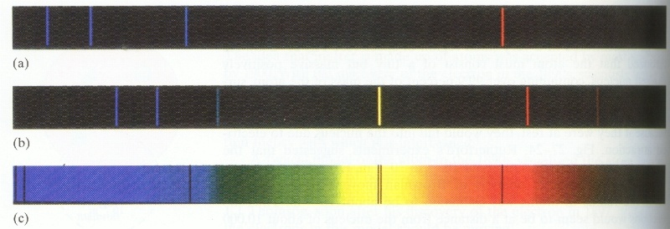
The atmosphere
The Star
Light from star is filtered by atmosphere

Slide 25
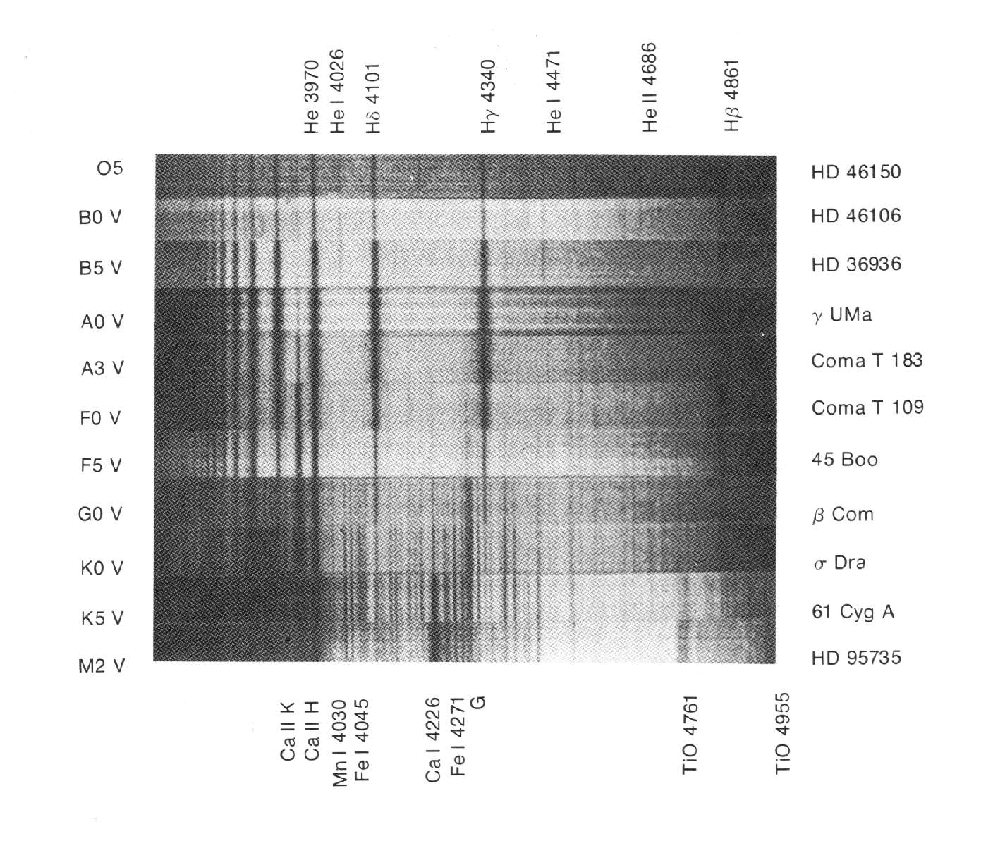
From Jay Pasachoff’s Contemporary Astronomy

Slide 26
3. Stars and brightness
Luminosity and brightness (Astro:1-7)
Magnitudes (Astro:8-10)
Distance to stars and brightness (Astro:11-12)
HR Diagrams, brightness and distance (Astro:13-14)
Parallax question (33:2 (3.6 pc))

Slide 27
Our Sun has a surface temp
Of about 5000 K, and a radius of
7 x 10⁸ m. What is its Luminosity?
L = σAT⁴ ⁼ 5.67x10⁻⁸(4π(7x10⁸ ) ² )(5000)⁴ = 2.2x10²⁶ Watts
2.2x10²⁶ Watts
Notes:
Luminosity L = σAT⁴ ⁼ 5.67E-8* 4π7E8²5000⁴ = 2.2E26 Watts

Slide 28
Another star has a luminosity of 3.2 x 10²⁶ Watts. We measure an apparent brightness of 1.4 x 10⁻⁹ W/m². How far are we from it?
b = L/4πd² , d = (L/4πb)^{.5} = 1.3x10¹⁷ m
1.3x10¹⁷ m
Notes:
b = L/4πd² , d = (L/4πb)^.5 = 1.3E17 m

Slide 29
What is the Apparent Magnitude
of a star that has an apparent
brightness of 1.4 x 10⁻⁹ W/m² ?
m = 2.5log₁₀ (2.52 x 10^{-8W}/_{m}2/b) = 2.5log₁₀ (2.52 x 10^{-8W}/_{m}2/ 1.4 x 10⁻⁹ W/m²) = 3.1
3.1
Notes:
m = 2.5log₁₀ (2.52 x 10^{-8W}/_{m}2/b) = 2.5log₁₀ (2.52 x 10^{-8W}/_{m}2/ 1.4 x 10⁻⁹ W/m²) = 3.1

Slide 30
You are 320 pc from a star with an absolute magnitude of 6.3. What is its apparent magnitude?
M = m - 5 log₁₀(d/10),
m = M + 5 log₁₀(d/10) = 6.3 + 5 log₁₀(320/10) = 14
14
Notes:
M = m - 5 log₁₀(d/10), m = M + 5 log₁₀(d/10) = 6.3 + 5 log₁₀(320/10) = 14

Slide 31
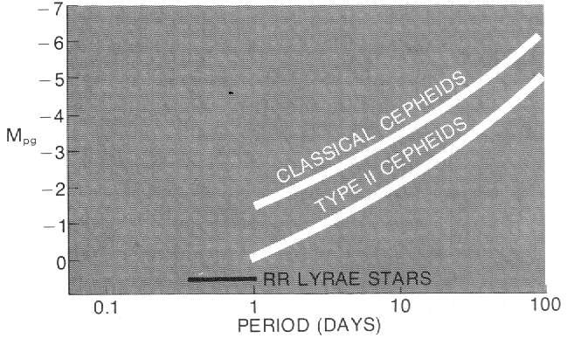
Cepheid Variables:
How to measure the distance to a galaxy using Cepheid variable stars:
Find the Cepheid, measure its spectrum
Measure a couple periods, and its apparent magnitude m
Look up its absolute magnitude
Use M = m - 5 log₁₀(d/10) to find d

Slide 32
Spectroscopic “parallax”
Since astronomers can
tell by the spectrum of
a star if and where it
falls on the main
sequence, they can get
the absolute magnitude.
If you then measure the
apparent magnitude,
it is a relatively simple process to calculate the
distance to the star: M = m - 5 log₁₀(d/10)
And you know M, and m…
From Douglas Giancoli’s Physics

Slide 33
M = m - 5 log₁₀(d/10)
5 log₁₀(d/10) = m - M
log₁₀(d/10) = (m - M)/5
d/10 = 10^{((m - M)/5)}
d = (10 pc)10^{((8 - -4.3)/5)}
d = 2884 pc
How far is an B0 that has an m of 8?
2884 pc

Slide 34
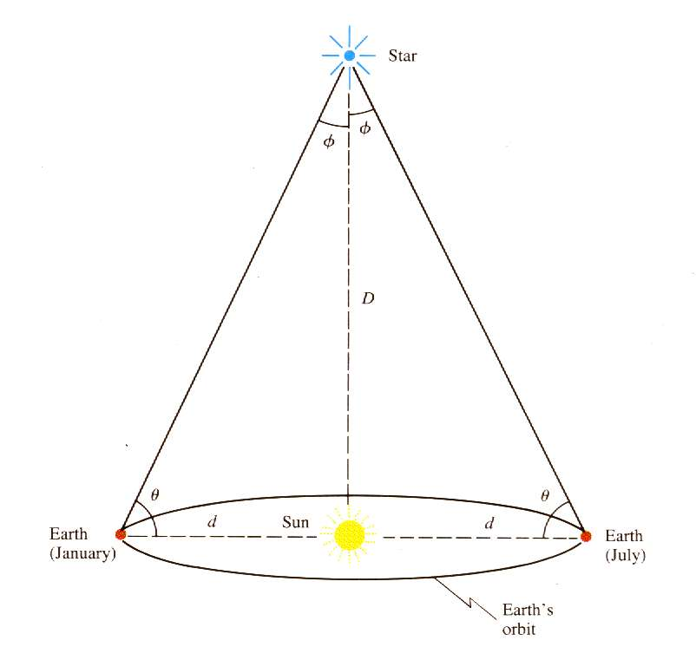
Parsecs - Parallax Seconds
pc = 1
Ø
Ø = parallax angle in seconds
(1 second - 1/3600 of a degree)
From Douglas Giancoli’s Physics

Slide 35
Notes:
3.2*3600=11520

Slide 36
Example: A star has an annual parallax of .037”. What is its distance in parsecs? How far away is it in km?
pc = 1/.037 = 27 pc
Tan(Ø) = O = (1 A.U)
A (distance to the star)
Ø = .037”/3600 = 1.02777 E-5 degrees
d = 2.54E11 km

Slide 37
How many arc seconds are
there in 3.2 degrees?
3.2º*3600”/o=11520”
11520”
Notes:
3.2*3600=11520

Slide 38
45 arc seconds is how many
degrees?
45”/3600”/o=.0125º
.0125º
Notes:
45/3600=.0125 degrees

Slide 39
If a star has a parallax of .12”,
what is its distance in parsecs?
Parsecs = 1/arcseconds =
1/.12 = 8.3 pc
8.3 pc
Notes:
Parsecs = 1/arcseconds = 1/.12 = 8.3 pc

Slide 40
If a star is 89 parsecs away,
what is its parallax in arc
seconds?
Parsecs = 1/arcseconds so 89 =
1/arseconds, arseconds = 1/89
= .0112”
.0112”
Notes:
Parsecs = 1/arcseconds so 89 = 1/arseconds, arseconds = 1/89 = .0112”

Slide 41
4. Stellar Evolution
Formation of Protostars (from lecture)
Stellar dynamics - stability of a star (33-2)
Creation of elements in a star (33-2)
Helium in a main sequence star (33-2)
Basic outline of stellar evolution (33-2)

Slide 42
Formation of protostar:
Gaseous clouds contract under their own gravity.
Gravitational potential turns to heat.
Heat and pressure start fusion.
Birth of a star
IP Demo: Star_Birth.ip

Slide 43
Birth of a star
Rotation speeds up (demo)
Mechanism for slowing…
B-Field – Polar Jets

Slide 44
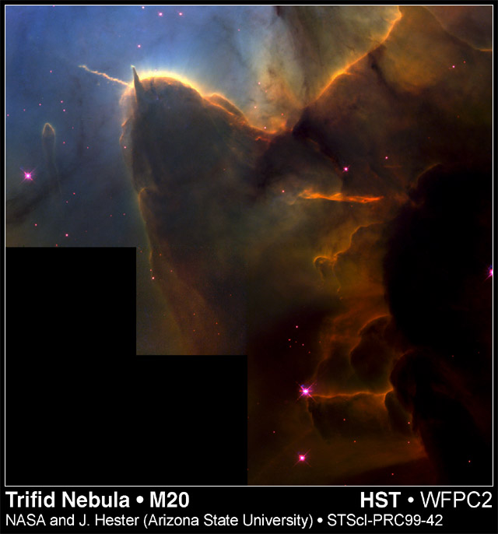
Notes:
This NASA Hubble Space Telescope image of the Trifid Nebula reveals a stellar nursery being torn apart by radiation from a nearby, massive star. The picture also provides a peek at embryonic stars that are forming within an ill-fated cloud of dust and gas, which is destined to be eaten away by the glare from the massive neighbor. This stellar activity is a beautiful example of how the life cycle of stars like our Sun is intimately connected with their more powerful siblings.
The Hubble image shows a small part of a dense cloud of dust and gas, a stellar nursery full of embryonic stars. This cloud is about 8 light-years away from the nebula's central star, which is beyond the top of this picture. Located about 9,000 light-years from Earth, the Trifid resides in the constellation Sagittarius.
A stellar jet [the thin, wispy object pointing to the upper left] protrudes from the head of a dense cloud and extends three-quarters of a light-year into the nebula. The jet's source is a very young stellar object that lies buried within the cloud. Jets such as this are the exhaust gases of star formation. Radiation from the massive star at the center of the nebula is making the gas in the jet glow, just as it causes the rest of the nebula to glow.
The jet in the Trifid is a "ticker tape," telling the history of one particular young stellar object that is continuing to grow as its gravity draws in gas from its surroundings. But this particular ticker tape will not run for much longer. Within the next 10,000 years the glare of the central, massive star will continue to erode the nebula, overrunning the forming star, and bringing its growth to an abrupt and possibly premature end.
Another nearby star may have already faced this fate. The Hubble picture shows a "stalk" [the finger-like object] pointing from the head of the dense cloud directly toward the star that powers the Trifid. This stalk is a prominent example of the evaporating gaseous globules, or "EGGs," that were seen previously in the Eagle Nebula, another star-forming region photographed by Hubble. The stalk has survived because at its tip there is a knot of gas that is dense enough to resist being eaten away by the powerful radiation.
Reflected starlight at the tip of the EGG may be due to light from the Trifid's central star or from a young stellar object buried within the EGG. Similarly, a tiny spike of emission pointing outward from the EGG looks like a small stellar jet. Hubble astronomers are tentatively interpreting this jet as the last gasp from a star that was cut off from its supply lines 100,000 years ago.
The images were taken Sept. 8, 1997 through filters that isolate emission from hydrogen atoms, ionized sulfur atoms, and doubly ionized oxygen atoms. The images were combined in a single color composite picture. While the resulting picture is not true color, it is suggestive of what a human eye might see.

Slide 45
Birth of a star
Spin Slows - Fusion
Nebula often blown away
Accretion disk

Slide 46
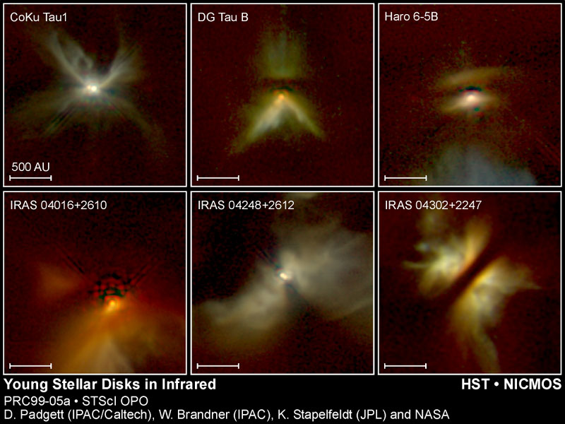

Slide 47
Birth of a solar system:
Accretion Disk
Icy and Gassy Stuff
Rocky Stuff
The New Star

Slide 48
Thermal Agitation balances the tendency
of gravity to crush a star:
Gravity -
Crushing
Pressure
Heat -
Thermal
Agitation

Slide 49
The rate of burn depends roughly on the cube of the mass
Large stars – Brief
Small stars – Durable
Big stars are Brief, Bright, and Blue
Diminutive stars are Durable, Dim and reD

Slide 50
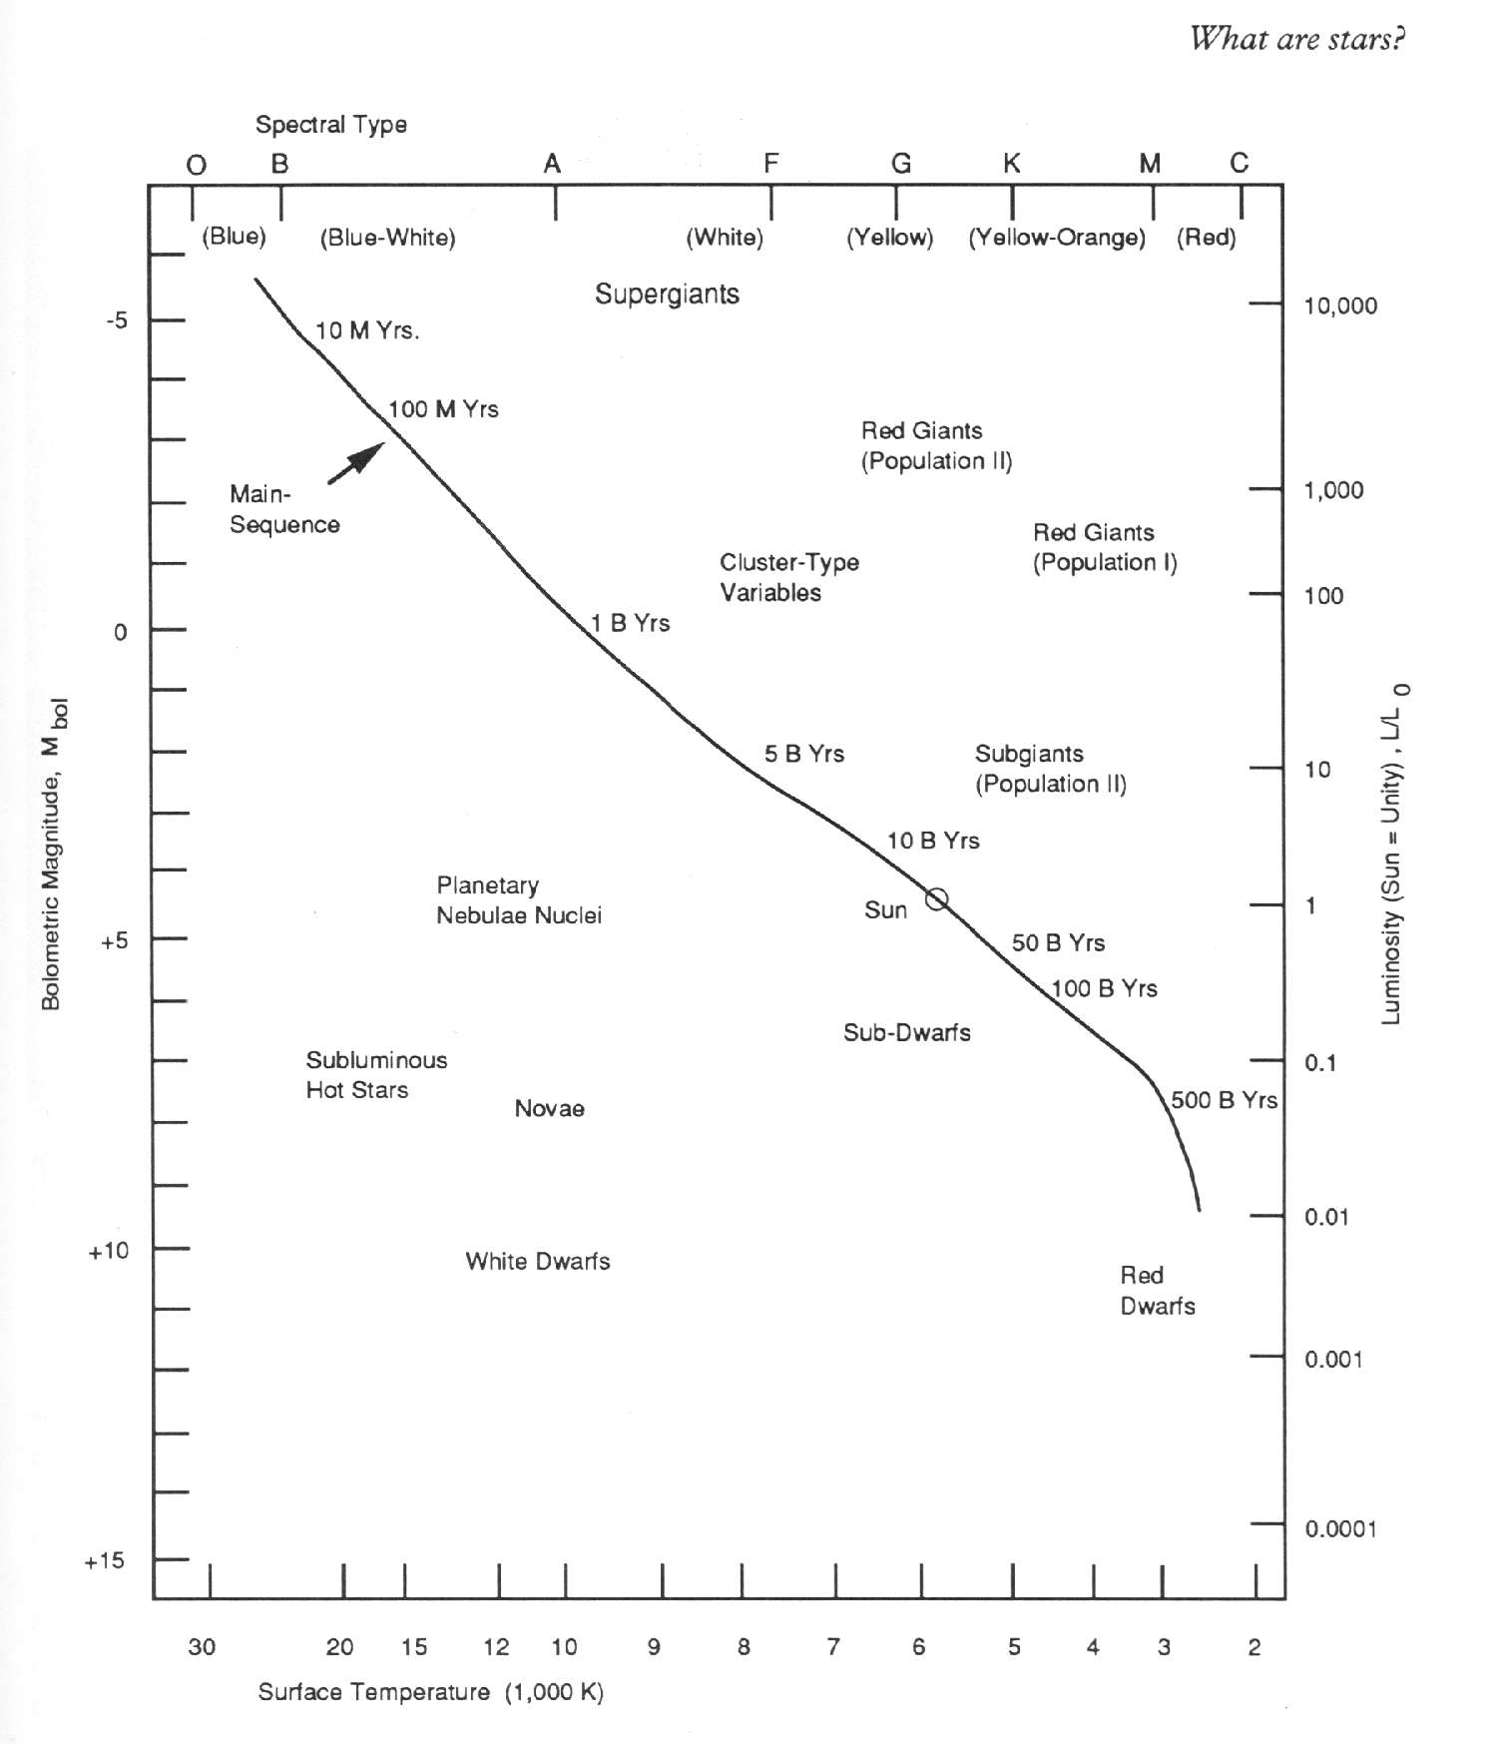
.01 Billion Years
1 Billion Years
.1 Billion Years
100 Billion
Years
10 Billion Years
500 Billion Years
From Robert Garfinkle’s “Star Hopping”

Slide 51
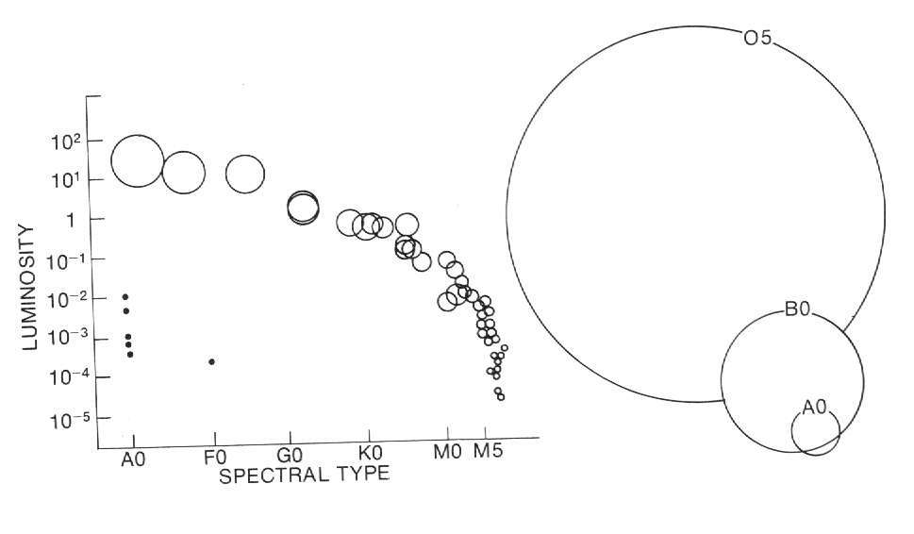
From Jay Pasachoff’s “Contemporary Astronomy”

Slide 52
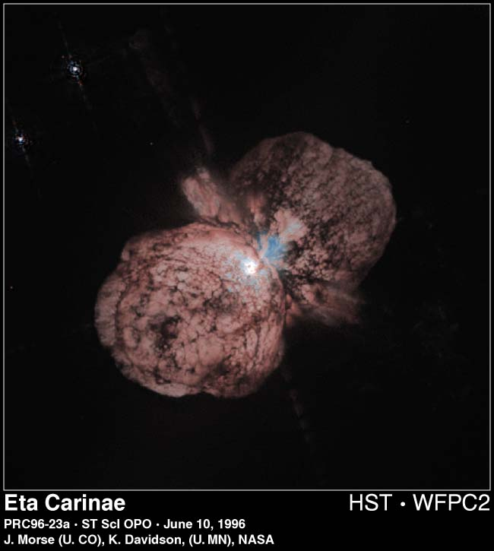
A Star trying to be too big
From Jay Pasachoff’s “Contemporary Astronomy”

Slide 53
Life on the Main Sequence:
Energy comes primarily from the Proton-Proton cycle:
¹H + ¹H = ²H + e⁺ + ν
¹H + ²H = ³He + γ
³He + ³He = ⁴He + ¹H + ¹H
(requires heat and pressure)

Slide 54
The death of a star:
Helium displaces Hydrogen in core
Star Cools
Heat energy no longer balances gravity.
Gravity collapses the He core.
Implosion spurs hydrogen fusion
Star is puffed up
It is now a Red Giant
Sun expands orbit of Venus or Earth
Star 8 solar masses -> 1 or 2 residual

Slide 55
Carbon Fusion:
IFF m > .7 Msun:
¹²C + ¹²C = ²⁴Mg + γ
¹⁶O + ¹⁶O = ²⁸Si + ⁴He
Nuclei as heavy as ⁵⁶Fe and ⁵⁶Ni can be created if the star core is hot enough.
Nucleosynthesis and fusion stop with ⁵⁶Fe and ⁵⁶Ni (Binding energy)

Slide 56
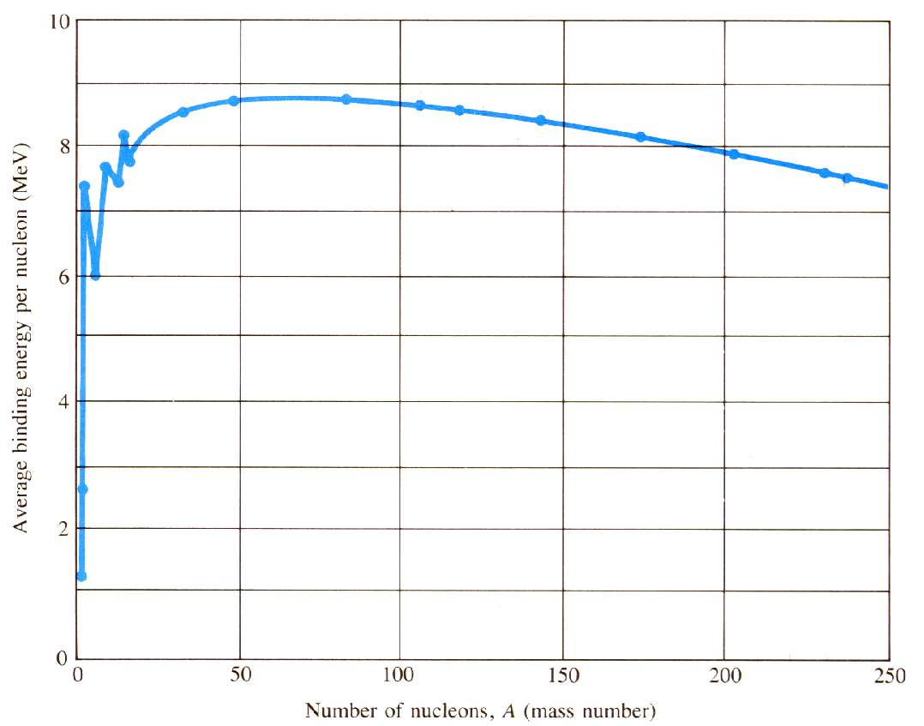
Most tightly bound nuclei
(If you go from less to more bound you release energy)
⁵⁶Fe and ⁵⁶Ni
From Douglas Giancoli’s “Physics”

Slide 57
If the mass of the star is greater than 1.4 times the mass of the sun. (This is called the Chandrasekhar limit) it don’t care about no Pauli exclusion principle.
When the Carbon Fusion fires burn down, gravity crushes the star.
The collapse of the star releases an incredible amount of energy. The star becomes a supernova, increasing in brightness by billions of times for a few days, and then dies out.

Slide 58
The terrific energy released by the collapse of the star creates elements heavier than Iron, and forces electrons and protons to combine creating neutrons.
Dogs become cats.
Republicans support campaign finance reform.
Democrats vote for tax cuts.
In February of 1987, a supernova occurred in the Large Magellenic Cloud, 170,000 ly from Earth. It was briefly visible to the naked eye.
(Assuming your eye was naked in Australia)

Slide 59
⁴He accumulates in the core of the star:

Slide 60
The death of a star:
Helium displaces Hydrogen in core
Star Cools
Heat energy no longer balances gravity.
Gravity collapses the He core.
Implosion spurs hydrogen fusion
Star is puffed up
It is now a Red Giant
Sun expands orbit of Venus or Earth
Star 8 solar masses -> 1 or 2 residual

Slide 61
Collapse of the He Core:
Expands
Cools Down

Slide 62
So far:
Collapse of C core
Helium Fusion
Carbon Fusion
(if > .7 M_{sun})
Collapse of He Core
Degenerate
Matter
Hydrogen Fusion stops

Slide 63
That’s all folks

