Slide 1
Introduction to Astrophysics

Slide 2
Now for something completely different…

Slide 3
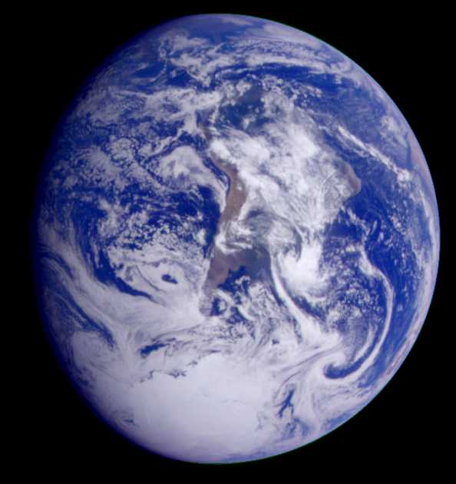
Just remember that you’re standing on a planet that’s evolving
And revolving at nine hundred miles an hour,

Slide 4
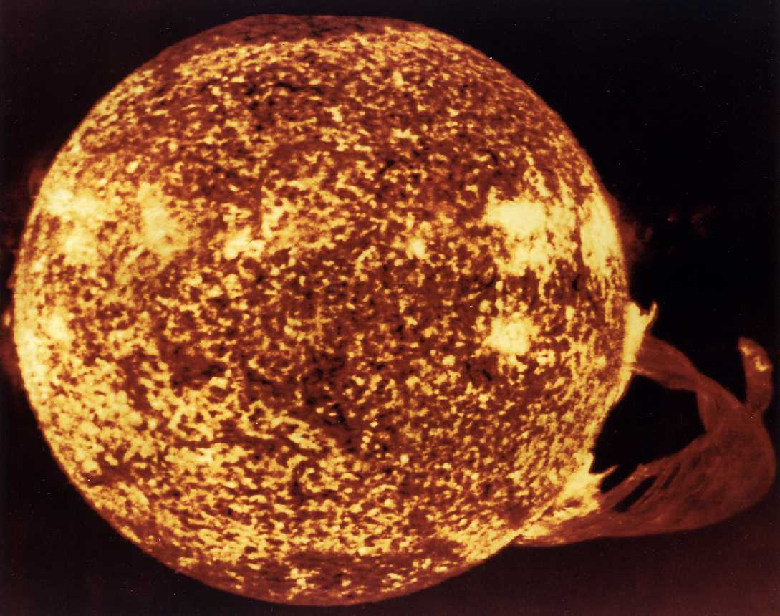
That’s orbiting at nineteen miles a second, so it’s reckoned
A sun that is source of all our power.

Slide 5
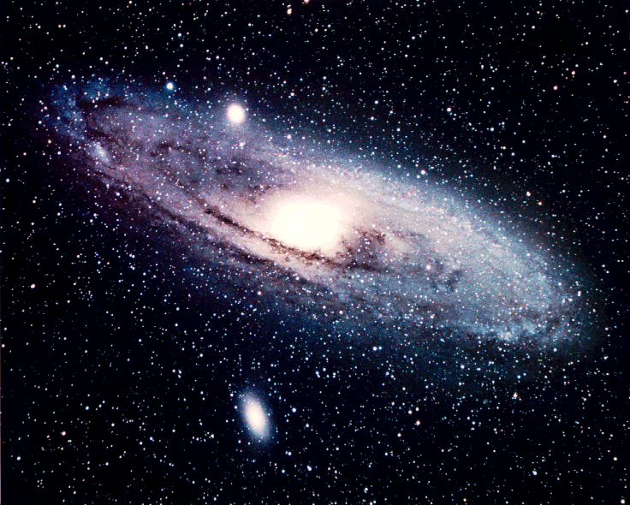
The sun, and you and me, and all the stars that we can see
Are moving at a million miles a day

Slide 6
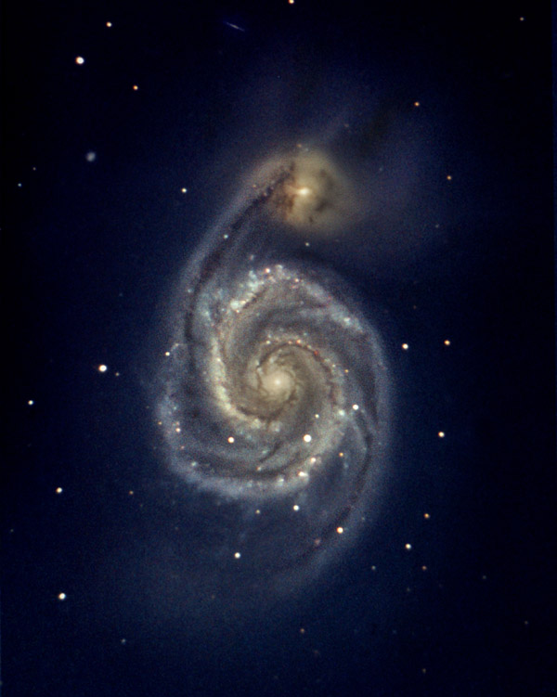
In an outer spiral arm at forty thousand miles an hour
Of the galaxy we call the Milky Way.

Slide 8
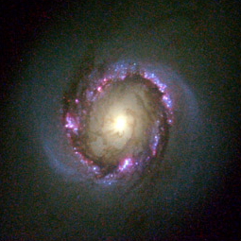
Our galaxy itself contains a hundred billion stars
It’s a hundred thousand light years side to side.

Slide 9
It bulges in the middle, sixteen thousand light years thick,
But out by us it’s just three thousand light years wide.

Slide 10
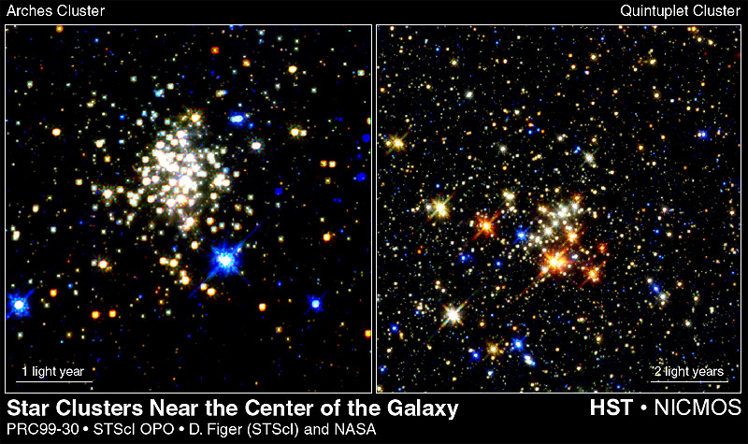
We’re thirty thousand light years from galactic central point
We go ‘round every two hundred million years,

Slide 11
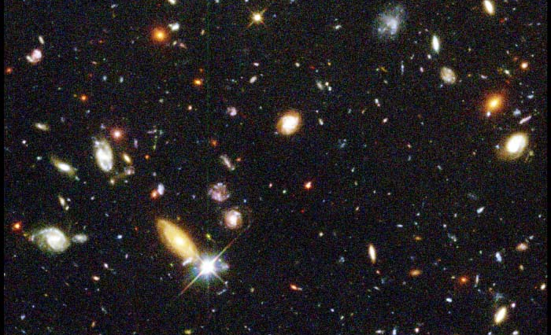
And our galaxy is only one of millions of billions
In this amazing and expanding Universe.

Slide 12
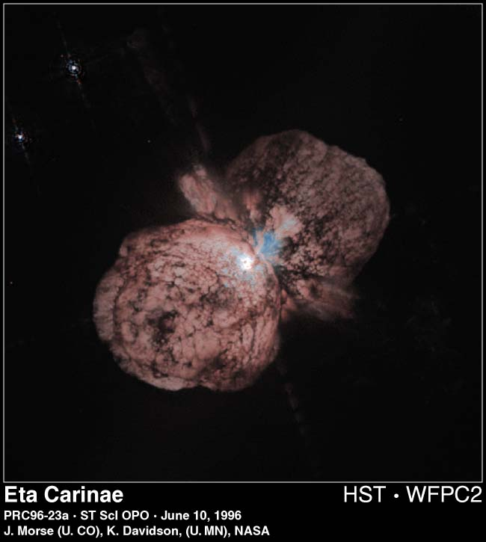

Slide 13
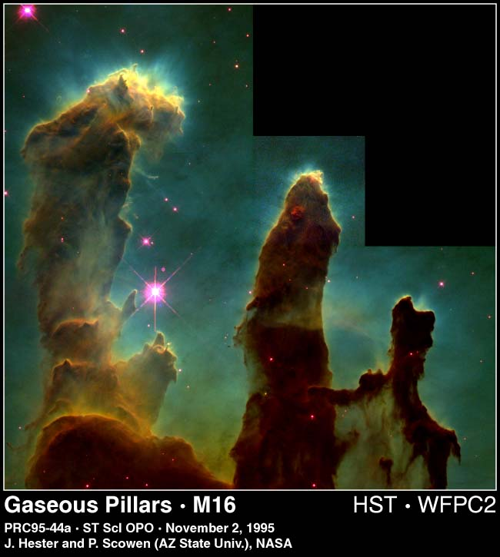

Slide 14
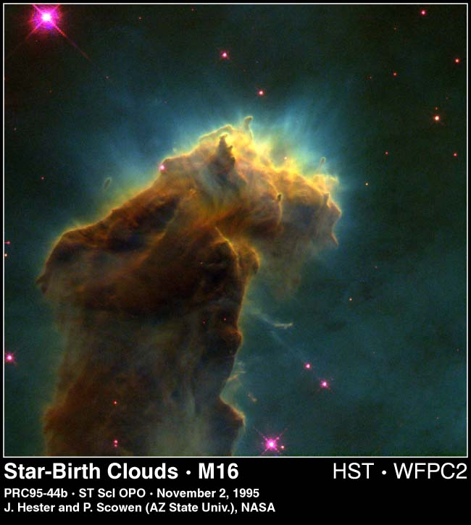

Slide 15
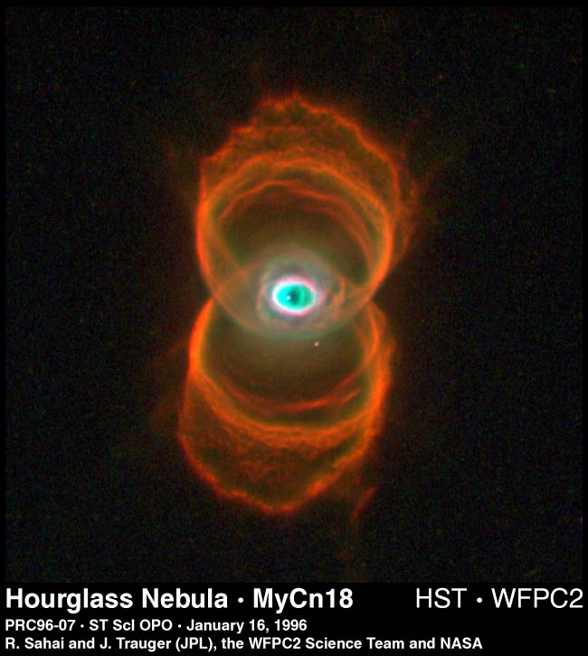

Slide 16
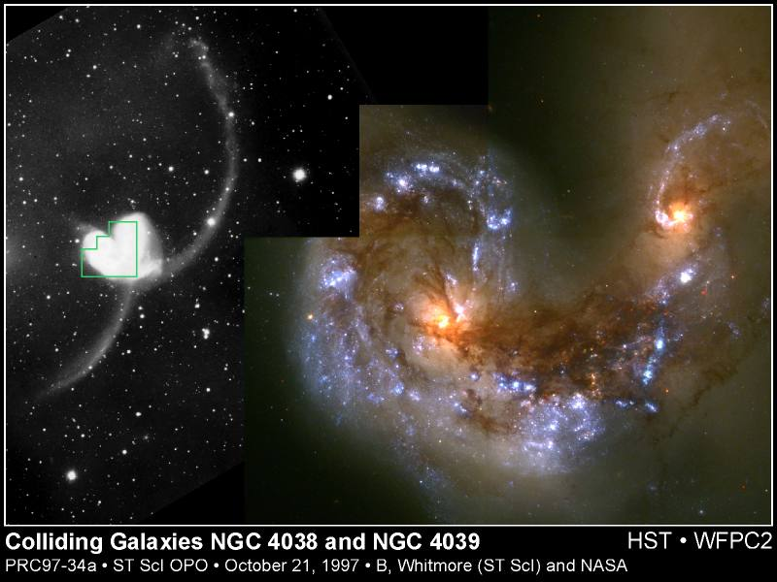

Slide 17
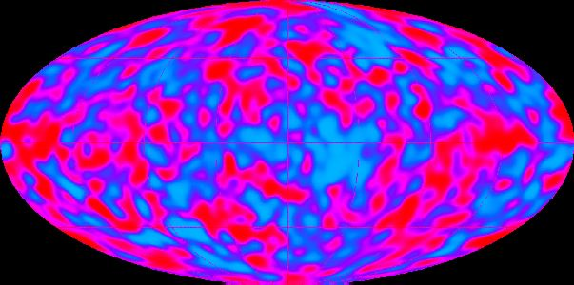
The Universe itself keeps on expanding and expanding
In all of the directions it can whizz

Slide 18
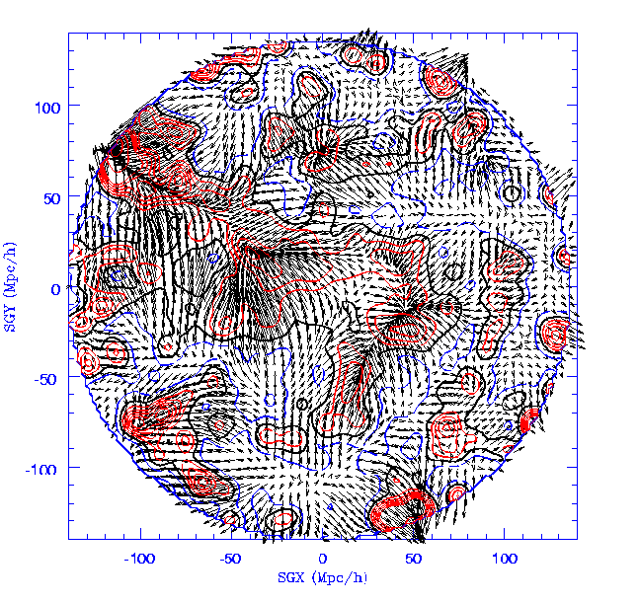
As fast as it can go, the speed of light you know,
Twelve million miles a minute, and that’s the fastest speed there is

Slide 19
So remember, when you’re feeling very small and insecure…
?

Slide 20
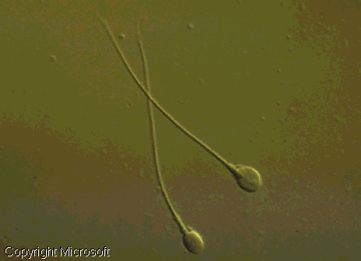
So remember when you’re feeling very small and insecure…
How amazingly unlikely is your birth,

Slide 21
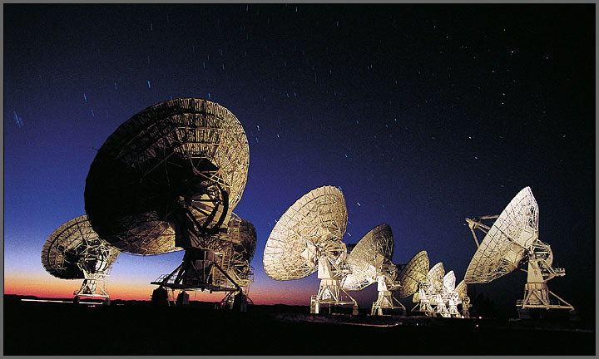
And pray that there’s intelligent life somewhere out in space,

Slide 22
‘Cause there’s <expletive>-all down here on earth.

Slide 23
All material, of course, stolen largely from Monty Python’s “Meaning of Life” and the Hubble Website.
The velocity map came from The IRAS PSCz Redshift Survey team, Will Saunders (Edinburgh) et. al.
Thanks also to NASA for the COBE picture
And of course, to Microsoft Encarta for the sperm.
Pictures of the solar system came from Views of the Solar System www.hawastsoc.org/solar/homepage.htm
and The Nine Planets www.seds.org/billa/tnp
Thanks also to Jason Ware's Galaxy Photography page at www.galaxyphoto.com/

