Slide 1
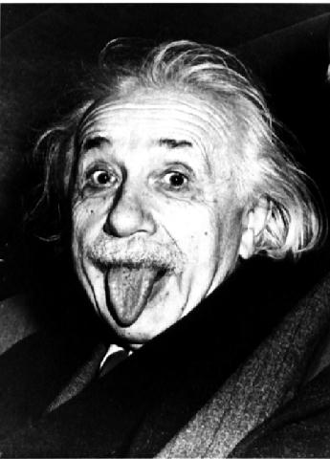
Kinetic Energy
Contents:
Rest Energy /Moving energy

Slide 2
Kinetic Energy
Mass increase is energy
Example: What is the kinetic energy of a 10.0 kg object going .60 c?
TOC

Slide 3
Example: What is the kinetic energy of a 10.0 kg object going .60 c?
Dilated mass is 10.0/√(1-.6²) = 12.5 kg
So its mass has increased by 2.5 kg, this mass is energy.
2.5 kg represents (2.5 kg)(3.00E8 m/s)² = 2.25E17 J
2.5 kg = energy mass
What does this diagram look like for a 6.5 TeV proton?
m_{o} ≈ 1 GeV
KE = 6,500 GeV
12.5 kg
10.0 kg = rest mass

Slide 4
Kinetic Energy
Example – A 0.144 kg baseball has 2.0x10¹⁵ J of kinetic energy. What is its mass, what is its velocity?
TOC

Slide 5
Example – A 0.144 kg baseball has 2.0x10¹⁵ J of kinetic energy. What is its mass, what is its velocity?
Well – the increase of mass is (2.0E15 J)/(3E8)² = .022222 kg
so the new mass is 0.16622 kg
and
v = c √(1-small²/big²) = c √(1-0.144²/0.16622²) ≈ .50c

Slide 6
Kinetic Energy
Example – An electron (rest mass 0.511 MeV) is accelerated through 0.155 MV, What is its velocity?
TOC

Slide 7
Example – An electron (rest mass 0.511 MeV) is accelerated through 0.155 MeV, What is its velocity?
Well – the new mass is 0.511 + 0.155 = 0.666 MeV
v = c √(1-small²/big²) = c √(1-0.511²/0.666²) = .64c

Slide 8
Whiteboards:
Kinetic Energy
1 | 2 | 3 | 4
TOC

Slide 9
A 1.2 kg object (rest mass) is moving at 2.85x10⁸ m/s. What is its new mass, and what is its kinetic energy?
So the new mass is 1.2/√(1-(2.85E8)²/(3E8)²) = 3.8431 kg
So the “energy mass” is 3.8431 kg – 1.2 kg =2.6431 kg
and that represents (2.6431 kg)(3E8)² = 2.4E+17 J
W
3.84 kg, 2.4E+17 J

Slide 10
What velocity must an electron have when it is accelerated through 340. kV?
m_{o} = 9.11E-31 kg = 0.511 MeV
So the new mass is 0.511 MeV + 0.340 MeV = 0.851 MeV
v = c √(1-small²/big²) = c √(1-0.511²/0.851²) = 0.799647258c
about .800 c
W
.800 c

Slide 11
A 0.00612 kg (rest mass) bullet is going so fast it has a (dilated) mass of 0.00645 kg. What is its kinetic energy, and what is its velocity
The increase in mass is 0.00645 kg - 0.00612 kg = 0.00033 kg
and that represents (0.00033 kg)(3E8)² = 2.97E+13 J
v = c √(1-small²/big²) = c √(1-612²/645²) = 0.315765657c
about .32 c
W
2.97E+13 J, .32 c

Slide 12
The LHC will accelerate protons to about 7 TeV. If a proton has a rest mass of 938 MeV, what is the velocity of the protons in the LHC?
So the new mass is 938 MeV + 7,000,000 MeV = 7,000,938 MeV
v = c √(1-small²/big²) = c √(1-(938)²/(7000938)²) = 0.999999991c
about 1 c
W
Your Mother

