Slide 1
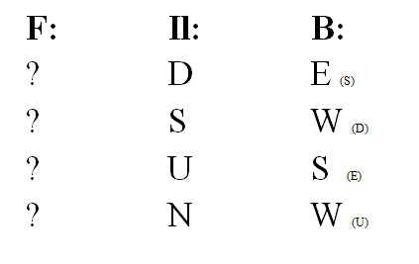
I. Map problems. F = IlxB Directions: North East South West Up Down.
Find the direction of the missing vector: F: Force, Il: Current, B: Magnetic field.
N
W
E
S
up is .
down is x

Slide 2
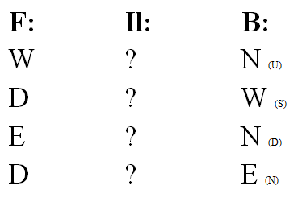
I. Map problems. F = IlxB Directions: North East South West Up Down.
Find the direction of the missing vector: F: Force, Il: Current, B: Magnetic field.
N
W
E
S
up is .
down is x

Slide 3
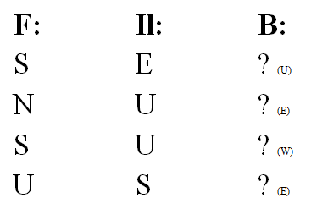
I. Map problems. F = IlxB Directions: North East South West Up Down.
Find the direction of the missing vector: F: Force, Il: Current, B: Magnetic field.
N
W
E
S
up is .
down is x

Slide 4
1. A current of 16.2 A flows West along a wire in a magnetic field of 0.0113 T that is 35.0º west of North. What force acts on the wire if it is 12.0 m long? (Magnitude and direction) (1.80 N, vert downward)
N
W
E
S
up is .
down is x

Slide 5
2. A current of 24.1 A flows East along a wire in a magnetic field of 0.0241 T that is 20.0º east of North. What force acts on the wire if it is 18.5 m long? (Magnitude and direction) (10.1 N, vert upward)
N
W
E
S
up is .
down is x

Slide 6
3. A current of 62.4 A flows South along a wire in a magnetic field of 0.0615 T that is 15.0º east of North. What force acts on the wire if it is 116 m long? (Magnitude and direction) (115.2 N, vert upward)
N
W
E
S
up is .
down is x

Slide 7
4. A 32.7 cm long wire experiences a force of 4.12 N to the West in a vertically upward 0.0452 T magnetic field. What is the current, and in what direction does it flow? (Assume it is perpendicular) (279 A South)
N
W
E
S
up is .
down is x

Slide 8
5. A 1.59 Amp current flows East in a wire that is 34.2 cm long. What is the magnetic field (Assume it is perpendicular) if the wire experiences a Northerly force of 3.74 N? (Magnitude and direction) (6.88 T vert downward)
N
W
E
S
up is .
down is x

Slide 9
6. A 3.80 Amp current flows South in a wire that is 21.1 cm long. What is the magnetic field (Assume it is perpendicular) if the wire experiences a vertically upward force of 4.78 N? (Magnitude and direction) (5.96 T East)
N
W
E
S
up is .
down is x

Slide 10
7. A proton travels at 3.20x10³ m/s vertically upward, and experiences a force of 9.50x10⁻¹⁵ N to the South. What is the magnitude and direction of the magnetic field exerting this force? (18.5 T West)
N
W
E
S
up is .
down is x

Slide 11
8. A moving electron travels through a 5.60 T easterly magnetic field, and experiences a force of 2.50x10⁻¹² N vertically upward. What is the magnitude and direction of the electron’s velocity? (2.79x10⁶ m/s North)
N
W
E
S
up is .
down is x

Slide 12
9. An electron travels at 6.50x10⁴ m/s to the South through a vertically upward 0.315 T magnetic field. What is the magnitude and direction of the force acting on the electron? (3.28x10⁻¹⁵ N East)
N
W
E
S
up is .
down is x

Slide 13
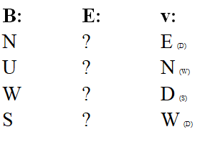
V. Crossed Fields Direction only. North East South West Up Down. B: Magnetic field, E: Electric field, v: velocity. Determine what direction the missing vector should be so that a moving charged particle can go straight. Assume all angles are perpendicular.
N
W
E
S
up is .
down is x

Slide 14
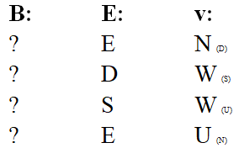
V. Crossed Fields Direction only. North East South West Up Down. B: Magnetic field, E: Electric field, v: velocity. Determine what direction the missing vector should be so that a moving charged particle can go straight. Assume all angles are perpendicular.
N
W
E
S
up is .
down is x

Slide 15
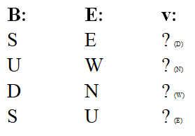
V. Crossed Fields Direction only. North East South West Up Down. B: Magnetic field, E: Electric field, v: velocity. Determine what direction the missing vector should be so that a moving charged particle can go straight. Assume all angles are perpendicular.
N
W
E
S
up is .
down is x

Slide 16
10. A proton traveling East at 5.90x10⁴ m/s through a northerly magnetic field of 0.290 T experiences what magnetic force in what direction? (2.74x10⁻¹⁵ N, vert upward) What electric field in what direction would keep it going straight? (1.71x10⁴ N/C, vert downward)
N
W
E
S
up is .
down is x

Slide 17
11. A proton goes straight East at 7.18x10³ m/s through a vertically downward electric field of 4.50x10⁵ N/C
What must be the direction and magnitude of the magnetic field in this region? (62.7 T, North)
If the proton were to speed up which way would it deflect? (up)
If the proton were to slow down which way would it deflect? (down)
If the magnetic field decreased? (down) increased? (up)
If the electric field increased? (down) decreased? (up)
If the mass of the particle increased, decreased? (no effect either way)
N
W
E
S
up is .
down is x

Slide 18
12. An electron travels in a straight line through a southerly electric field of 3.80x10⁵ N/C, and a magnetic field of 0.287 T that is vertically downwards.
What must be the direction and magnitude of the electron’s velocity? (1.32x10⁶ m/s, East)
If the electron were to speed up which way would it deflect? (South)
If the magnetic field decreased? (North)
If the electric field increased? (North)
N
W
E
S
up is .
down is x

Slide 19
13. a. A proton traveling at 3.71x10⁶ m/s in the plane of this page travels clockwise in a circle with a radius of 4.90 cm. What is the magnitude and direction of the magnetic field that effects this? (0.791 T out of the page)
b. What electric field in what direction would make the proton go straight to the left on the page (⬅) in the previous problem?
(2.93x10⁶ N/C, down the page)

Slide 20
14. a. An electron in a 0.0312 mT magnetic field into this page is going in a 2.65 mm radius circle. What is the electron’s velocity, and which direction does it circle, ACW or CW? (1.45x10⁴ m/s, CW)
b. What electric field in what direction would make the electron go straight up the page in the previous problem?
(0.454 N/C, right)

Slide 21
15. a. A mystery particle with a mass of 6.69x10⁻²⁷ kg traveling 3.62x10⁶ m/s in a 0.982 T magnetic field into this page revolves anti-clockwise with a radius 7.70 cm. What is the charge of the particle, and is it positive, or negative? (3.20x10⁻¹⁹ C, positive)
b. What electric field in what direction would make the particle go straight down the page in the previous problem?
(3.55x10⁶ N/C, left)

