Slide 1
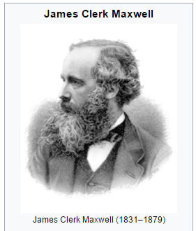
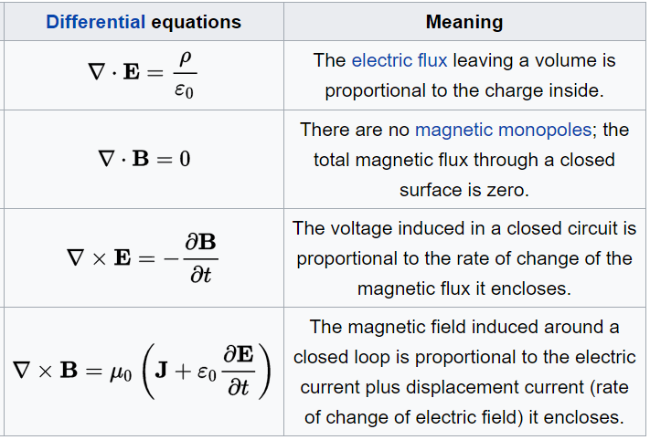
Maxwell’s Equations:
Lewis Campbell
made these coherent

Slide 2
One last thing – This is Maxwell’s 4th equation with an interesting twist
B fields circle moving charge:
R
Capacitor

