Slide 1
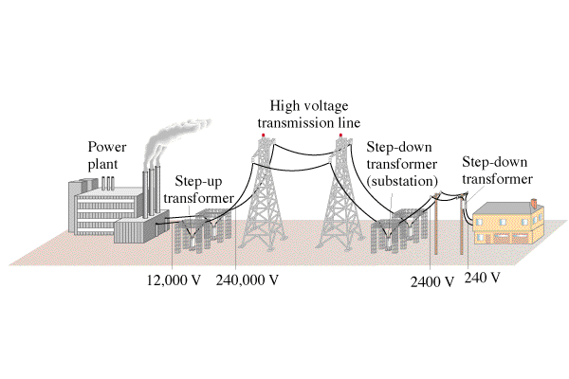
Calculate power lost

Slide 2
If you transmit 1000. W at 120 V on wires that have a resistance of 2.0 ohms, what power is lost?
If you transmit 1000. W at 12,000 0V on wires that have a resistance of 2.0 ohms, what power is lost?
140 W, 0.014 W

Slide 3
Wipe Boards

Slide 4
If you transmit 1300. W of power at 600. VAC, how much power is lost if the lines have a resistance of 1.70 Ω?
7.98 W

Slide 5
If you wanted to transmit 7800. W of power over 5.20 Ω power lines, what voltage would you need to use to waste only 6.30 W?
7086 V

Slide 6
You transmit 23,000. W of power at 19,300 VAC and waste only 8.20 W. What is the resistance of your transmission lines?
5.77 Ω

Slide 7
You are wasting 9.50 W of power, when you transmit at 32,400 VAC on 2.30 Ω transmission lines. What is your transmitted power?
65,848 W

