Slide 1
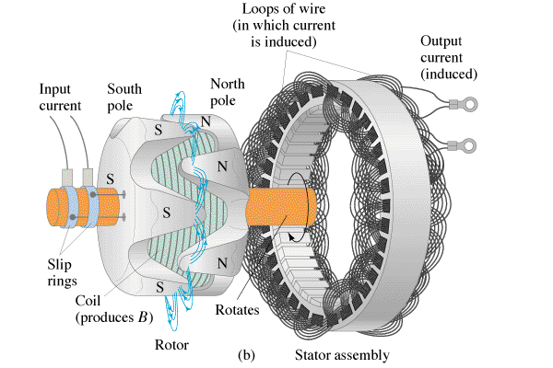
Alternators
Derivation
Whiteboards

Slide 2
Loop Rotating in B field (show)
ε = -Nd BAcos(ωt)
dt

Slide 3
Show hand crank + lt bulb, two generators, Prius braking

