Slide 1
Motors, Galvanometers, and Speakers
Galvanometers
DC Motors
Speakers

Slide 2
A Galvanometer

Slide 3
A Galvanometer

Slide 4
A DC Motor

Slide 5
A Speaker

Slide 6
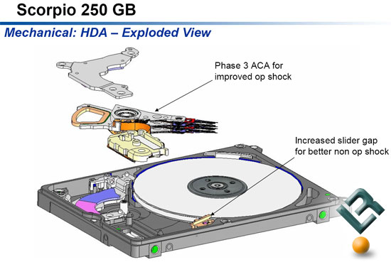
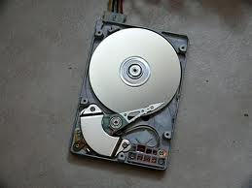
N
S

