Slide 1
Magnetization
Domains
AC magnetization, demagnetization

Slide 2
Demo
Banging a magnet can re-orient domains.
Show magnetizing with a hammer
Domains - small bits (1mm) that are aligned
a - unmagnetized = random orientation
b - slight preference down (N pole)

Slide 3
Oscillating B field - (AC source)
N
S

Slide 4
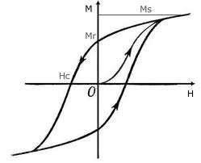
Hysteresis

Slide 5
Oscillating B field - (AC source)
N
S
results in South polarity

Slide 6
Oscillating B field - (AC source)
Pop!
N
S
results North polarity

Slide 7
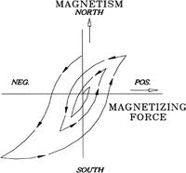
Demagnetizing with AC magnet:
N
S

