Slide 1
Hall Effect
What it is
Two possibilities
Positive charge moves
Negative Charge Moves

Slide 2
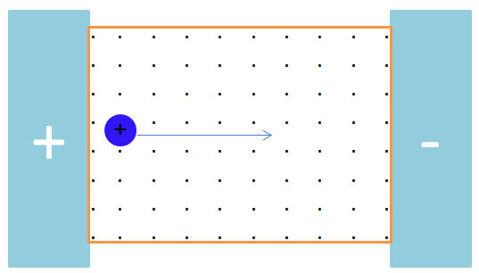
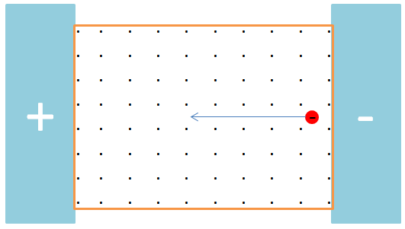

Slide 3
