Slide 1
Forces on Charged particles
Derivation
Example
Whiteboards
Motion in a circle
Direction
Northern Lights
Whiteboards

Slide 2
Recall
F = IlBsinθ
Derive
F = qvBsinθ
F = force on moving particle
q = charge on particle (in C) (+ or -???)
v = particle’s velocity
θ = angle twixt v and B
Can a magnetic force increase a charged particle’s speed?

Slide 3
. . . . . . . . . . . .
. . . . . . . . . . . .
. . . . . . . . . . . .
. . . . . . . . . . . .
. . . . . . . . . . . .
. . . . . . . . . . . .
. . . . . . . . . . . .
. . . . . . . . . . . .
. . . . . . . . . . . .
. . . . . . . . . . . .
. . . . . . . . . . . .
p+

Slide 4
Consider the path of particle
. . . . . . . . . . . .
. . . . . . . . . . . .
. . . . . . . . . . . .
. . . . . . . . . . . .
. . . . . . . . . . . .
. . . . . . . . . . . .
. . . . . . . . . . . .
. . . . . . . . . . . .
. . . . . . . . . . . .
. . . . . . . . . . . .
. . . . . . . . . . . .
F
F
F
F

Slide 5
Whiteboards -
Force: F = qvBsinθ
1 | 2

Slide 6
What is the force acting on a proton moving at 2.5 x 10⁸ m/s to the North in a 0.35 T magnetic field to the East?
q = 1.602 x 10⁻¹⁹ C
F = qvBsinθ
F = qvBsinθ
F = (1.602 x 10⁻¹⁹ C)(2.5 x 10⁸ m/s)(.35 T)sin(90º) = 1.4 x 10⁻¹¹ N
1.4 x 10⁻¹¹ N, Downward

Slide 7
What magnetic field would exert 1.2 x 10⁻¹² N on an alpha particle going 17% the speed of light?
alpha = 2p2n
q = 2(1.602 x 10⁻¹⁹ C) = 3.204 x 10⁻¹⁹ C
v = .17x3.00 x 10⁸ m/s = 5.1 x 10⁷ m/s
F = qvBsinθ
F = qvBsinθ
1.2 x 10⁻¹² N = (3.204 x 10⁻¹⁹ C)(5.1 x 10⁷ m/s)Bsin(90º)
B = 0.073437615 T = .073 T
0.073 T

Slide 8
What is the path of the proton in the B field?
. . . . . . . . . .
. . . . . . . . . .
. . . . . . . . . .
. . . . . . . . . .
. . . . . . . . . .
. . . . . . . . . .
. . . . . . . . . .
. . . . . . . . . .
. . . . . . . . . .
. . . . . . . . . .
. . . . . . . . . .
. . . . . . . . . .
. . . . . . . . . .
. . . . . . . . . .
. . . . . . . . . .
p+
CW

Slide 9
What is the path of the electron in the B field?
. . . . . . . . . .
. . . . . . . . . .
. . . . . . . . . .
. . . . . . . . . .
. . . . . . . . . .
. . . . . . . . . .
. . . . . . . . . .
. . . . . . . . . .
. . . . . . . . . .
. . . . . . . . . .
. . . . . . . . . .
. . . . . . . . . .
. . . . . . . . . .
. . . . . . . . . .
. . . . . . . . . .
e-
ACW

Slide 10
What is the path of the electron in the B field?
. . . . . . . . . .
. . . . . . . . . .
. . . . . . . . . .
. . . . . . . . . .
. . . . . . . . . .
. . . . . . . . . .
. . . . . . . . . .
. . . . . . . . . .
. . . . . . . . . .
. . . . . . . . . .
. . . . . . . . . .
. . . . . . . . . .
. . . . . . . . . .
. . . . . . . . . .
. . . . . . . . . .
e-
ACW

Slide 11
What is the path of the proton in the B field?
p+
x x x x x x x x x x x x
x x x x x x x x x x x x
x x x x x x x x x x x x
x x x x x x x x x x x x
x x x x x x x x x x x x
x x x x x x x x x x x x
x x x x x x x x x x x x
x x x x x x x x x x x x
x x x x x x x x x x x x
x x x x x x x x x x x x
ACW

Slide 12
What is the path of the electron in the B field?
x x x x x x x x x x
x x x x x x x x x x
x x x x x x x x x x
x x x x x x x x x x
x x x x x x x x x x
x x x x x x x x x x
x x x x x x x x x x
x x x x x x x x x x
x x x x x x x x x x
x x x x x x x x x x
x x x x x x x x x x
x x x x x x x x x x
x x x x x x x x x x
x x x x x x x x x x
x x x x x x x x x x
x x x x x x x x x x
x x x x x x x x x x
e-
CW

Slide 13
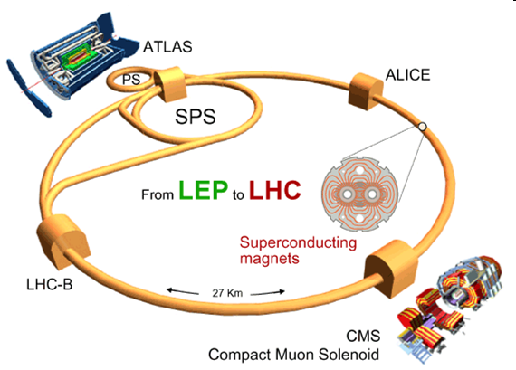

Slide 14
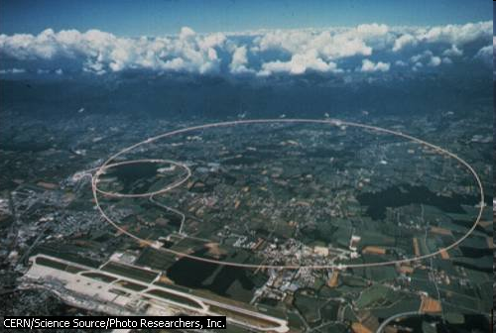

Slide 15
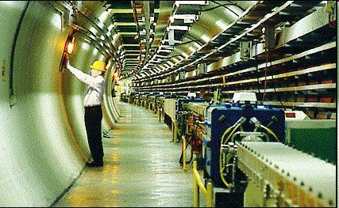
Superconducting magnets
Energy of particles
Why we have particle accelerators

Slide 16
Earth’s Magnetic field
Explain angle to B-Field
(vertical B field, velocity angled upward)

Slide 17
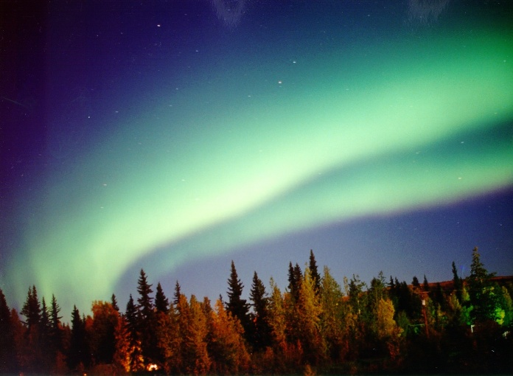

Slide 18
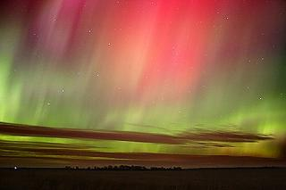

Slide 19
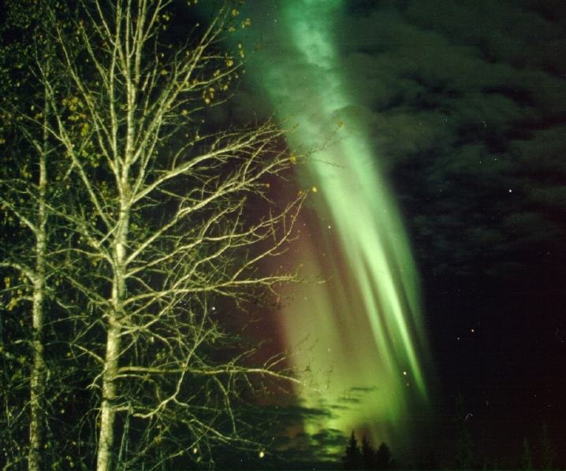

Slide 20
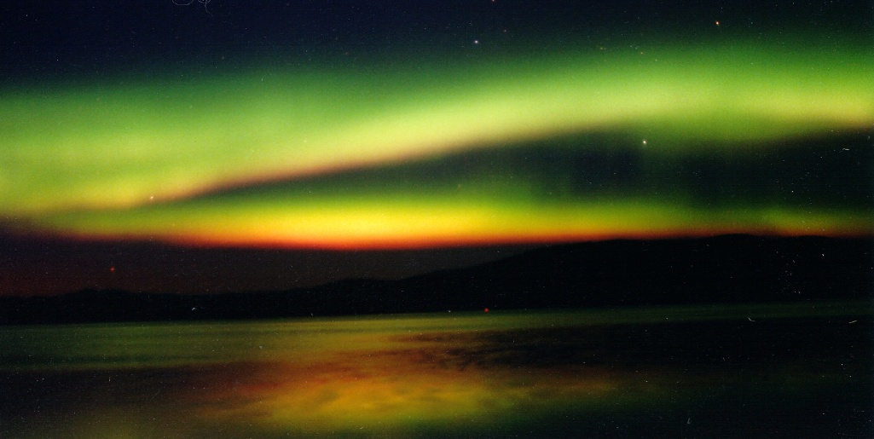

Slide 21
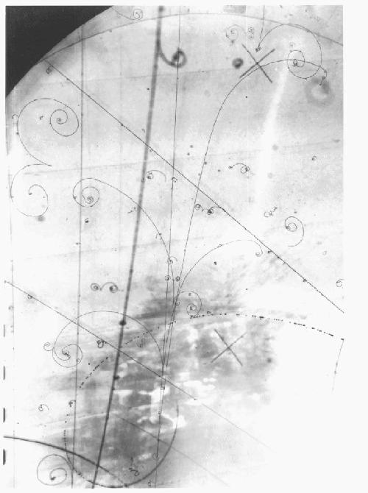
Bubble Chamber - particles make tracks in B field.
e-
e+
Directions, spiral

