Slide 1
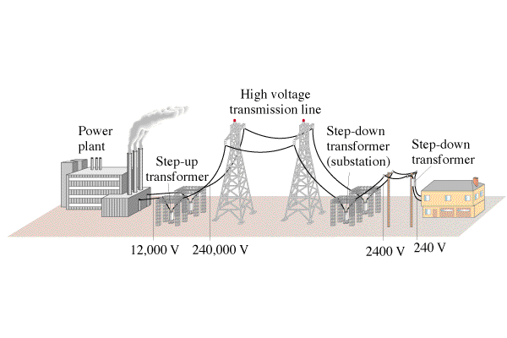
Calculate power lost

Slide 2
If you transmit 1000. W at 120 V on wires that have a resistance of 2.0 ohms, what power is lost?
If you transmit 1000. W at 12,000 0V on wires that have a resistance of 2.0 ohms, what power is lost?
Use P = IV, so I = P/V, and then P = I²R for power lost in each case…..
140 W, 0.014 W

