Slide 1
Forces on Charged particles
Derivation
Example
Whiteboards
Motion in a circle
Direction
Northern Lights
Whiteboards

Slide 2
Recall
F = IlBsinθ
Derive
F = qvBsinθ
F = force on moving particle
q = charge on particle (in C) (+ or -???)
v = particle’s velocity
θ = angle twixt v and B
Can a magnetic force increase a charged particle’s speed?

Slide 3
Example - proton going 4787.81 m/s
in earth’s magnetic field (5.0 x 10⁻⁵ T) What force?
. . . . . . . . . . . .
. . . . . . . . . . . .
. . . . . . . . . . . .
. . . . . . . . . . . .
. . . . . . . . . . . .
. . . . . . . . . . . .
. . . . . . . . . . . .
. . . . . . . . . . . .
. . . . . . . . . . . .
. . . . . . . . . . . .
. . . . . . . . . . . .
p+
v = 4787.81 m/s
q = 1.602 x 10⁻¹⁹ C
F = qvBsinθ
F = qvBsinθ
F = (1.602 x 10⁻¹⁹ C)(4787.81 m/s)(5.0 x 10⁻⁵ T)sin(90º)
F = 3.8 x 10⁻²⁰ N

Slide 4
Consider the path of particle
Force is centripetal
. . . . . . . . . . . .
. . . . . . . . . . . .
. . . . . . . . . . . .
. . . . . . . . . . . .
. . . . . . . . . . . .
. . . . . . . . . . . .
. . . . . . . . . . . .
. . . . . . . . . . . .
. . . . . . . . . . . .
. . . . . . . . . . . .
. . . . . . . . . . . .
F
F
F
F
If at 90º
qvB = ma = mv²/r
qvB = mv²/r
qB = mv/r, r = mv/(qB)
r = (1.673 x 10⁻²⁷ kg)(4787.81 m/s)/(1.602 x 10⁻¹⁹ C)/(5.0 x 10⁻⁵ T)
r = 1.0000 m = 1.0 m

Slide 5
What is the path of the proton in the B field?
p+
. . . . . . . . . .
. . . . . . . . . .
. . . . . . . . . .
. . . . . . . . . .
. . . . . . . . . .
. . . . . . . . . .
. . . . . . . . . .
. . . . . . . . . .
. . . . . . . . . .
. . . . . . . . . .
CW

Slide 6
What is the path of the electron in the B field?
e-
. . . . . . . . . .
. . . . . . . . . .
. . . . . . . . . .
. . . . . . . . . .
. . . . . . . . . .
. . . . . . . . . .
. . . . . . . . . .
. . . . . . . . . .
. . . . . . . . . .
ACW

Slide 7
What is the path of the proton in the B field?
. . . . . . . . . .
. . . . . . . . . .
. . . . . . . . . .
. . . . . . . . . .
. . . . . . . . . .
. . . . . . . . . .
. . . . . . . . . .
. . . . . . . . . .
. . . . . . . . . .
. . . . . . . . . .
. . . . . . . . . .
. . . . . . . . . .
. . . . . . . . . .
. . . . . . . . . .
. . . . . . . . . .
p+
CW

Slide 8
What is the path of the electron in the B field?
e-
x x x x x x x x x x x x
x x x x x x x x x x x x
x x x x x x x x x x x x
x x x x x x x x x x x x
x x x x x x x x x x x x
x x x x x x x x x x x x
x x x x x x x x x x x x
x x x x x x x x x x x x
x x x x x x x x x x x x
x x x x x x x x x x x x
CW

Slide 9
What is the path of the proton in the B field?
x x x x x x x x x x
x x x x x x x x x x
x x x x x x x x x x
x x x x x x x x x x
x x x x x x x x x x
x x x x x x x x x x
x x x x x x x x x x
x x x x x x x x x x
x x x x x x x x x x
x x x x x x x x x x
x x x x x x x x x x
x x x x x x x x x x
x x x x x x x x x x
x x x x x x x x x x
x x x x x x x x x x
x x x x x x x x x x
x x x x x x x x x x
p+
ACW

Slide 10
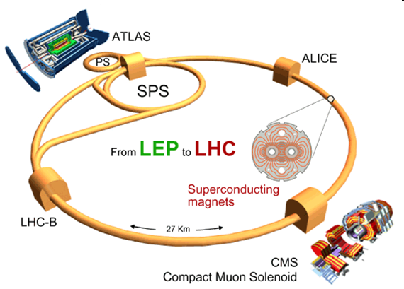

Slide 11
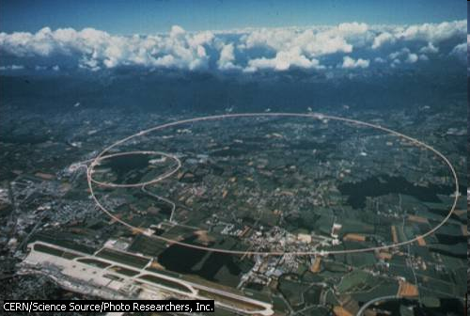

Slide 12
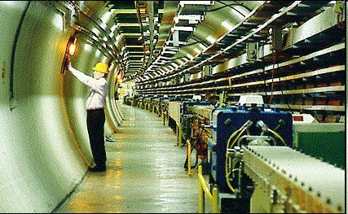
Superconducting magnets
Energy of particles
Why we have particle accelerators

Slide 13
Whiteboards -
Force: qvB = mv²/r
1 | 2

Slide 14
If the electron is going 1.75 x 10⁶m/s, and the magnetic field is .00013 T, what is the radius of the path of the electron?
m = 9.11 x 10⁻³¹ kg
q = 1.602 x 10⁻¹⁹ C
F = qvBsinθ
F = ma, a = v²/r
x x x x x x x x x x
x x x x x x x x x x
x x x x x x x x x x
x x x x x x x x x x
x x x x x x x x x x
x x x x x x x x x x
x x x x x x x x x x
x x x x x x x x x x
x x x x x x x x x x
x x x x x x x x x x
x x x x x x x x x x
x x x x x x x x x x
x x x x x x x x x x
x x x x x x x x x x
x x x x x x x x x x
x x x x x x x x x x
x x x x x x x x x x
F = qvBsinθ
F = ma, a = v²/r
qvB = mv²/r
r = mv/qB
r = 0.07655 m = 7.7 cm
e-
7.7 cm

Slide 15
What B-Field do you need to make a proton going 2.13 x 10⁷ m/s go in a 3.2 cm radius circle?
m = 1.673 x 10⁻²⁷ kg
q = 1.602 x 10⁻¹⁹ C
F = qvBsinθ
F = ma, a = v²/r
F = qvBsinθ
F = ma, a = v²/r
qvB = mv²/r
B = mv/qr
B = 6.951 T = 7.0 T
7.0 T

Slide 16
Earth’s Magnetic field
Explain angle to B-Field
(vertical B field, velocity angled upward)

Slide 17
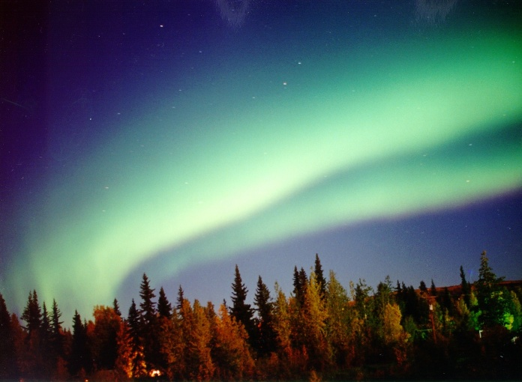

Slide 18
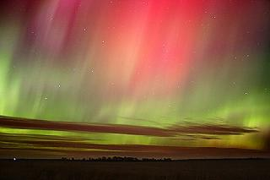

Slide 19
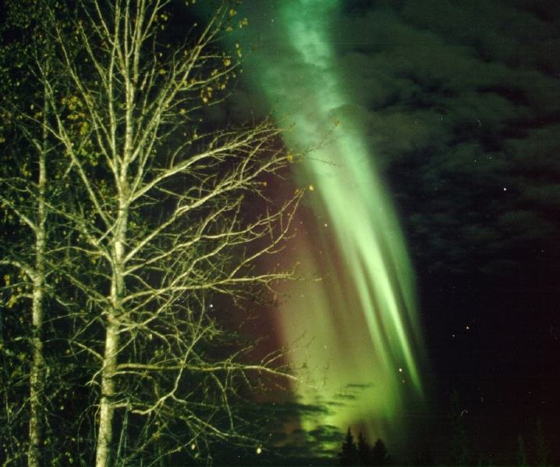

Slide 20
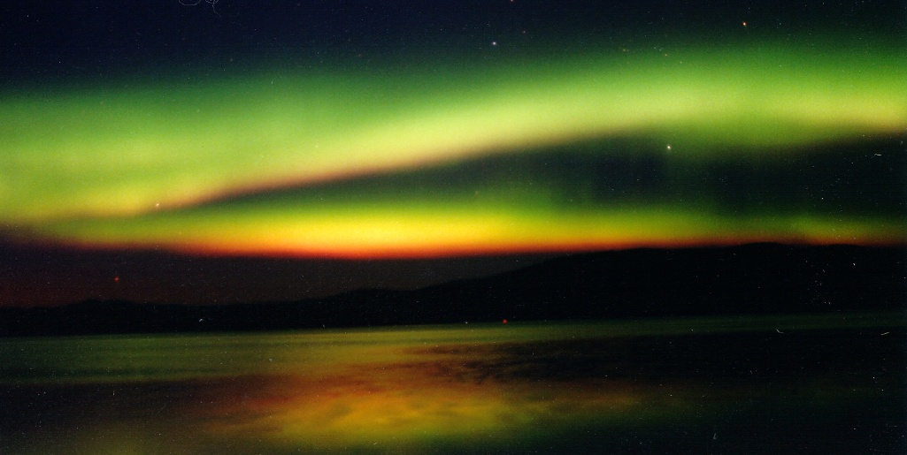

Slide 21
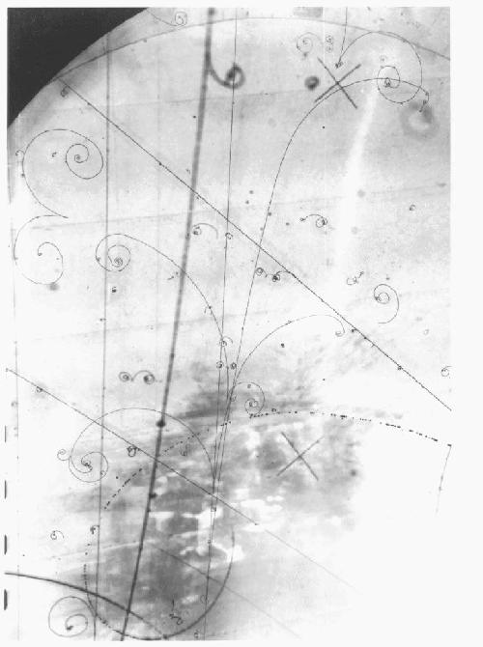
Bubble Chamber - particles make tracks in B field.
e-
e+
Directions, spiral

