Slide 1
1. How much current flows when you hook a 45.0 Ω heater up to a 117 V source? (2.60 A)

Slide 2
2. A resistor is connected to 5.00 V and there is a current of 125 mA flowing. What is the resistance? (40.0 Ω)

Slide 3
3. What is the voltage across a 220. Ω resistor with a current of 12.0 mA flowing through it? (2.64 V)

Slide 4
4. If you want to limit the current to 0.450 A, what resistance would you use with 12.0 V (26.7 Ω)

Slide 5
5. What must be the current flowing through a 945 Watt heater connected to a 12.0 V source? (78.75 A)

Slide 6
6. A 1400. W heater plugs into a 120. V source. What must be its resistance? (10.3 Ω)

Slide 7
7. A 165 W heater has a resistance of 1.85 Ω. At what voltage must it operate? (17.5 V)

Slide 8
8. A 385 Ω resistor is rated at 0.250 Watts. What is the maximum current that can flow through it? (25.5 mA)

Slide 9
9. What time must a 215 mA current flow to deliver 2.30 C of charge? (10.7 s)

Slide 10
10. A capacitor bank is charged at an average rate of 0.312 A. What charge is moved in 2.00 minutes? (37.4 C)

Slide 11
11. An elevator motor must draw 15.1 A of current, and lift an 875 kg elevator from the ground to a height of 22.5 m in 58.0 s. What must be the input voltage for the elevator? (221 V)

Slide 12
12. A 1.95 Ω heater core operating at 32.0 V is used to heat 1.40 liters of water initially at 21.0 ºC. What time will it take to reach boiling if it loses no heat to the surroundings? (Cwater = 4186 J kg⁻¹ ºC⁻¹) (882 s)

Slide 13
13. A 78.0 kg go cart is sped up from rest by a motor with an effective resistance of the 0.961 Ω, and that draws an average of 12.5 A of current. What is the final speed of the go cart after 10.0 seconds assuming there is no friction or other losses? (6.20 m/s)

Slide 14
14. A 12.2 Ω heater is connected to an alternating current with a peak voltage of 172 V. What is the power dissipated? (1212 W)

Slide 15
15. A heater runs on alternating current. The peak voltage across the heater is 35.0 V, and the peak current through the heater is 3.80 A. What is the power consumption of the heater? (66.5 W)

Slide 16
16. A 1400. Watt heater runs on alternating current at 120. V (RMS). What is the peak current flowing? (16.5 A)

Slide 17
17. What is the power of a heater that operates with a peak current of 12.9 A and has a resistance of 2.50 Ω?
(208 W)

Slide 18
18. A 113 Ω heater is dissipating 825 W of power. What must be the peak voltage if it operates on an alternating current source? (432 V)

Slide 23
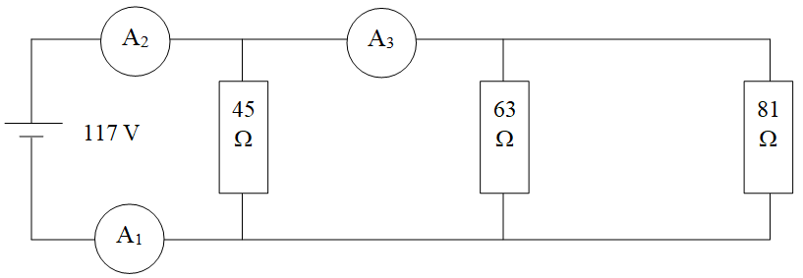

Slide 28
