Slide 1
Group Quiz E-G

Slide 2
1. What is the gravitational force on a 3.40 kg mass in a gravitational field with a strength of 9.81 N/kg?

Slide 3
2. A -140. μC charge experiences a force of 1.50 N to the right. What is the magnitude and direction of the electric field?

Slide 4
3. A 3.20 kg mass on the moon experiences a force of 5.15 N. What is the gravitational field strength on the moon?

Slide 5
4. A 72,100 N/C electrical field to the right exerts what force on a proton? (Force and direction)

Slide 6
5. A proton accelerates North at 9.58x10⁸ m/s/s. What is the magnitude and direction of the electric field?

Slide 7
6. An electron is in a 317 N/C electric field to the West. What is the magnitude and direction of its acceleration?

Slide 8
7. What is the electrical field 82.0 cm to the right of a -2.10 μC charge? (Magnitude and direction)

Slide 9
8. Where is the electrical field 1.25x10⁴ N/C straight up in the proximity of a 13.0 μC charge. (Location and distance)

Slide 10
9. I am 2.15 m to the left of an unknown charge, and there is an electric field of 1.65x10⁵ N/C to the right. What is the magnitude and polarity of the charge? (How many C, and is it + or -)

Slide 11
10a. What is the gravitational field on the surface of a planet with a mass of 1.60x10²³ kg, and a radius of 1.85x10⁶ m?

Slide 12
10b. What is the gravitational field 3.50 m to the left of a (very dense) mass of 6.40x10¹² kg? (Magnitude and direction)

Slide 13
11. Where in the proximity of a 5.00 kg shot put is the gravitational field 2.08x10⁻¹¹ N/kg to the right? (Location and distance)

Slide 14
12. I am 15.0 m to the right of an unknown mass and there is a gravitational field of 2.16 N/kg due to the mass. Which direction is the field, and what is the mass?

Slide 15
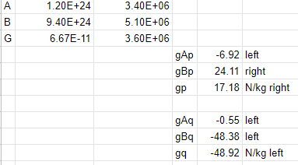

Slide 16
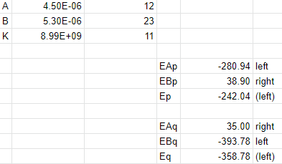

Slide 17
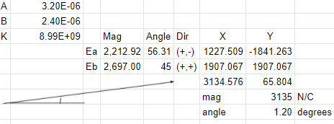

Slide 18
