Slide 1
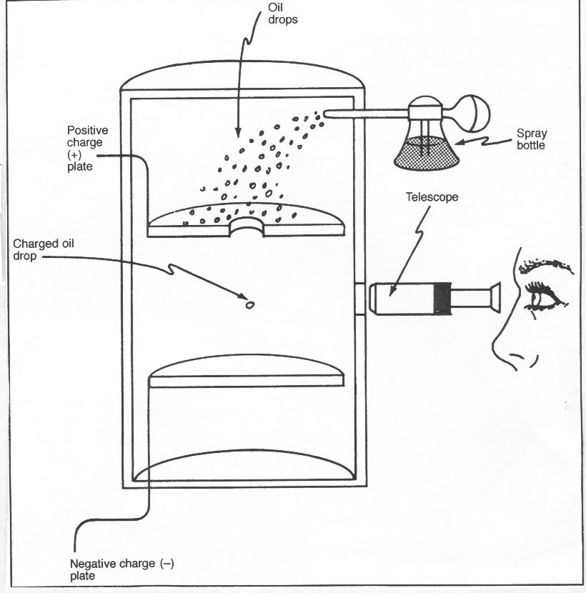
Overview

Slide 2
