Slide 1
13 N

Slide 2
2.7E-3 N

Slide 3
12
+75µC: 147.2 N left, +48µC: 563.5 N right, -85µC: 416.3 N left

Slide 4
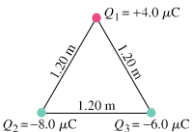
17
Q₁: 0.30 N @ 265º, Q₂: 0.26 N @139º

Slide 5
8.4E7 N/C toward the negative charge

Slide 6
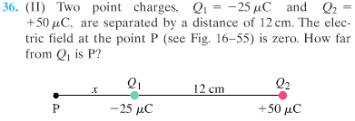
29 cm

Slide 7
4.2E-4 J

Slide 8
3.8E4 V/m

Slide 9
2.40E5 V

Slide 10
4.8E3 m/s

Slide 11
5.0E7 m²

Slide 12
4.6E-4 J

Slide 13
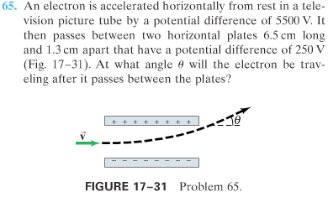
6.5º

Slide 14
answer

Slide 15
answer

Slide 16
answer

Slide 17
answer

Slide 18
answer

