Slide 1
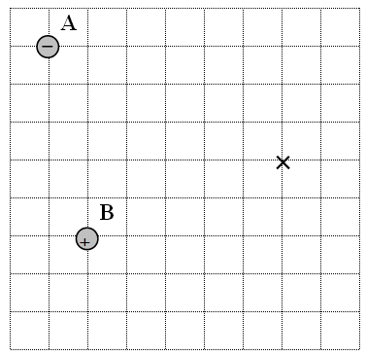
Charge A is -1.20 μC, charge B is +3.40 μC Find the Potential at the x
(Each square is a meter)
4.07x10³ V

Slide 2
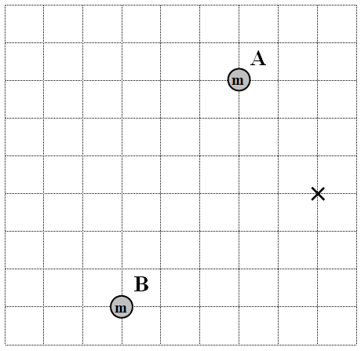
Mass A is 2.30x10¹² kg, mass B is 8.70x10¹² kg Find the Potential at the x
(Each square is a meter)
-142 J/kg

Slide 3
Whiteboards:
Voltage charge arrays
1 | 2 | 3

Slide 4
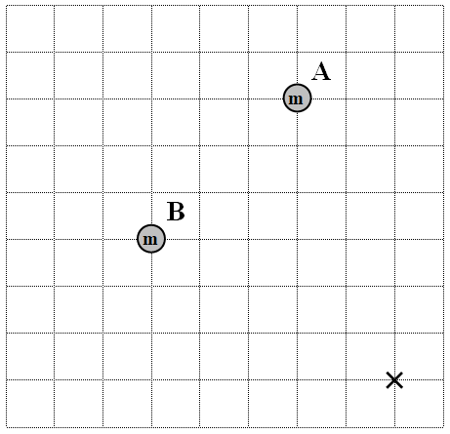
Mass A is 5.10x10¹² kg, mass B is 2.40x10¹² kg Find the Potential at the x
(Each square is a meter)
-81.2 J/kg

Slide 5
Find the voltage at point C
C
-4.1 μC
38 cm
85 cm
Q₁
Q₂
+1.1 μC
-14,000 V

Slide 6
Find the voltage at point B
+1.1 μC
+2.1 μC
91 cm
B
138 cm
Q₁
Q₂
25,000 V

Slide 7
Each grid is a meter. If charge A is -14.7 μC, and charge B is +17.2 μC, calculate the voltage at the origin:
y
A
x
B
+2.26E4 V

Slide 8
Find the voltage in the center of a square 45.0 cm on a side whose corners are occupied by 12.0 μC charges.
1.36x10⁶ V

Slide 9
Voltages in non linear arrays
Find the voltage at point A:
A
x
+1.5 μC
+3.1 μC
75 cm
190 cm
Q₁
Q₂
2.6x10⁴ V

