Slide 1
1. If it takes +34.0 J of work to move a -250. µC charge from plate A to plate B, what is the potential difference, and which plate is more positive, A or B? (136,000 V, A is more positive)

Slide 2
2. What is the velocity of a proton accelerated through 3.70 Volts from rest? (2.66x10⁴ m/s)

Slide 3
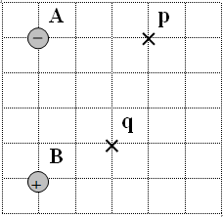
3. Find the electric potential at point p and point q. Charge A is -3.10 µC, B is +2.60 µC, and each grid line is a meter. (p: -4614.9 J/C or V, q: +2723.7 J/C)

Slide 4
4. What work would it take to move a +370. µC charge from point q to point p? (p: -4614.9 J/C or V, q: +2723.7 J/C)
(-2.72 J)

Slide 5
5. A 5.20 kg piece of rock is in an elliptical orbit around a 4.80x10²⁴ kg planet. At one point in time, its velocity is 6790 m/s when it is at a distance of 8.40x10⁶ m from the planet's center. What is its distance from the planet's center when it is going 5860 m/s? (9.93x10⁶ m)

