Slide 1
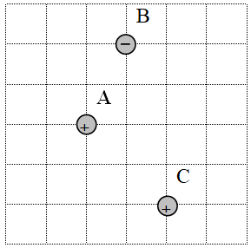
5. Each grid line is a meter. Charge A is +160. µC, and charge B is -210. µC, and C is +630. µC. Calculate the force on charge A. Draw the force vector and label its magnitude and direction.
(144 N left and up at 68.4º above the x-axis)

