Slide 1
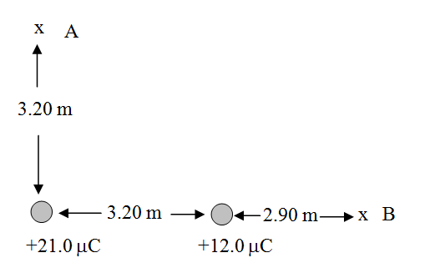
What is the electric field at A and B?
 | mag | angle | x | y
1 | 5073.636 | 0 | 5073.636119 | 0
2 | 12827.59 | 0 | 12827.58621 | 0
 |  |  | 17901.22233 | 0
 |  |  | mag | 17901.22
 |  |  | Angle with x | 0
18436.52 | 90 | 1.12937E-12 | 18436.52
5267.578 | 135 | -3724.740213 | 3724.74
 |  | -3724.740213 | 22161.26
 |  | mag | 22472.1
 |  | Angle with x | 80.45922

