Slide 1
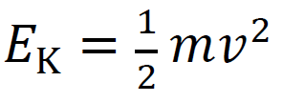
Conservation of energy
An 89.0 gram +2.30 µC charge is brought to 15.0 cm from a +1.10 μC charge. The 2.30 µC charge is released from rest, while the +1.10 μC is held fixed. What is its speed when it is 37.0 cm away? When it is very far away? At what distance is it when it is going 1.60 m/s?
89.0 g
+2.30 μC
+1.10 μC
+
15.0 cm
+
+
37.0 cm
1.42 m/s, 1.85 m/s, 0.603 m

Slide 2
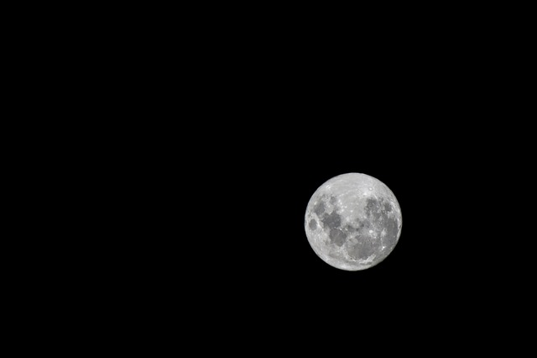
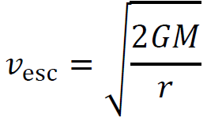
Suppose you fired a 2.3 g rifle bullet at 1150 m/s straight up from the surface of the moon.
A. What would be its greatest height it would reach?
B. What speed would it be going when it was 100. km above the surface?
C. What would its elevation be when it was traveling 500. m/s?
C. What speed would it need to escape the moon’s gravity?
Mass = 7.35x10²² kg
Radius = 1,737.1 km
531.6 km, 1008 m/s, 407 km, 2380 m/s

Slide 3
Whiteboards:
Conservation of Energy
1-9

Slide 4
A 45.0 gram mass traveling 23.0 m/s (when it is very far away) with a charge of +6.7 μC approaches a fixed charge of +12.3 μC directly.
A. How close will it get before it is stopped by the repulsion?
solution
0.0622 m, or 6.22 cm

Slide 5
A 45.0 gram mass traveling 23.0 m/s (when it is very far away) with a charge of +6.7 μC approaches a fixed charge of +12.3 μC directly.
A. How close will it get before it is stopped by the repulsion?
B. What is the speed of the moving mass when it is 0.150 m from the fixed charge?
solution
17.6 m/s

Slide 6
A 56.0 gram mass traveling 12.0 m/s (when it is very far away) with a charge of +15.0 μC approaches a fixed charge of -21.0 μC directly.
A. What is its speed when it is 0.750 m from the negative charge?
solution
16.7 m/s

Slide 7
An astronaut on a 3.70x10²⁰ kg moon with a radius of 1.60x10⁵ m fires a 4.30 g rifle bullet straight up at a speed of 710. m/s.
A. What is the escape velocity from this moon?
solution
555 m/s

Slide 8
An astronaut on a 3.70x10²⁰ kg moon with a radius of 1.60x10⁵ m fires a 4.30 g rifle bullet straight up at a speed of 710. m/s.
A. What is the escape velocity from this moon?
B. What is the speed of the bullet when it is very far away from the moon?
solution
442 m/s

Slide 9
An astronaut on a 3.70x10²⁰ kg moon with a radius of 1.60x10⁵ m fires a 4.30 g rifle bullet straight up at a speed of 710. m/s.
A. What is the escape velocity from this moon?
B. What is the speed of the bullet when it is very far away from the moon?
C. What is the speed of the bullet when it is 300. km above the moon’s surface?
solution
550. m/s

Slide 10
Two 63.0 gram masses have a charge of +45.0 μC each. If they are released from rest when they are 34.0 cm from each other,
A. How fast are they going when they are very far away from each other?
solution
29.2 m/s

Slide 11
Two 63.0 gram masses have a charge of +45.0 μC each. If they are released from rest when they are 34.0 cm from each other,
A. How fast are they going when they are very far away from each other?
B. What is their speed when they are only 0.500 m away from each other?
solution
16.5 m/s

Slide 12
A 3.00 g mass with a charge of +2.7 μC is 12.0 cm from a 5.00 g mass with a charge of +5.3 μC. If they are released from rest,
A. How fast are they each going when they are very far away from each other? (They will be going different velocities)
(hint: due to COM, the velocity of the 5 g will be 3/5 the velocity of the 3 g)
solution
3 g: 21.1 m/s 5 g: 12.7 m/s

