Slide 1
Methods of Charging
Contents:
Methods of charging
Friction
Conduction
Induction
Van de Graaff generators
How it works
Stupid tricks

Slide 2
Insulators and Conductors
Insulators - Charge cannot move
Conductors - Charge moves freely - stays on outside
Insulators
Glass
Wood
Plastics (organics)
Dry Air (10,000 V/inch)
Vacuum
Pure water
Conductors
Metals - sea of electrons
Graphite
Semiconductors
Salt water
Any ionic solutions
Ionized air

Slide 3
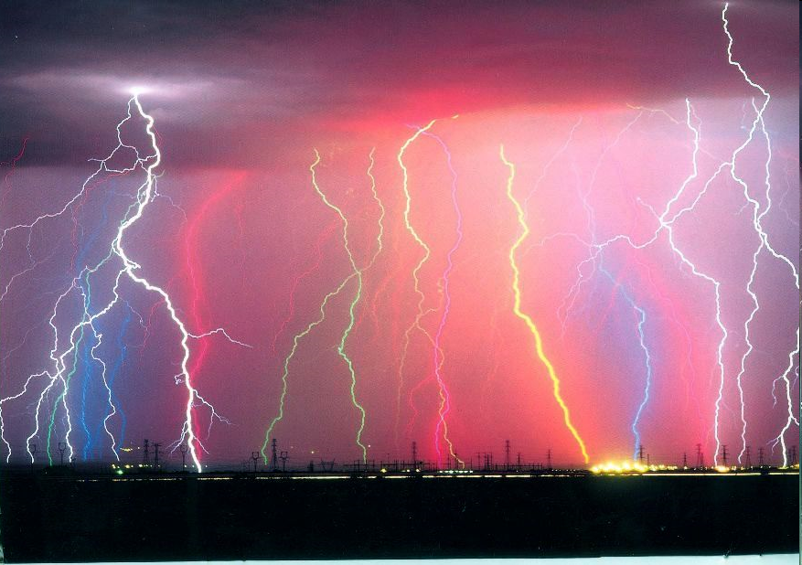

Slide 4
Methods of charging
Friction - greater/lesser affinity
Conduction - actual transfer of electrons (demo)
Induction - Charge just moves around (demo)
Visa/Mastercard/Discover
Demo Electroscope:
Inductive/Conductive
Grounding
with
Silk + plex
fur + rubber
Charge with VdG/induce Coronal with VdG
Discharge:dosimeter/match
Why there is an attraction?
Vdg and water (Why is there attraction)

Slide 5
Van de Graaff Generator
How it works
Charge stays on outside
Polished surface - coronal discharge
VdG’s Setup
30’ Domes in Hangar
Laboratory in domes
How to power
Pigeons
Stupid tricks
Ball
Motor 1 & 2
Hair

