Slide 1
IB8.1
Energy Production

Slide 2
Energy Density
Heating water
Thermal Power Plants

Slide 3
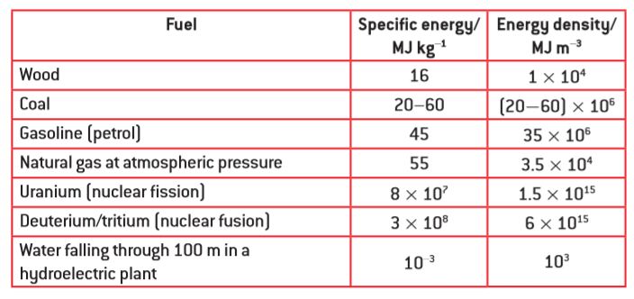
Concept 0 – Energy Density
How many grams of petrol must you burn to release 100 kJ of energy?
(2.22 grams)

Slide 4
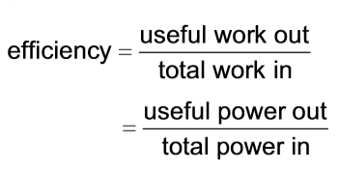
Concept 0 – Energy Density
A water heater uses natural gas to heat 195 liters of water from 15.0 ºC to 59.0 ºC. What mass of natural gas would this take for a 100% efficient heater? What if the efficiency is 56.0%
(c_{water} = 4186 J kg⁻¹ ºC⁻¹) (0.653 kg, 1.17 kg)

Slide 5
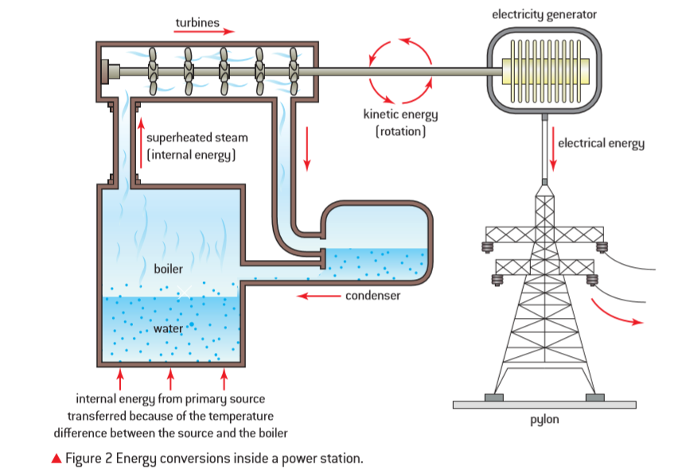
Thermal Power Stations

Slide 6
A coal fired electrical generation plant has an overall efficiency of 34.0% and generates an average of 180. MW of electrical power. What quantity of a coal with a specific energy of 47.0 MJ kg⁻¹ would this plant use in one week? (6.81x10⁶ kg)

Slide 7
Wipe boards

Slide 8
A water heater uses natural gas to heat 180. liters of water initially at 20.0 ºC. If the heater has an efficiency of 54.0%, what is the final temperature of the water after it has burned 0.500 kg of natural gas?
(c_{water} = 4186 J kg⁻¹ ºC⁻¹)
39.7 ºC

Slide 9
A natural gas electrical generation plant puts out an average of 312 MW of power for a year, and in the process, uses 4.36x10⁸ kg of natural gas. What is its overall efficiency?
41.0%

Slide 10
Pumped energy storage

Slide 11
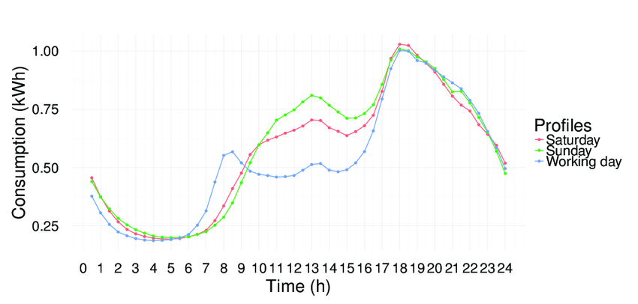
Daily electrical consumption:

Slide 12
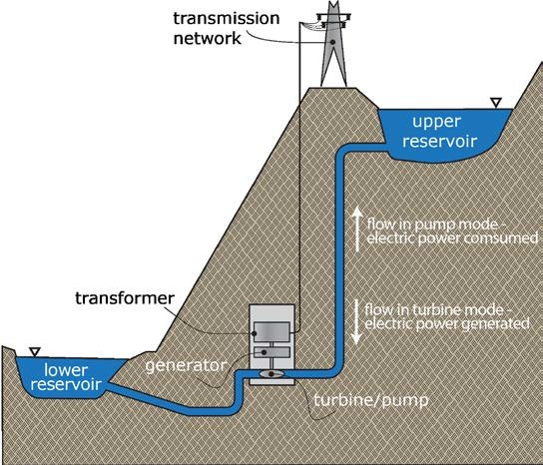

Slide 13
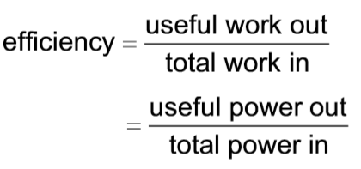
A 65.0% efficient pumped storage plant uses a reservoir that is 196 m higher than the generation site. What is its electrical power output if it is draining water from the reservoir a a rate of 1250 kg s⁻¹? (1.56 MW)

Slide 14
Wipe Board

Slide 15
A pumped electrical storage facility generates 1.66 MW of power. It has a reservoir height of 130. m, and releases 2240 kg of water per second. What is its overall efficiency?
58.1%

Slide 16
Solar Power

Slide 17
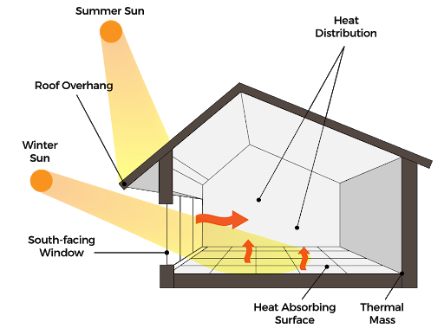
Passive solar basic

Slide 18
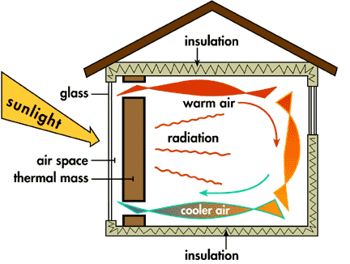
Passive solar with thermal mass

Slide 19
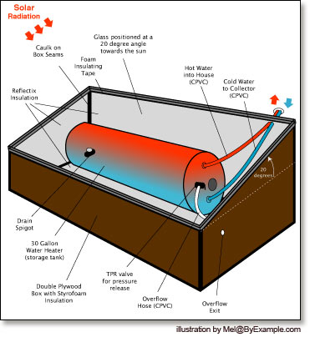
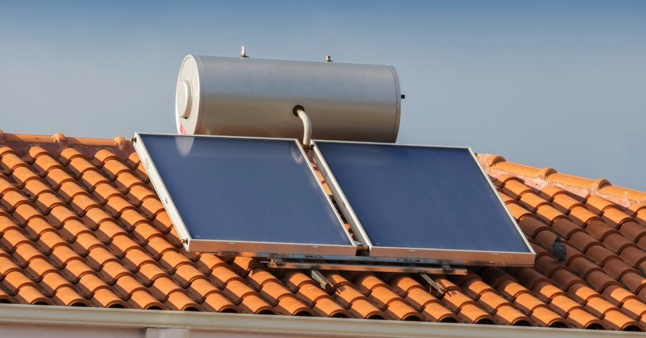
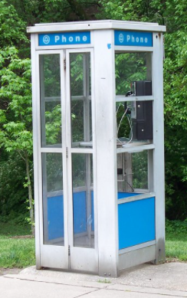
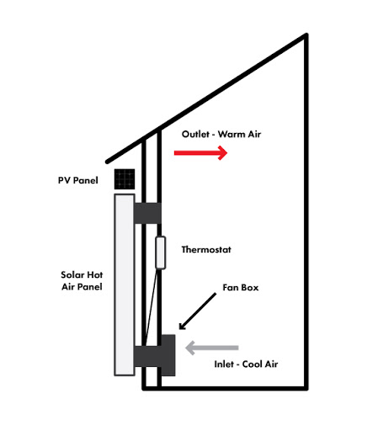
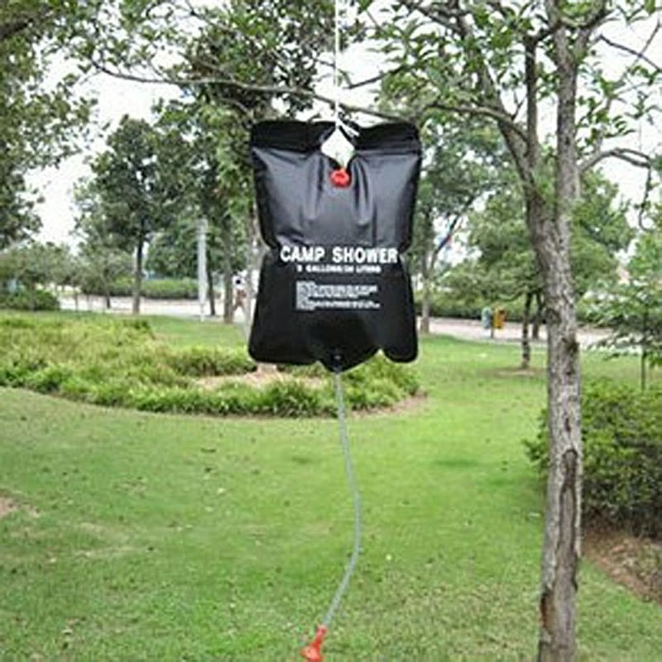
Heating water or air

Slide 20
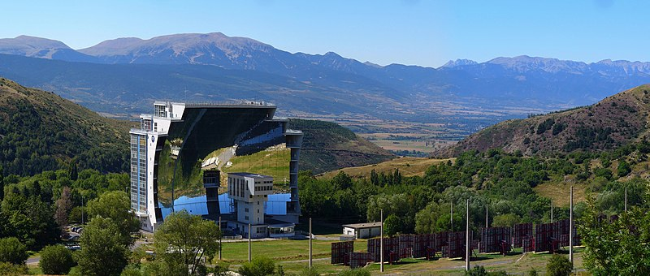

Slide 21
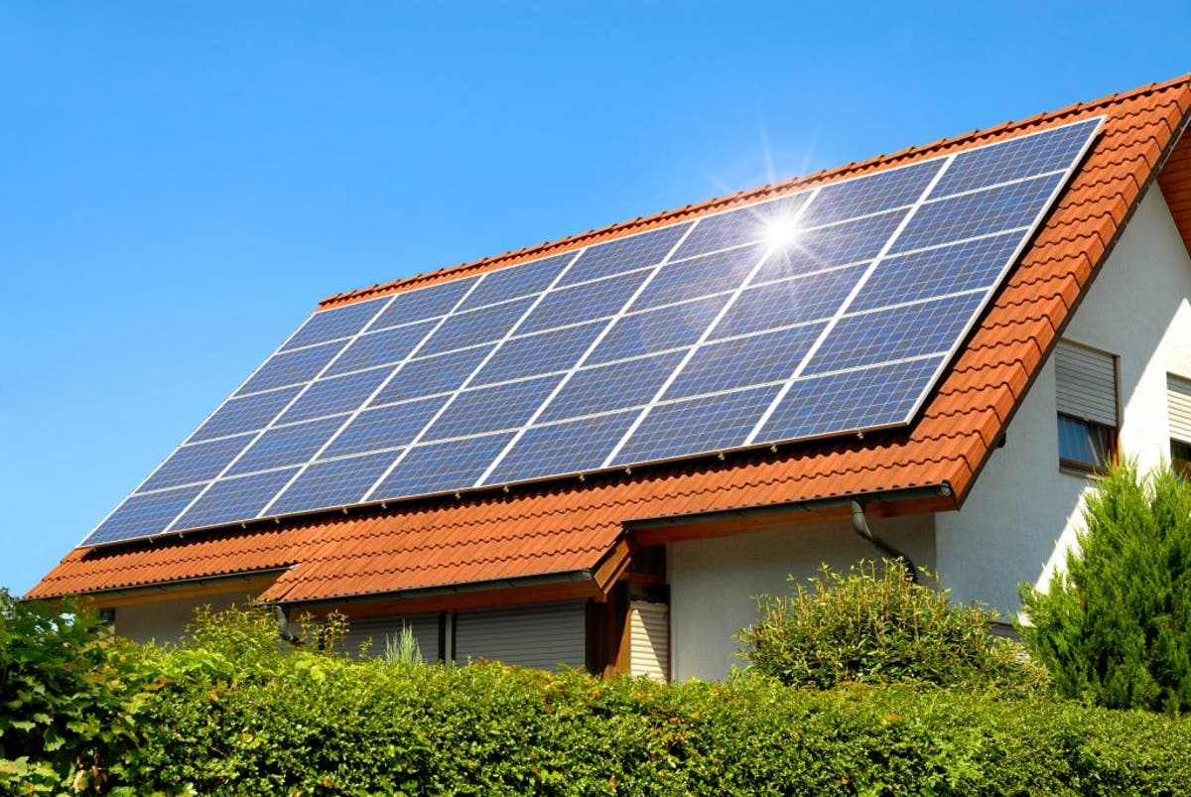
Photovoltaic (Not super efficient ≈ 20%)

Slide 22
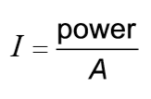
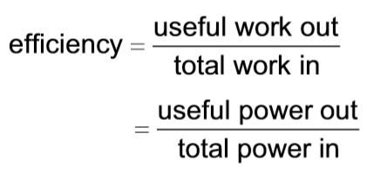
A photovoltaic panel measures 1.75 m by 1.10 m, and is 23.0% efficient. How much total electrical power can it put out if the solar intensity is 890 W m⁻²? How many Joules of electrical energy can it produce in a 6.00 hour period when the sun is hitting the panels? How many kWh of electricity? (394 W, 8.51x10⁶ J, 2.36 kWh)

Slide 23
Wipe Board

Slide 24
A house has a total of 12.8 m² of solar panels that generate a power of 2045 Watts when the solar intensity is 750. W m⁻². What is the efficiency of the panels?
21.3 %

Slide 25
Worksheet IB8.1

Slide 26
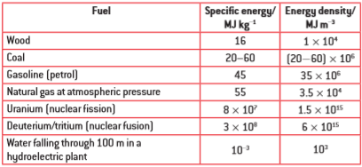
1. What is the energy content of 10.0 g of petrol (gasoline)? (450 kJ)

Slide 27
2. How many grams of coal must you burn to get 125 kJ of heat energy? Use an specific energy of 40.0 MJ kg⁻¹. (3.13 g)

Slide 28
3. How many grams of petrol must you burn to raise the temperature of 750. ml of water (C_{water} = 4186 J kg⁻¹ ºC⁻¹) from 15.0 ºC to 100.0 ºC? if the stove is 100% efficient? What if it is 65.0% efficient? (5.93 g, 9.12 g)

Slide 29
4. A gas water heater contains 189 liters of water at 15.0 ºC. If it is 55.0% efficient, and it burns 0.889 kg of natural gas, what is the final temperature of the water? (49.0 ºC, the delta T is 34.0 ºC)

Slide 30
5. An on demand water heater needs to heat 17.0 liters of water per minute from a temperature of 13.0 ºC to 54.3 ºC. How many grams of natural gas will it burn in one minute if it is 58.0% efficient?
(92.1 g)

Slide 31
6. A gas water heater can raise the temperature of 178 liters of water from 21.0 ºC to 65.0 ºC by burning 1.10 kg of natural gas. What is its efficiency? (54.2%)

Slide 32
7. A power plant generates 125 MW of power. How much energy does it generate in a day? If it is 37.0% efficient, what is the energy input in a day? How many kilograms of coal would it burn to produce that amount of energy? (Use an specific energy of 40.0 MJ kg⁻¹) How many kilograms of Uranium would it go through in a day? (1.08x10¹³ J, 2.92x10¹³ J, 7.30x10⁵ kg or 730 metric tons, 0.365 kg of Uranium)

Slide 33
8. A power plant is 37.0% efficient and burns 4190 kg of natural gas a day. What is its average power output? (987 kW)

Slide 34
9. A natural gas generation plant generates a power output of 0.850 MW. It consumes 159 kg of natural gas per hour. What is its efficiency? (35.0%)

Slide 35
10. How many kg of natural gas will a 145 MW natural gas electrical generation plant that is 34.0% efficient burn in a year? (2.45x10⁸ kg)

Slide 36
11. A giant wind turbine has a radius of 43.9 meters, and operates where the average wind speed is 6.64 m/s, and the air density is 1.31 kg m⁻³. What is the maximum amount of power available to it? What power does it capture if the air exiting the turbine is still going 5.14 m/s? If the electrical generator is 89.0% efficient, what electrical power does it create? (1.16 MW, 622 kW, 554 kW)

Slide 37
12. A wind turbine slows air with a density of 1.25 kg m⁻³ from 7.12 m/s to 6.50 m/s and needs to capture 26.5 kW of power. What radius does it need to be? How many of these would you need to capture 1.20 MW of power? (12.5 m, about 45, I suppose 46 to be more than that)

Slide 38
13. A wind turbine with 15.0 m blades captures 45.8 kW of power from air with a density of 1.35 kg m⁻³ initially moving at 6.15 m/s. What is the speed of the air leaving the turbine? (5.15 m/s)

Slide 39
14. A wind farm operates in air with a density of 1.30 kg m⁻³ . The individual turbine blades are 45.1 m long, and the average wind speed is 5.40 m/s. If the turbines have an overall efficiency of 41.5%, what is its average power output of a single turbine? How many of these turbines would you need if you wanted to generate 120. MW? (271 kW, about 442)

Slide 40
15. A wind turbine with 35.0 m long blades slows air with a density of 1.30 kg m⁻³ from 8.15 m/s to 7.25 m/s. What power does it capture from the wind? If the electrical generator is 92.0% efficient, what is the power output? (401 kW, 369 kW)

Slide 41
16. A pumped storage system allows water to fall through a vertical distance of 270. m at a rate of 450. kg s⁻¹. What is the total power being transformed? If the generation system has an overall efficiency of 56.0 % what is the electrical power output? (1.19 MW, 667 kW)

Slide 42
17. You are designing a pumped storage system. You can raise the reservoir a height of 85.0 m above the generation site, and the overall efficiency is 62.0%. What flow rate in kg s⁻¹ do you need to have to generate 125 kW? (242 kg s⁻¹)

Slide 43
18. A pumped storage facility is generating 860. kW of electrical power with a flow rate of 712 kg s⁻¹, and an overall efficiency of 67.0%. What height is the reservoir above the generation site?
(184 m)

Slide 44
19. A pumped storage system is generating 413 kW of electricity with a reservoir that is 312 m above the generation site, and is operating a flow rate of 237 kg s⁻¹. What is its overall efficiency? (56.9%)

Slide 45
20. A 72.0% efficient pumped storage plant operates with a vertical displacement of 185 m, and lets 2740 kg of water per minute into the generator. What is its power output? (59.7 kW)

Slide 46
21. A house has solar panels that measure 1.65 m by 0.991 m, and are 22.3% efficient. If the sunlight has an intensity of 850. W m⁻², what is the electrical power generated by a single panel? How many panels would you need to generate at least 4 kW? (310. W, 13)

Slide 47
22. A house has 12 solar panels with an efficiency of 21.5% that measure 1.57 m by 1.05 m, and are generating 4020 W of power. What is the intensity of the solar radiation? (945 W m⁻²)

Slide 48
23. You need to generate 5.60 kW of power for a house with solar panels that have an efficiency of 23.0% and the average intensity of sunlight is 450. W m⁻². What area do you need? (54.1 m²)

Slide 49
24. Some solar panels measure 1.60 m by 1.02 m, each one generating 275 W of power when the sunlight intensity is 750. W m⁻². What is the efficiency of the panels? (22.5%)

Slide 50
25. A house has 35.0 m² total area of solar panels with an efficiency of 24.0%. What is the power output when the sunlight intensity is 1020 W m⁻²? (8570 W)

Slide 51
FAIB8.1

Slide 52
1. A 57.0% efficient gas water heater contains 175 liters of water at 18.0 ºC. What is the temperature of the water (c = 4186 J kg⁻¹ ºC⁻¹) after it has burned 0.784 kg of natural gas? (The specific energy of natural gas is 55 MJ kg⁻¹)

Slide 53
2. A 42.0% efficient power plant burns coal and generates an average power output of 2.60 MW. How many kilograms of coal will it burn in a year? (The specific energy of the coal used is 47.0 MJ kg⁻¹)

Slide 54
3. Air with a density of 1.28 kg m⁻³ enters a 24.0 m radius wind turbine at 7.30 m/s and exits at 6.10 m/s. It generates 160. kW of electrical power. What is the efficiency of the generator in turning the captured wind energy into electrical energy?

Slide 55
4. You are designing a pumped storage electrical generation site. It needs to generate 950. kW of electrical power with a flow rate of 860. kg s⁻¹. What height above the generation site does the reservoir need to be if such systems are typically 65.0% efficient?

Slide 56
5. A solar panel measures 2.74 m by 1.35 m, and generates 547 W of power when the sunlight intensity is 800. W m⁻². What is the efficiency of the panels?

Slide 57
Question

