Slide 1
15.3
Thermodynamics

Slide 2
FA 15.3

Slide 3
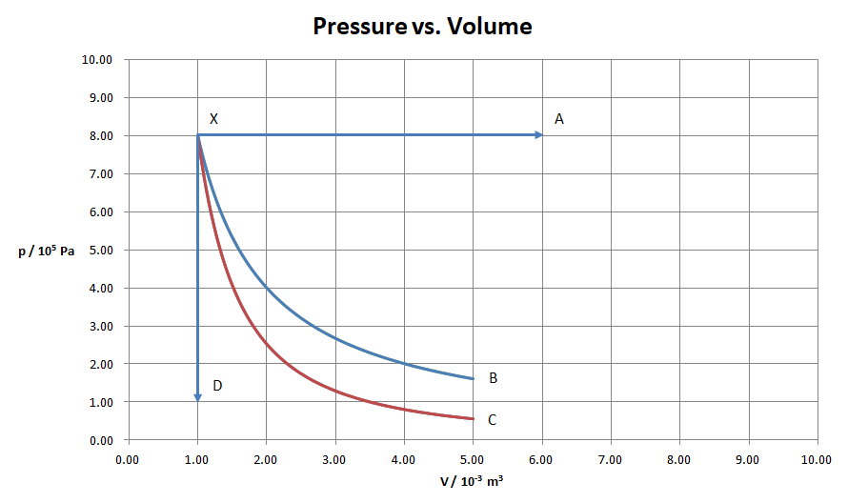
Process XB is isothermal, XC adiabatic. The temperature at X is 430. K
A. For process XA, find the temperature at A, and the W, ΔU, and Q. [3]

Slide 4
Process XB is isothermal, XC adiabatic. The temperature at X is 430. K
B. For process XC find the W, ΔU, and Q. [3]

Slide 5
Process XB is isothermal, XC adiabatic. The temperature at X is 430. K
C. For process XD find the temperature at D, and the W, ΔU, and Q. [2]

Slide 6
Process XB is isothermal, XC adiabatic. The temperature at X is 430. K
D. For process XB the work done is 1288 J. Find the pressure at B, and the W, ΔU, and Q. [2]

Slide 7
Worksheet 15.3

Slide 8
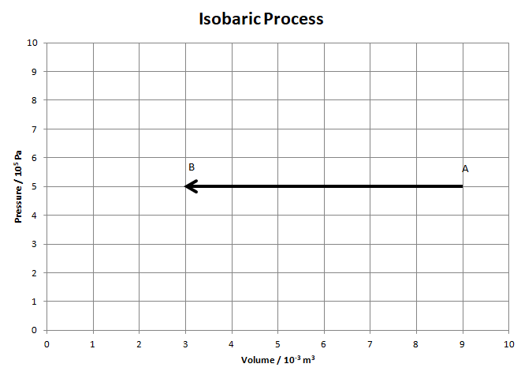
1. Consider this isobaric process for 0.9025 moles of an ideal gas.
a. Calculate the temperature at A and B
(A: 600 K, B: 200 K)
b. Find Q, ΔU, and W for this process.
(Q = -7500 J, ΔU = -4500 J, W = -3000 J)

Slide 9
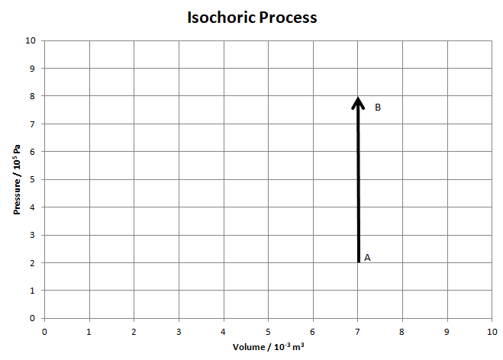
2. Consider this isochoric process. The ideal gas starts at A at a temperature of 120 K.
a. How many moles of gas are there in the cylinder? (1.40 moles)
b. What is the temperature at B? (480 K)
c. Find Q, ΔU, and W for this process.
(Q = +6300 J, ΔU = +6300 J, W = 0 J)

Slide 10
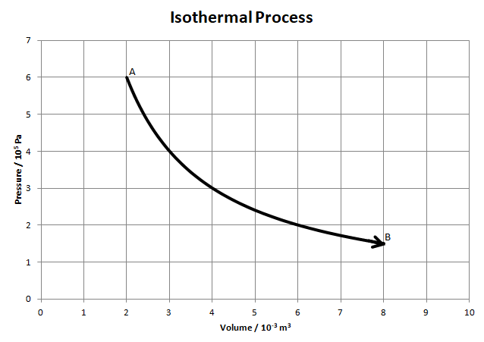
3. Consider the isothermal expansion AB for 0.4513 moles of an ideal gas. The gas starts at A with a pressure of 6.0x10⁵ Pa and a volume of 2.0x10⁻³ m³. At B the volume is 8.0x10⁻³ m³.
a. What is the temperature at A? How could you show that the process is isothermal? (320 K)
b. What is the pressure at B? (1.5x10⁵ Pa)
c. What is the temperature at B? (320 K)
d. The work done for this process is about +1664 J. Calculate the Q and ΔU. (Q = +1664 J, ΔU = 0)

Slide 11
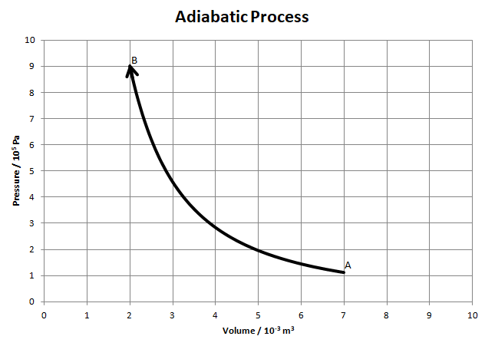
4. Consider the adiabatic compression AB. At point B (at the end) the gas is at a pressure of 9.0x10⁵ Pa, a volume of 2.0x10⁻³ m³, and a temperature of 850 K. It starts at a volume of 7.0x10⁻³ m³.
a. How many moles of gas are there?
(0.255 moles)
b. What is the pressure at point A?
(1.12x10⁵ Pa)
c. What is the temperature at point A? (369 K)
d. Calculate the Q, ΔU and W for this process. (Calculate ΔU first) (Q = 0, ΔU = +1529 J, W = -1529 J)

Slide 12
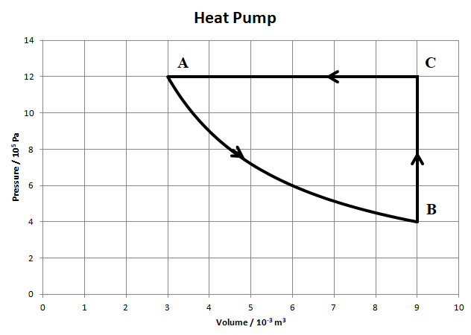
5. Consider the process ABCA for 1.45 moles of gas. The work done by the gas for process AB is 3955 J.
a. Show that process AB is isothermal. (Do some calculations)
b. Find the temperatures at the vertices A, B and C. (A: 299 K, B: 299 K, 896 K)

Slide 13
A,B: 298.76758 K, C: 896.30275 K
The work done by the gas for process AB is 3955 J.

Slide 14
A,B: 298.76758 K, C: 896.30275 K
The work done by the gas for process AB is 3955 J.

Slide 15
A,B: 298.76758 K, C: 896.30275 K
The work done by the gas for process AB is 3955 J.

Slide 16
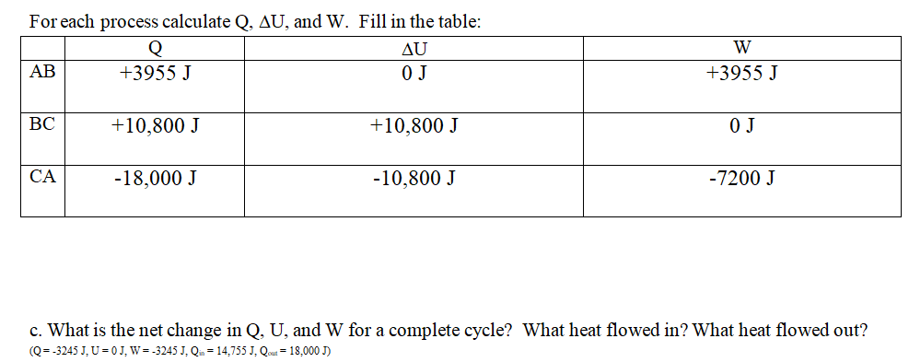
d. This is a heat pump. The overall “W” is provided by electrical energy, and the heat that flows in during process AB and BC comes from cooler air outside. The heat that flows out in CA heats your house. The ratio of this heat to the work we provide is called the COP (Coefficient of Performance) Calculate the COP for this heat pump (5.55)

Slide 17
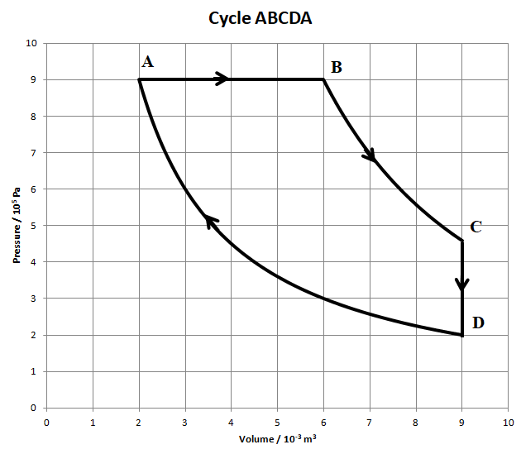
6. Consider cycle ABCDA below. AB is an isobaric expansion, BC is adiabatic, CD is isochoric, and DA is isothermal. Point A is at a temperature of 350 K. The work done by the gas for BC is 1919 J. The work done on the gas for DA is 2707 J.
a. How many moles of gas are present?
(0.619 moles)
b. What is the temperature at point B? (1050 K)
c. What is the pressure and temperature at point C? (4.58x10⁵ Pa, 801 K)
d. State the temperature of point D. (350 K)

Slide 18
6. Consider cycle ABCDA below. AB is an isobaric expansion, BC is adiabatic, CD is isochoric, and DA is isothermal. Point A is at a temperature of 350 K. The work done by the gas for BC is 1919 J. The work done on the gas for DA is 2707 J.

Slide 19
6. Consider cycle ABCDA below. AB is an isobaric expansion, BC is adiabatic, CD is isochoric, and DA is isothermal. Point A is at a temperature of 350 K. The work done by the gas for BC is 1919 J. The work done on the gas for DA is 2707 J.

Slide 20
6. Consider cycle ABCDA below. AB is an isobaric expansion, BC is adiabatic, CD is isochoric, and DA is isothermal. Point A is at a temperature of 350 K. The work done by the gas for BC is 1919 J. The work done on the gas for DA is 2707 J.

Slide 21
6. Consider cycle ABCDA below. AB is an isobaric expansion, BC is adiabatic, CD is isochoric, and DA is isothermal. Point A is at a temperature of 350 K. The work done by the gas for BC is 1919 J. The work done on the gas for DA is 2707 J.

Slide 22
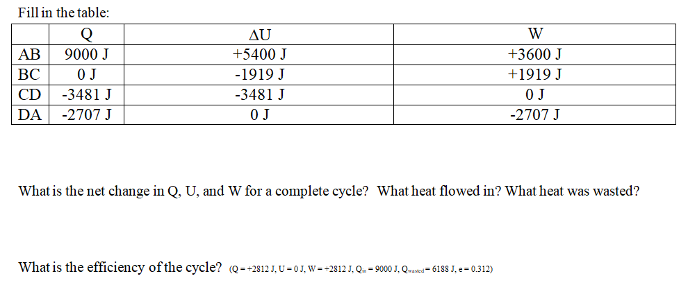

Slide 23
Question

