Slide 1
15 D2 Basic Thermo

Slide 2
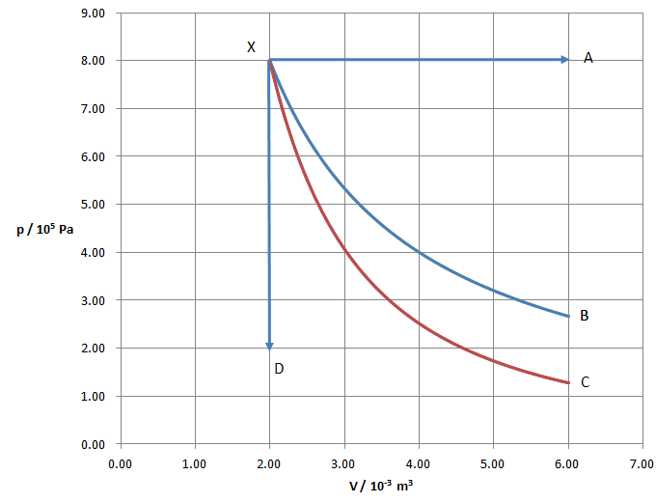
Point X is at 100. K.
How many moles of gas do we have?
What is the temperature at point A?
For the process isobaric process XA:
find Q, ΔU, and W
1.9254 moles, 300. K, 8000 J, 4800 J, 3200 J

Slide 3
Point X is at 100. K. (n = 1.9254 moles)
What is the temperature at point D?
For the isochoric (constant volume) process XD: find Q, ΔU, and W
25.0 K, 1800 J, 1800 J, 0 J

Slide 4
Point X is at 100. K. (n = 1.9254 moles)
The work done for the Isothermal process XB is 1760 J.
What is the pressure at point B?
What is the temperature at point B?
Find the Q, ΔU, and W for this process.
2.67E5 Pa, 100. K, 1760 J, 0 J, 1760 J

Slide 5
Point X is at 100. K. (n = 1.9254 moles)
The work done for the Adiabatic process XC is 1250 J.
What is the pressure at point C?
What is the temperature at point C?
Find the Q, ΔU, and W for this process.
1.282E5 Pa, 48.1 K, 0 J, -1250 J, 1250 J

Slide 6
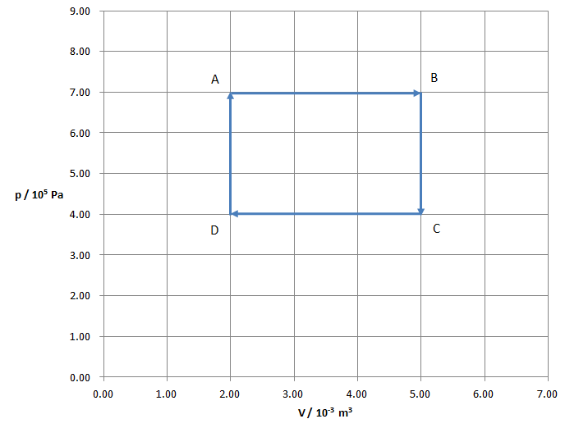
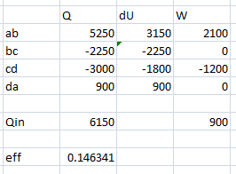
For the cycle ABCD find the Q, ΔU, and W for each process, the net work done, and the efficiency of the cycle.

